Slide 1

Division: A Partitive Model

Slide 2



What does it mean to Partition?
Use students’ prior knowledge of “real” world experiences

Slide 3
Partitive Division
Mark has 24 apples. He wants to share them equally
among his 4 friends. How many apples will each
friend receive?
Question: How many of Mark’s 24 apples can he share, equally, among his 4 friends?
“Fair Share”
Notes:
24 divided by 4 =

Slide 4
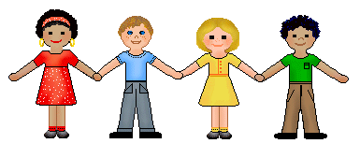

Important Information
Know: Number of groups
sharing/distributing among a known number of groups
Don’t know: How many in each group or the size of the group

Slide 5

252 $÷$6
252
- 120_
132
6 groups of 42 is 252
6 x 42 = 252
132
- 120
12
20
2
2
20
20
20
20
2
20
20
2
20
2
20
20
20
2
20
12
- 12_
0

Slide 6

Why does the Division model Matter?
252 $÷$6
375 $÷$50
Parting or fair sharing 252 among six groups
vs.
Parting or fair sharing 375 among 50 groups
That’s more difficult!

Slide 7
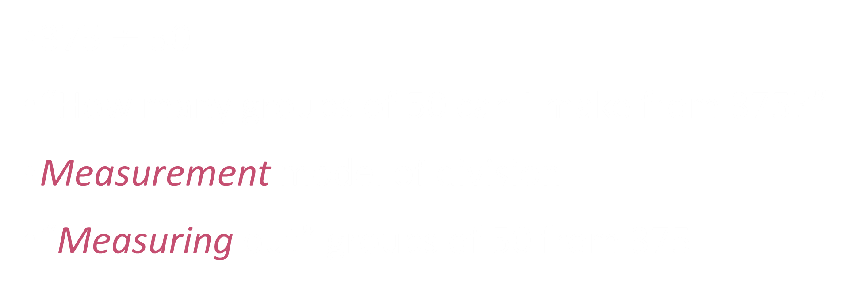
INSTEAD…
375 $÷$50
“How many groups of 50 can I make from 375?”
Measurement model of division
“Measuring out” groups of 50 from 375

Slide 8

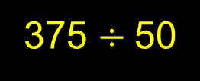
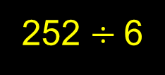
Rules of Thumb
Given a problem without a context (i.e., “naked-numbers” problems)
If the divisor is relatively small compared to the dividend, use the partitive model to approach the problem. Ex:
252 $÷$6
If the divisor is relatively large compared to the dividend, use the measurement model to approach the problem. Ex:
375 $÷$50

