Slide 1

Fraction Division: Using a Comparison Model

Slide 2

$\frac{2}{3}÷ \frac{3}{4}$
Measurement model interpretation
“How many groups of three-fourths can we make from two-thirds?”
What can we predict about the size of our quotient?
Since $\frac{3}{4 }$ $>\frac{2}{3}$ we cannot make 1 whole group of $\frac{3}{4}$ from $\frac{2}{3}$

Slide 3
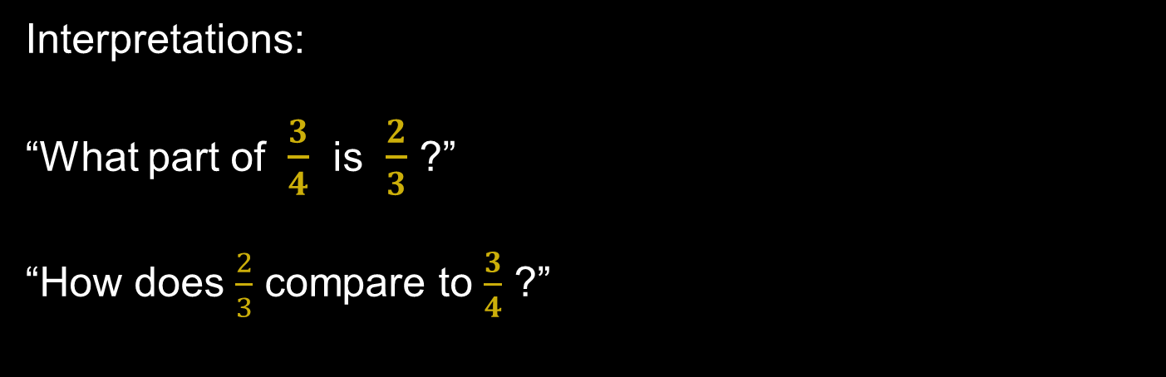
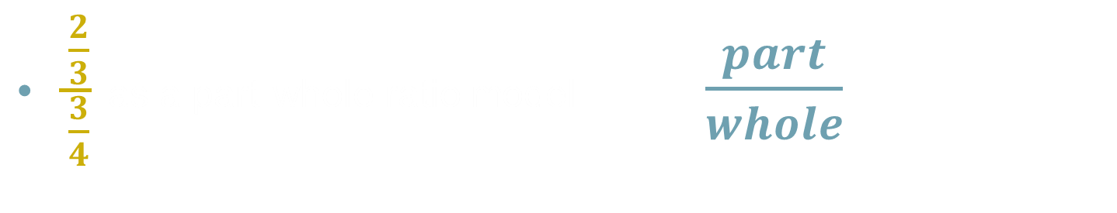
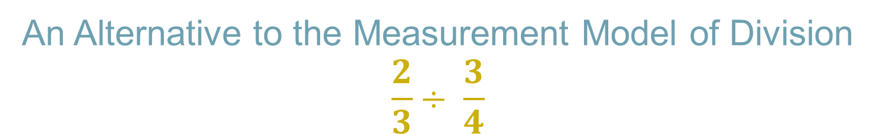
An Alternative to the Measurement Model of Division
$\frac{\frac{2}{3}}{\frac{3}{4}}$ as a part-whole ratio model $\frac{part}{whole}$
Interpretations:
“What part of $\frac{3}{4}$ is $\frac{2}{3}$ ?”
“How does $\frac{2}{3}$ compare to $\frac{3}{4}$ ?”

Slide 4
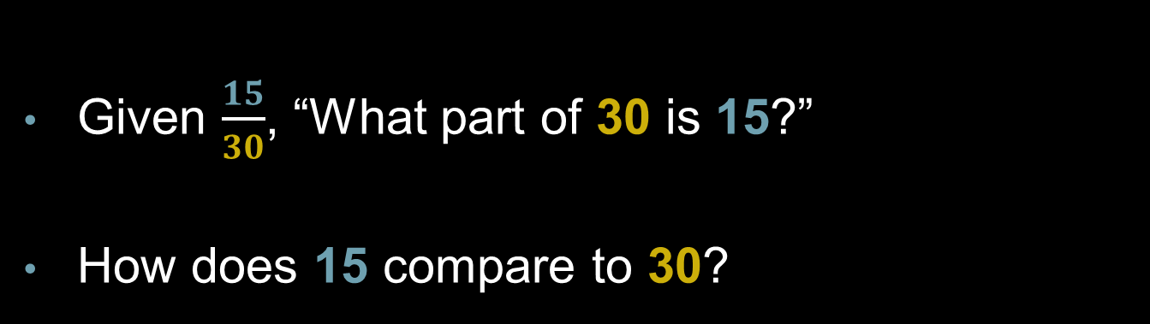
Bridging the Gap with Prior Knowledge
Given $\frac{15}{30}$, “What part of 30 is 15?”
How does 15 compare to 30?
15 is one-half of 30.

Slide 5


Recalling the Questions
What part of $\frac{3}{4}$ is $\frac{2}{3}?$
How does $\frac{2}{3}$ compare to $\frac{3}{4}$?

Slide 6
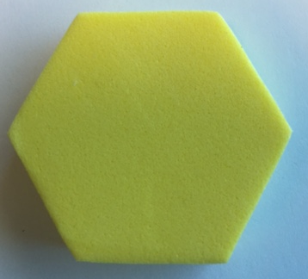
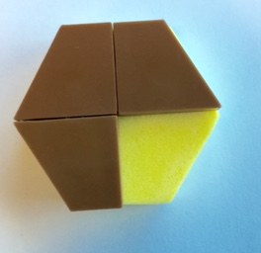
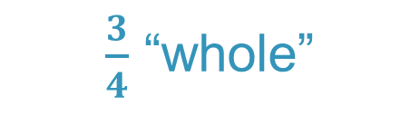

$\frac{\frac{2}{3}}{\frac{3}{4}}$ A Region Model
1
$\frac{3}{4}$ “whole”

Slide 7
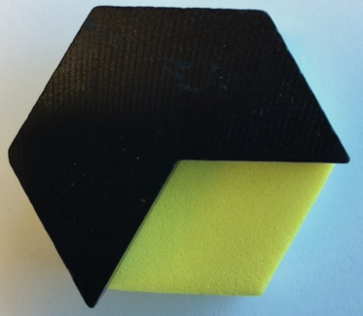


$$\frac{\frac{2}{3}}{\frac{3}{4}}$$
1
$\frac{2}{3}$ “part”

Slide 8
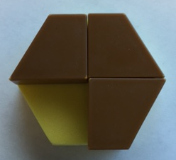
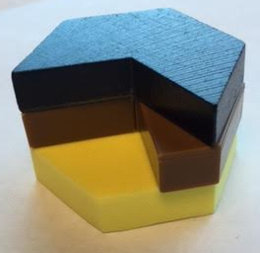
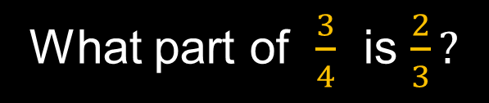
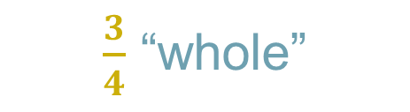

$$\frac{\frac{2}{3}}{\frac{3}{4}}$$
$\frac{3}{4}$ “whole”
What part of $\frac{3}{4}$ is $\frac{2}{3}?$

Slide 9
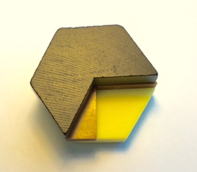
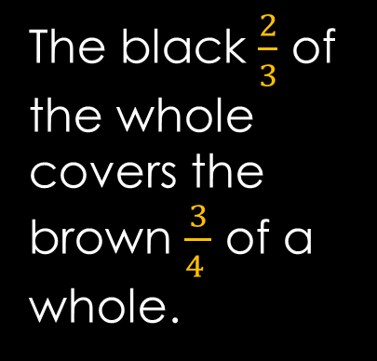

$$\frac{\frac{2}{3}}{\frac{3}{4}}$$
The black $\frac{2}{3}$ of the whole covers the brown $\frac{3}{4 }$ of a whole.
The leftover piece is equivalent to a purple triangle.

Slide 10
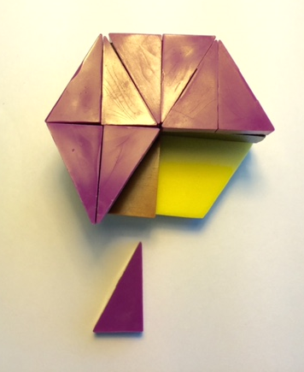

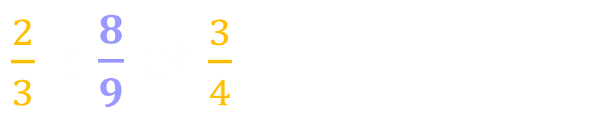

What part of $\frac{3}{4}$ is $\frac{2}{3}$?
$$\frac{1}{9}$$
$\frac{2}{3}$ is $\frac{8}{9}$ of $\frac{3}{4}$

Slide 11

$$\frac{\frac{2}{3}}{\frac{3}{4}}$$
0
1/3
2/3
3/3
0
1/4
2/4
3/4
4/4
0
3/12
8/12
12/12
9/12

Slide 12

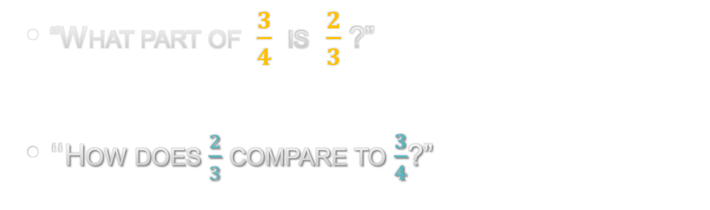
Understanding the Answer
“What part of $\frac{3}{4}$ is $\frac{2}{3}$ ?”
“How does $\frac{2}{3}$ compare to $\frac{3}{4}$?”
$\frac{2}{3}$is $\frac{8}{9}$ of $\frac{3}{4}$
0
8/12
9/12
12/12

