Slide 1

Fraction Division: A Partitive Model

Slide 2

Partitive Division
Given some starting amount or dividend…
Known: number of groups
sharing/distributing our dividend among a known number of groups
A.K.A. the divisor
Unknown: Size of the group or how many is in each group
A.K.A. the quotient

Slide 3

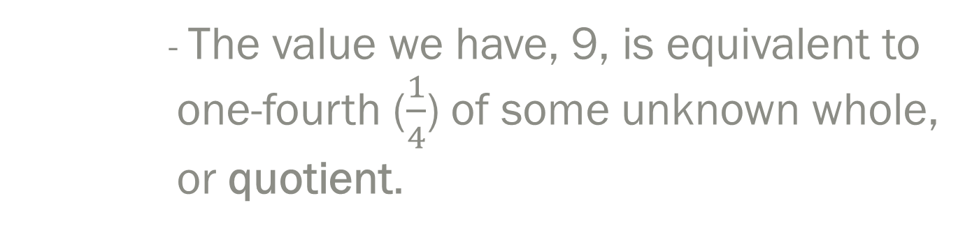
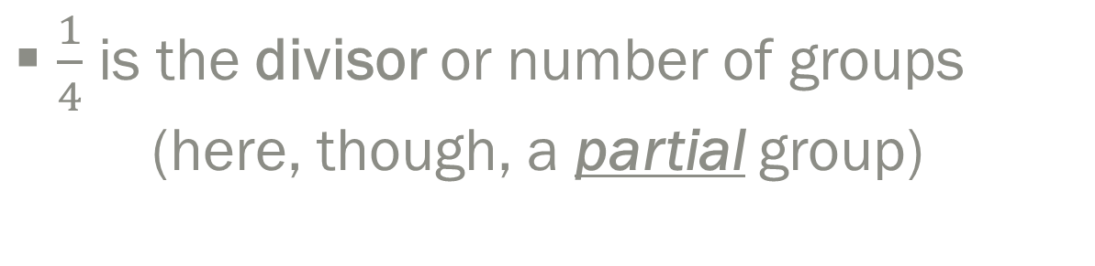
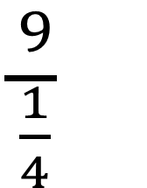
Analyzing a Fraction Partitive Division Problem
$\frac{9}{\frac{1}{4}}$
9 is the dividend or starting amount
$\frac{1}{4}$ is the divisor or number of groups (here, though, a partial group)
- The value we have, 9, is equivalent to
one-fourth ($\frac{1}{4}$) of some unknown whole, or quotient.

Slide 4


$$\frac{9}{\frac{1}{4}}$$
Interpretation: 9 is the size of one-fourth ($\frac{1}{4})$of a group
Our quotient will be the size of the whole group, our unknown information
9
9
9
9
9
Conventional Related Multiplication Problem: $9×\frac{4}{1}=36$
Conceptual Related Multiplication Problem: $\frac{4}{1}$ $×9=36$
Notes:
As division: 9 is ¼ of some number; partitive; ¼ of a group of 1 whole is equal to 9
Multiply both quantities by 4
Set up result as a proportion

Slide 5

$$\frac{8}{\frac{2}{3}}$$
4
4
4
8
Conventional Related Multiplication Problem: $8×\frac{3}{2}=24$
Conceptual Related Multiplication Problem: $\frac{3}{2}$ $×8=24$

Slide 6

4
4
4
8
$\frac{3}{2}$ $×8=24$
1$\frac{1}{2}$ $×8$ = 24
$1\left(8\right)× \frac{1}{2}$ (8)
8 + 4 = 12

Slide 7

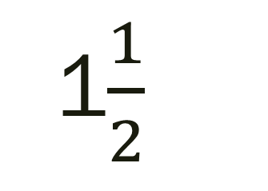
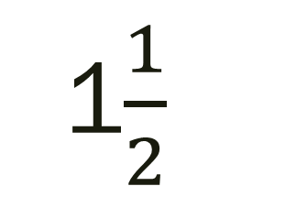

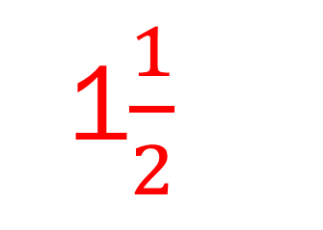
$$\frac{3}{\frac{2}{3}}$$
1$\frac{1}{2}$
1$\frac{1}{2}$
1$\frac{1}{2}$
3
Conventional Related Multiplication Problem: $3×\frac{3}{2}=4\frac{1}{2}$
Conceptual Related Multiplication Problem: $\frac{3}{2}$ $×3=4\frac{1}{2}$

Slide 8

$$\frac{6}{\frac{3}{4}}$$
2
2
2
2
6
Conventional Related Multiplication Problem: $6×\frac{4}{3}=8$
Conceptual Related Multiplication Problem: $\frac{4}{3}$ $×6=8$

Slide 9
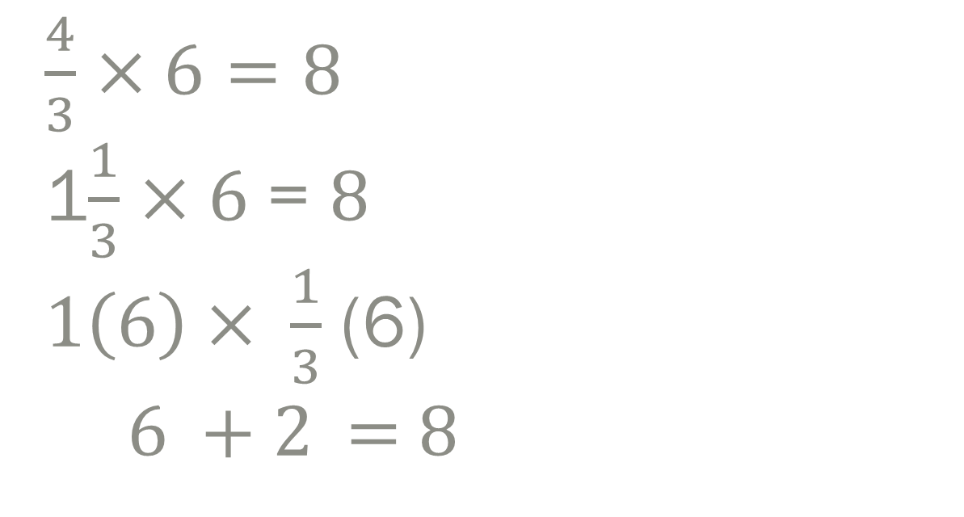
2
2
2
2
6
$\frac{4}{3}$ $×6=8$
1$\frac{1}{3}$ $×6$ = 8
$1\left(6\right)× \frac{1}{3}$ (6)
6 + 2 = 8

