Slide 1

Multiplying a Fraction by a Fraction

Slide 2
What Does it Mean to Multiply?
_____________ groups of _______________
Number of groups
Multiplier
Amount in each group
Multiplicand or “given number”

Slide 3



A Few Reminders
A fraction is named by its whole.
Given any object – the denominator
tells us the number of equal parts into
which the whole is partitioned
The denominator refers to the whole, even if we do not have the entire whole.

Slide 4

$\frac{1}{2}$ x $\frac{2}{ 3 }$
Multiplier
Operator
Action
Multiplicand
Given number
Starting value

Slide 5
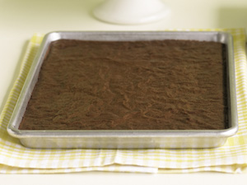
Pan costs $18
Notes:
Consider this common scenario.
Your school is planning a fundraiser to pay for a special project.
You will sell brownies at a cost of $18 per pan.
Some people will buy whole pans but some won’t. How will you determine the cost of all of these purchases?
If a customer buys a whole pan, the cost is easy…18 dollars.

Slide 6
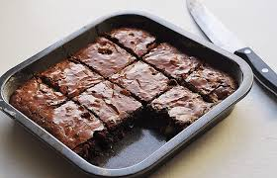
Brownie Sale!
Your class is selling brownies as a fundraiser. Brownies cost $18 per pan. However, customers may purchase partial pans.

Slide 7
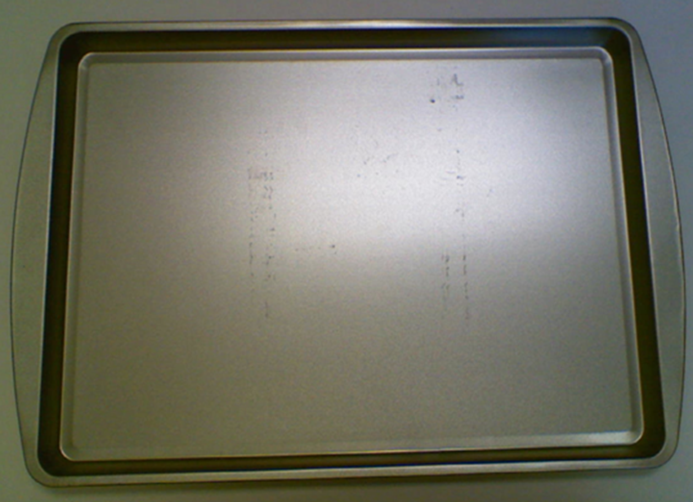

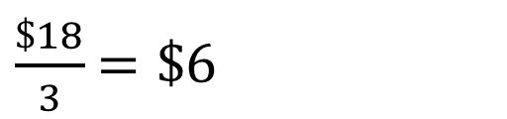
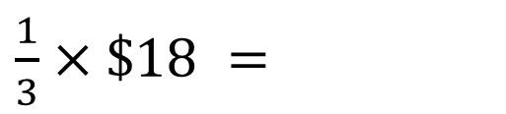
$\frac{1}{3}×\$18 =$
$\frac{\$18}{3}$ $=\$6$
$$1×\$6=\$6$$

Slide 8
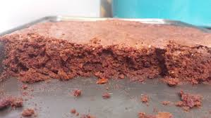
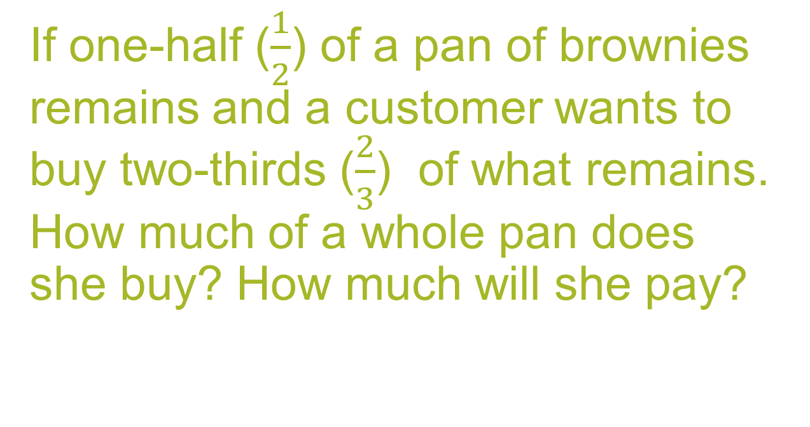
If one-half ($\frac{1}{2}$) of a pan of brownies remains and a customer wants to buy two-thirds ($\frac{2}{3}$) of what remains. How much of a whole pan does she buy? How much will she pay?

Slide 9



$$\frac{2}{3}×\frac{1}{2}=$$
Use $\frac{2}{3}$ as an operator
Number of groups of the partitioned multiplicand that we will consider
$$\frac{2}{3}$$
Partition our multiplicand, or given number, into 3 equal parts

Slide 10
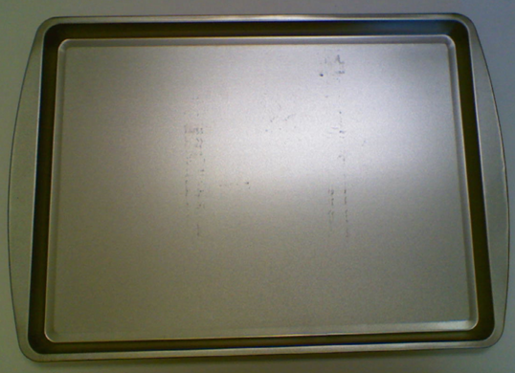

Slide 11


Slide 12
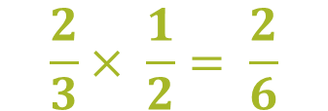
$$\frac{2}{3}× \frac{1}{2}= \frac{2}{6}$$

Slide 13

$$\frac{2}{3}×\frac{1}{2}=\frac{1}{3}$$

Slide 14
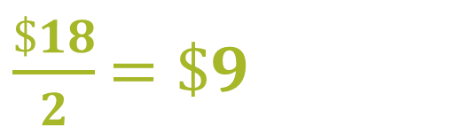
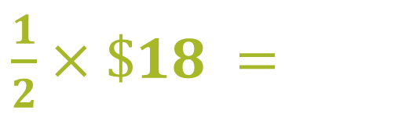
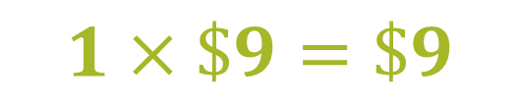
$\frac{1}{2}×\$18 =$
$\frac{\$18}{2}$ $=\$9$
$$1×\$9=\$9$$

Slide 15




$9
$\frac{2}{3}×\frac{1}{2}$
$$\frac{2}{3}×\$9$$
$$\frac{\$9}{3}=\$3$$
$$2×\$3=\$6$$

Slide 16
3 x $6 = $18
$6
$6
$6

