Slide 1
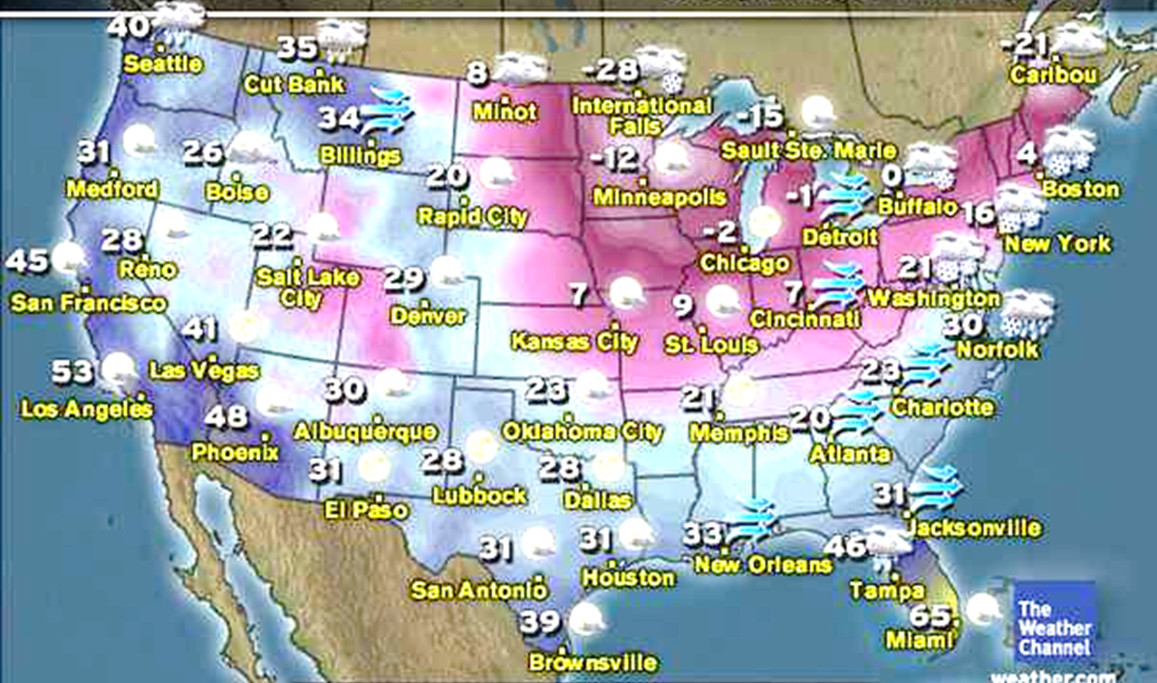

Integer Subtraction in the Real World

Slide 2
A Trip Back to Second Grade
8 - 5 =
Create a story problem that matches the subtraction problem above.

Slide 3
Option 1: Take Away
________ has 8 ________. He loses/gives away 5
(person) (objects)
________.
(objects)
QUESTION:
How many ________ does he have left?
(objects)

Slide 4
Option 2: How much more or less?
________ has 8 ________. ________ has 5
(Person 1) (objects) (Person 2)
________.
(objects)
QUESTION: How many more _______ does
(objects)
________ have than _________?
(Person 1) (Person 2)

Slide 5
Questions We Need to Ask
How Much More?
How Much Less?

Slide 6

A Distance Model of Subtraction

Slide 7

Temperature: How Much Warmer or Colder?

Slide 8
Warmer move up
Colder move down

Slide 9


How much colder is ____ than ___?
Negative - positive
24
How much colder is International Falls (-28°) than Dallas (24°)?
$$−28 −24=$$
- 52
0
Check: -28 + -24 = -52
International Falls is 52° colder than Dallas.
-28

Slide 10

How much warmer is ____ than ____?
Positive - negative
How much warmer is Kansas City (7°) than Minneapolis (-12°)?
7
$$7−(−12)=$$
19
0
Check: 7 + 12 = 19
Kansas City is 19° warmer than Minneapolis.
-12

Slide 11
How much colder is ____ than ____?
Smaller positive - larger positive
21
How much colder is Boston (4°) than Memphis (21°)?
4
0
4 - 21 =
-17
Check: 4 + -21 = -17
Boston is 17° colder than Memphis.

Slide 12
How much warmer is ____ than ____?
Larger negative - smaller negative
How much warmer is Caribou (-21°) than International Falls (-28°)?
0
-21 – (-28) =
7
Check: -21 + 28 = 7
-21
Caribou is 7° warmer than International Falls.
-28

