Slide 1
Rational and Irrational Numbers
Place yourself on the numberline based on your number card.
Notes:
An active lesson inspired by number talks and

Slide 2
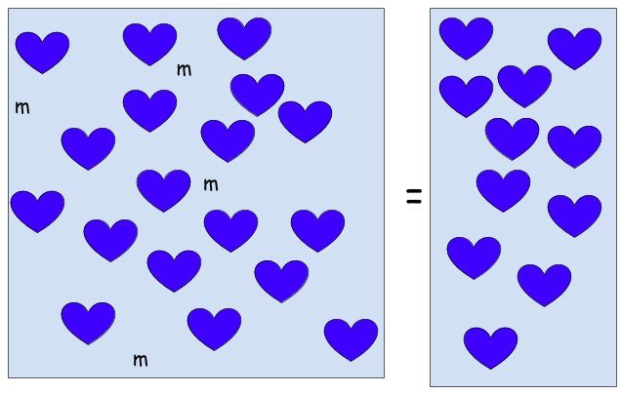
What do you see?
Notes:
Number talks – 1. Ask the students what they see? 2. Take all answers with out judgement or praise. 3. Ask the students to explain how they got the answers they gave. Be sure to have them justify reasoning.
See the September 2018 edtition of Mathematics Teacher – Number Talks: Gateway to Sense Making

Slide 3
Solving Equations
What’s it look like on a line?
Notes:
Students will have cards with rational and irrational numbers on them.
We will discuss what makes them rational and irrational.
We may divide as rational and irrational.
We will organize into a number line base on values on the card.
Cards Link

Slide 4
Solving Equations
Double Open Number Line
x = 4
x
0
4
Where would zero be?
Notes:
Inspired by: Algebra Problem Strings – by Pamela Harris and Lara Imm

Slide 5
X = -3
Double Open Number Line
Where would zero be?

Slide 6
-x = 3
Double Open Number Line
Notes:
What if the opposite of x = 5 ?
Where is zero?
If the opposite of x is 5, what is x?

Slide 7
-x = -5
Double Open Number Line
Notes:
What if the opposite of x is the opposite of 4?
Where is the zero?
If the opposite of x is the opposite of 4, What is the value of x?

Slide 8
X-2 = 5
Double Open Number Line
Notes:
If a number minus 4 is 6, I bet you could tell me where the number is?
The number is to the right of the x minus 4 and 6 is in the same location.

Slide 9
X + 2 = - 5
Double Open Number Line
Notes:
The next problem is x plus 4 is -6. What do you think x is?

Slide 10
Solving Equations 2
Double Open Number Line
3x+7=22
Notes:
A Big jump. Be ready to reason

