Slide 1

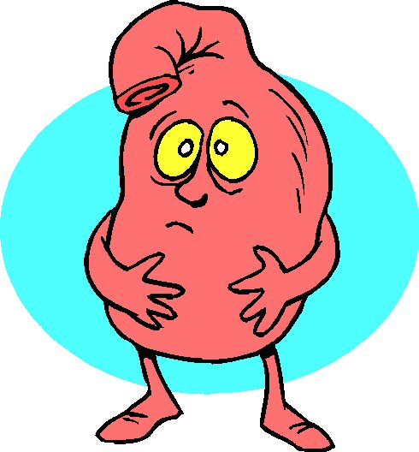
Sour Chemistry: Modeling a neutralizing reaction

Slide 2
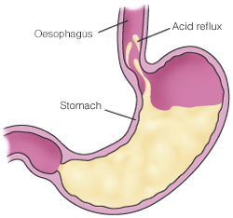
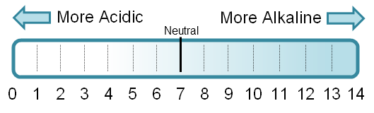
Gastric Chemistry
pH range 0-14
pH < 7 is acid
pH = 7 is neutral
pH > 7 is base/alkaline
Normal stomach pH 5.0-6.0
Digestion 3.0-5.0
Conduct neutralizing reaction
Begin with acid ~ 3.0
Add antacid tablet
Describe graph of pH versus time

Slide 3

Exponential Function Family
Go to www.desmos.com
Launch calculator
Enter y = a b^x
Play around with sliders

Slide 4
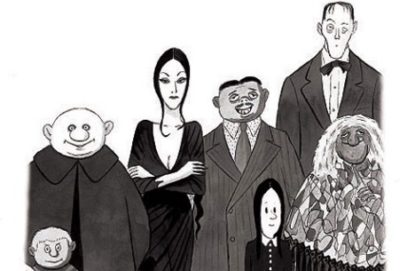
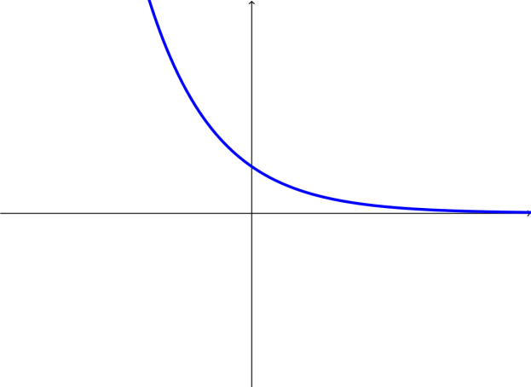
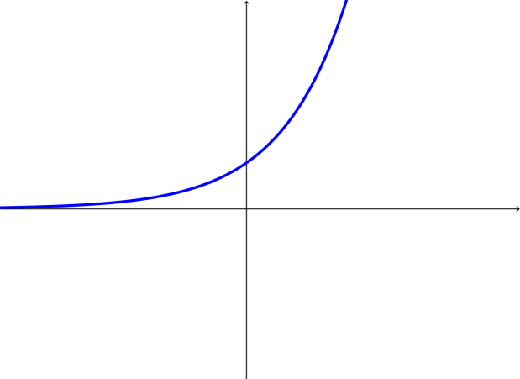
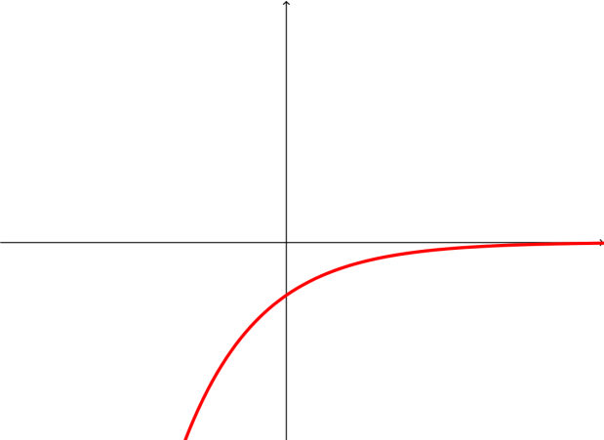
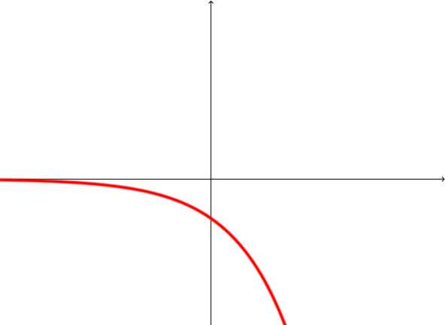
The family of exponential functions y = a b^{x}
 | 0 < b < 1 | b > 1
a > 0
a < 0
Common family traits
Domain all real numbers
Rapid growth/decay
Horizontal asymptote

Slide 5
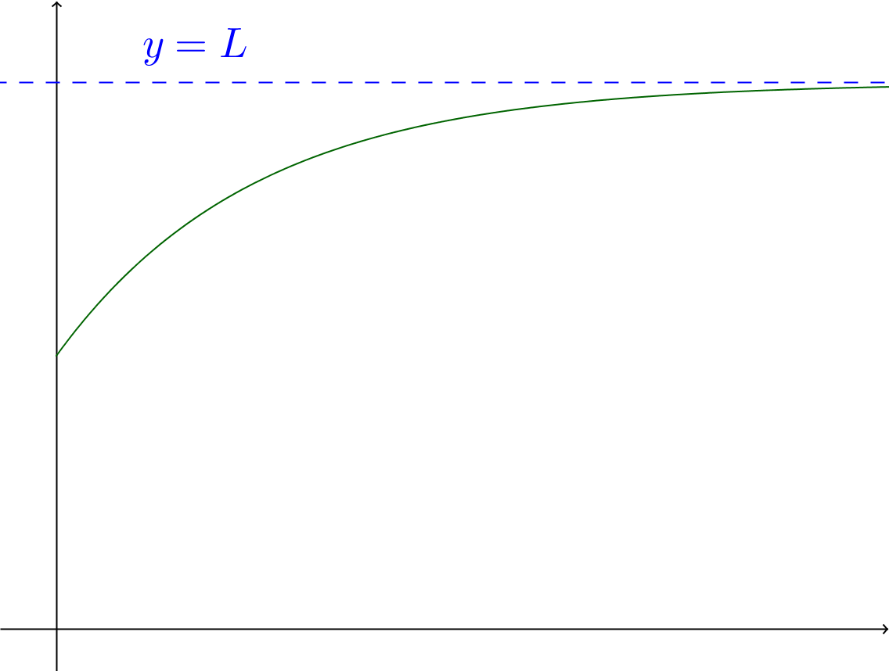
The model for our neutralizing reaction
Discuss why these two models are equivalent.
Why would someone prefer the 2nd model?

Slide 6

Let’s collect some data

Slide 7
Questions for further discussion/exploration
How does the value of B affect the shape of the modeling curve?
How would adding more drops of lemon juice to the starting solution affect the resulting plot of pH versus time? Which of the parameters A, B and C in the model expression would change?
How would adding two antacid tablets (instead of one) to the starting solution affect the resulting plot of pH versus time? Which of the parameters A, B and C in the model expression would change?
How do you expect the model to change if you use an Extra Strength tablet?

