Slide 1

Direction Variation

Slide 2
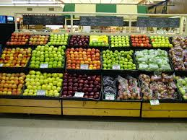

Slide 3
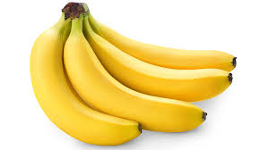
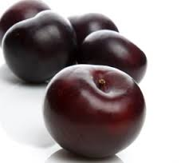
For every 4 bananas, I get five plums.
4 bananas cost the same as 5 plums.

Slide 4
Tabular Representation

Slide 5
Bananas
Plums
4
8
12
16
5
10
15
20

Slide 6
Pictorial Representation

Slide 7
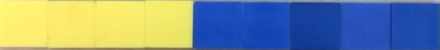

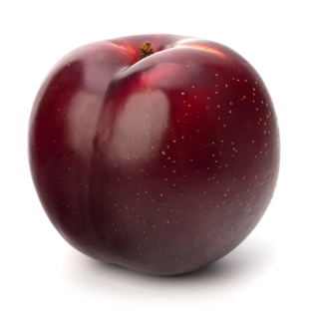
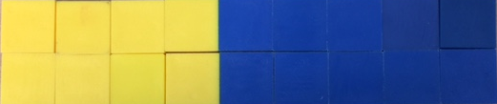
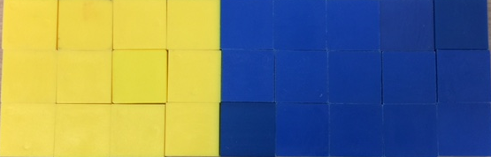

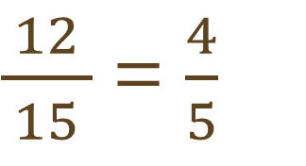
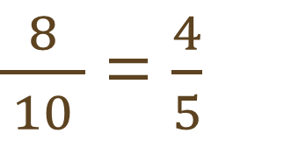
Pictorial Representation
$\frac{4}{ 5 }$
$\frac{8}{ 10 }$ = $\frac{4}{5}$
$\frac{12}{ 15 }$ = $\frac{4}{5}$

Slide 9
Pictorial Representation

Slide 10




Unit Rate for Plums
$$÷5$$
$$\frac{4 bananas}{5 plums}$$
$$\frac{\frac{4}{5} banana}{1 plum}$$
=
$$÷5$$

Slide 11

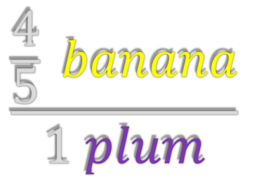
Unit Rate as Rate of Change
Output
$$\frac{\frac{4}{5} banana}{1 plum}$$
$$= \frac{y}{x}$$
Input

Slide 12
Tabular Representation

Slide 13
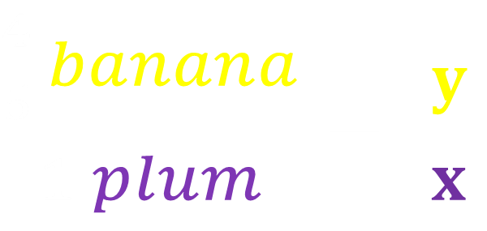
$\frac{\frac{4}{5} banana}{1 plum}$ = $\frac{y}{x}$
PLUMS
(input)
x
BANANAS
(output)
y
0
0
5
4
Bananas in terms of plums
10
8
15
12
20
16

Slide 14
Variables
PLUMS
(input)
x
BANANAS
(output)
y
Independent – Plums (input)
0
0
5
4
Dependent – Bananas (output)
10
8
15
12
20
16

Slide 15
Graphical Representation

Slide 16
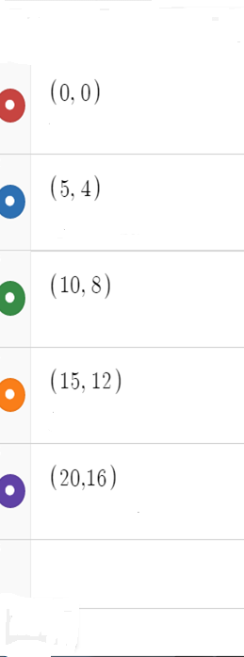
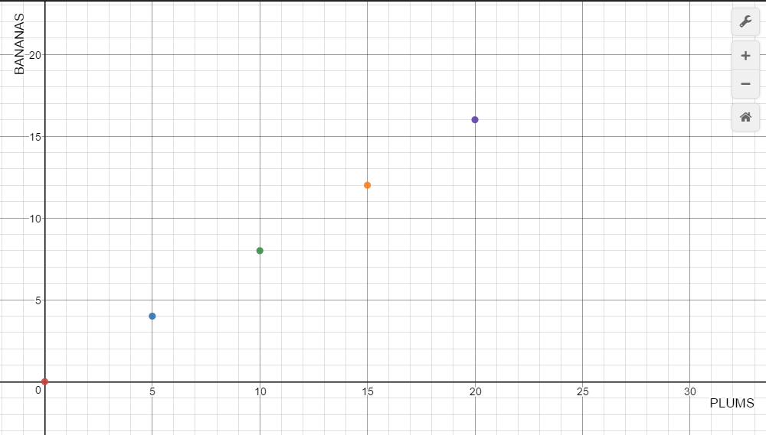

Slide 17
PLUMS
x
BANANAS
y

Slide 18
PLUMS
x
BANANAS
y

Slide 19
Symbolic Representation

Slide 20




y = kx
$$\frac{\frac{4}{5} banana}{1 plum}$$
Constant
of variation
PLUMS
x
BANANAS
y
$$\frac{\frac{4}{5} banana}{1 plum}$$
$$k= \frac{y}{x}$$
Banana = $\frac{4}{5}$ plum

