Slide 1

division of Integers

Slide 2
Two Models of Division
Partitive
Measurement

Slide 3
Partitive Division
Partitive Division
Mark has 24 apples. He wants to share them equally
among his 4 friends. How many apples will each
friend receive?
Question: How many of Mark’s 24 apples can he share, equally, among his 4 friends?
“Fair Share”
Notes:
24 divided by 4 =

Slide 4


Important Information for Partitive Division
Know: Number of groups
    sharing/distributing among a known number of groups
Don’t know: How many in each group or the size of the group

Slide 5


Size
of
group
6
4
24
Total Apples
Number of groups

Slide 6

Measurement Division
Mark has 24 apples.
He puts them into bags containing 6 apples each.
How many bags can Mark fill?
Known: Size of group
Unknown: Number of groups of size 6
Mark can make
How many bags can Mark fill “measuring out” 6 apples at a time?

Slide 7

4
Number of groups
24
6
Total Apples
Size of group

Slide 8
Two-Color Counters
Positive Integers
Negative Integers

Slide 9

Positive $÷$ Positive
12 $÷$ 4 =
Partitive Division Model: Given 12 objects and four groups, how many objects will there be in each group?
Start with: 12 counters
Action: Split equally (partition) into 4 groups
Group 1
3 objects
Group 2
3 objects
Group 3
3 objects
Group 4
3 objects
3 objects in each of the 4 groups

Slide 10

Positive $÷$ Positive
12 $÷$ 4 =
Measurement Division Model: How many groups of 4 can I make from 12?
Start with: 12 counters
Action: Measure out groups the size of 4.
Group 1
Group 2
Group 3
3 groups of 4 are in 12

Slide 11

Negative $÷$ Positive
-12 $÷$ 4 =
Partitive Division Model: If I partition -12 into 4 groups, how many objects will there be in each group?
Start with: Counters representing -12
Action: Split equally (partition) into 4 groups
Group 1
3 objects whose value is negative
Group 2
3 objects
whose value is negative
Group 3
3 objects
whose value is negative
Group 4
3 objects whose value is negative

Slide 12

Negative $÷$ Negative
-12 $÷$ - 4 =
Measurement Division Model: How many groups of -4 can I make from -12?
Start with: Counters representing -12
Action: Measure out groups the size of -4
Group 1
Group 2
Group 3
3 groups of -4 in -12

Slide 13

Negative $÷$ Negative
-12 $÷$ - 4 =
Repeated Subtraction Model
-12 – (-4) = -8
Group 1
-8 – (-4) = -4
Group 2
- 4 – (-4) = 0
Group 3
3 groups of -4 are in -12

Slide 14



Positive ÷ Negative
12$÷$ -4
We cannot find groups of -4 in 12 using a measurement division model.
We cannot partition 12 into -4 groups using a partitive division model.

Slide 15

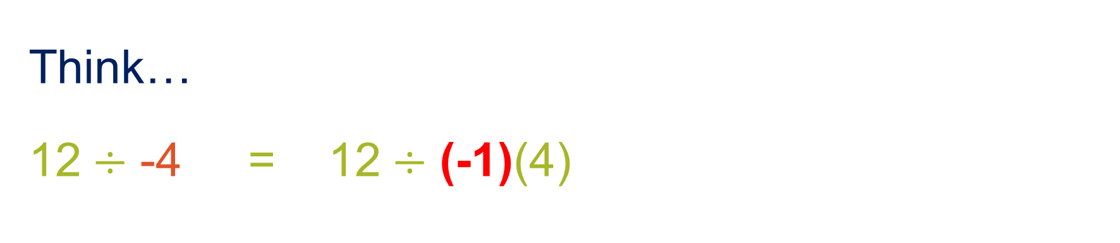

Interpreting 12$÷$ -4
Think…
12$÷$ -4 = 12$÷$ (-1)(4)

Slide 16





What Does it Mean to Multiply by a Negative 1?
-1 $×$ 5 = -5
-1 $×$ -5 = 5
-1 $×$ n = -n
When multiplying by -1, take the opposite of the multiplicand, or given number.

Slide 17


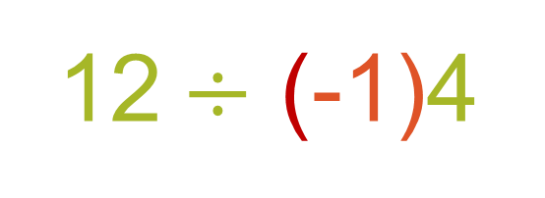
Showing the Effect of Multiplying by -1
12$÷$ (-1)4
Take the opposite of -4

Slide 18






Positive ÷ Negative
12$÷$ -4 =
Partitive Division Model: What will be the opposite of the group size if 12 is partitioned into 4 equal groups?
Start with: Counters representing positive 12
1st Action: Partition (split equally) 12 into 4 groups with 3 counters in each group
2nd Action: Take the opposite of 4 groups of 3

