Slide 1

Division of a Fraction by a Fraction
Measurement Model of Division

Slide 2

$$\frac{1}{2 }÷ \frac{1}{4}$$
Notes:
I imagine you have seen problems like this in your math textbook. Have you ever wondered why you need to know how to do this type of problem and what do these problems actually mean? In this vodcast, you will learn several real-world application of these types of problems.

Slide 3
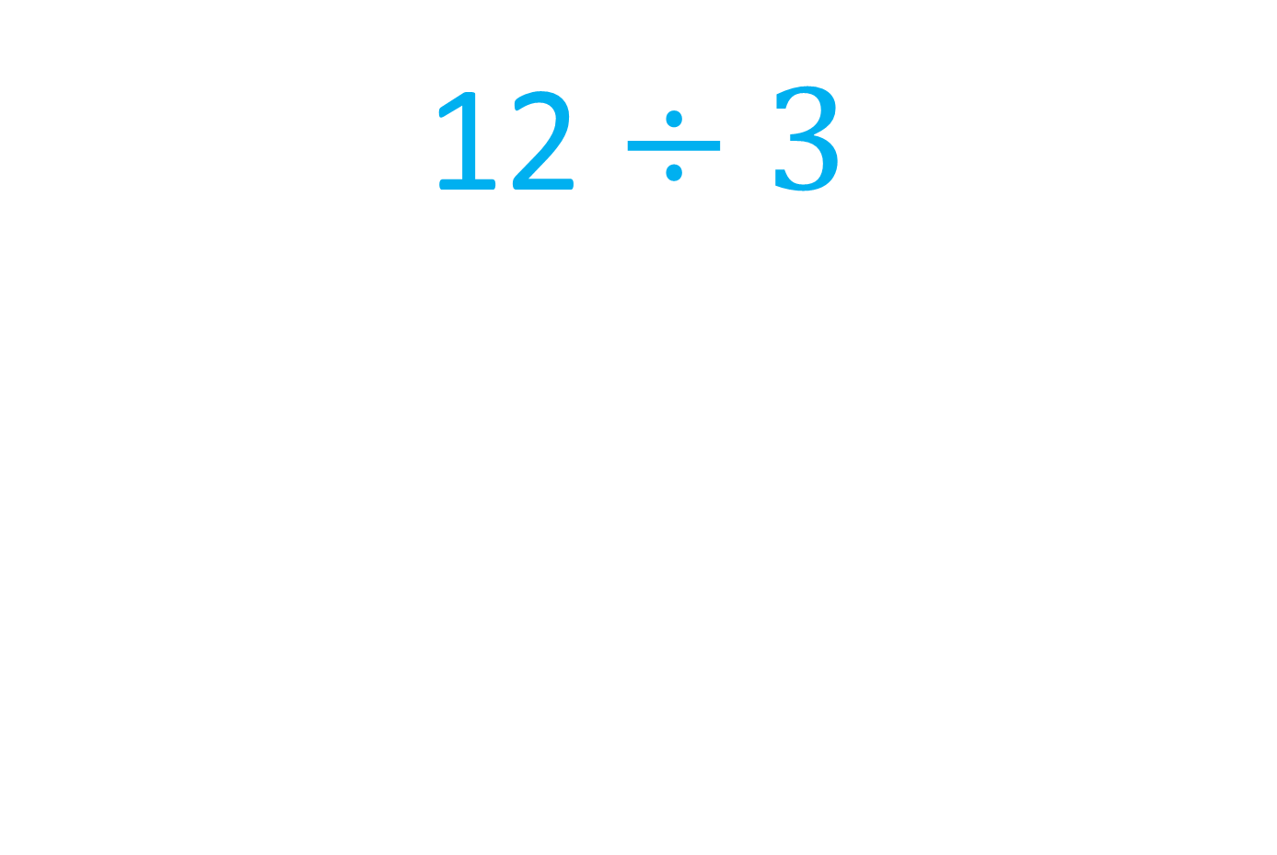
12 $÷3$
Notes:
Let’s look at a more familiar problem – 12 divided by 3. We can apply what we know about this problem to our problem ½ divided by ¼. One way to approach 12 divided by 3 is to think about how many groups of 3 are in 12. Look at the 12 blue ovals. How many sets of 3 ovals are in the total of 12 ovals. There are 4 sets!

Slide 4
$$\frac{1}{2 }÷ \frac{1}{4}$$
Notes:
Applying what we already know about division of whole numbers to division of fractions, we can interpret this problem in the same way. We need to determine how many sets of one-fourth are in one-half.

Slide 5
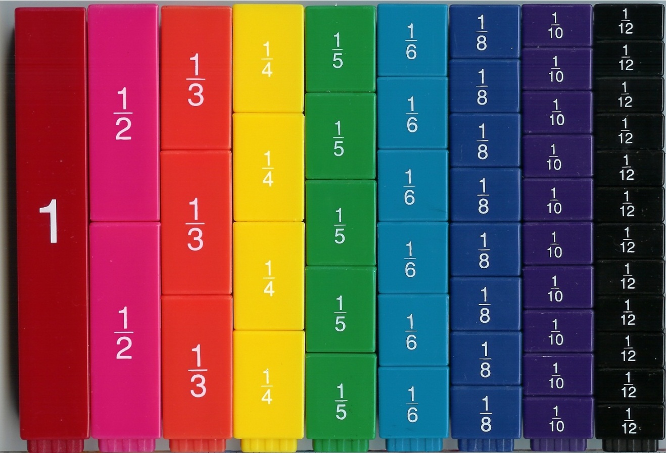
Notes:
These fraction bars can help us picture the problem ½ divided by ¼. How many sets of one-fourth are in one-half? Let’s find out. Looking at the pink one-half that is outlined in blue, how many sets of yellow one-fourths do you predict we will find? Check your answer by looking at the fourths outlined in red.
There are two sets of one-fourth in one-half.

Slide 6
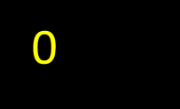





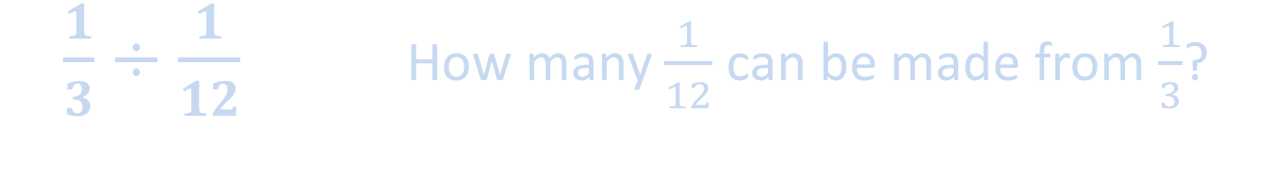

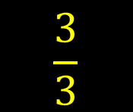
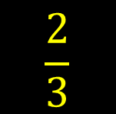
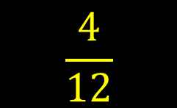

$\frac{1}{3}÷\frac{1}{12}$ How many $\frac{1}{12}$ can be made from $\frac{1}{3}$?
$$\frac{4}{12}$$
$$\frac{8}{12}$$
$$\frac{12}{12}$$
$$\frac{1}{12}$$
$$\frac{2}{12}$$
$$\frac{3}{12}$$
$$\frac{4}{12}$$
$$\frac{1}{3}$$
$$\frac{2}{3}$$
$$\frac{3}{3}$$
0

Slide 7
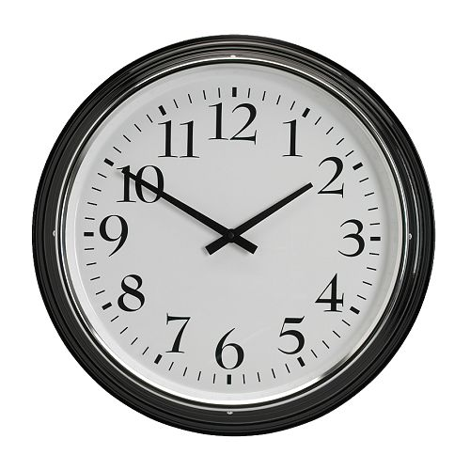
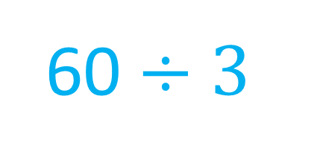

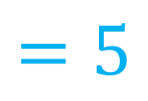
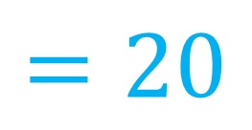
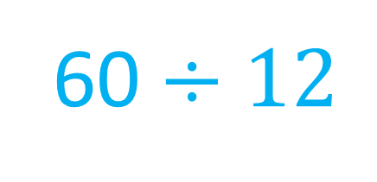
$$\frac{1}{3}÷\frac{1}{12}$$
60 $÷12$
$$=5$$
60 $÷$ 3
$$=20$$
Notes:
Here’s a new problem (click). 1/3 divided by 1/12. Let’s use a clock (click) to help us visualize this problem. There are 60 minutes in an hour. If we divide 60 minutes (click) into three equal parts, our clock face becomes divided into three groups of 20 minutes (click, click, click) … because 1/3 of 60 is 20. Now, if we divide (click) 60 minutes into twelve equal parts, because there are 12 numbers on a clock, we find that five minutes is equal to one- twelfth of 60.

Slide 8

$$\frac{1}{3}÷\frac{1}{12}$$
Notes:
So, the problem (click) 1/3 divided by 1/12 could be thought of as…how many sets of 5 minutes are in 20 minutes? Our section of 20 minutes (click) is identified in red. Let’s divide this space into groups of five minutes. Watch the arrows in yellow (click, click, click, click). There are four sets of five minutes in 20 minutes. So, 1/3 (click) divided by 1/12 is 4.

Slide 9

$\frac{20 minutes}{5 minutes}$ $=4$
Notes:
Our fraction problem could also be represented using whole numbers…20 minutes divided by 5 minutes is 4.

Slide 10
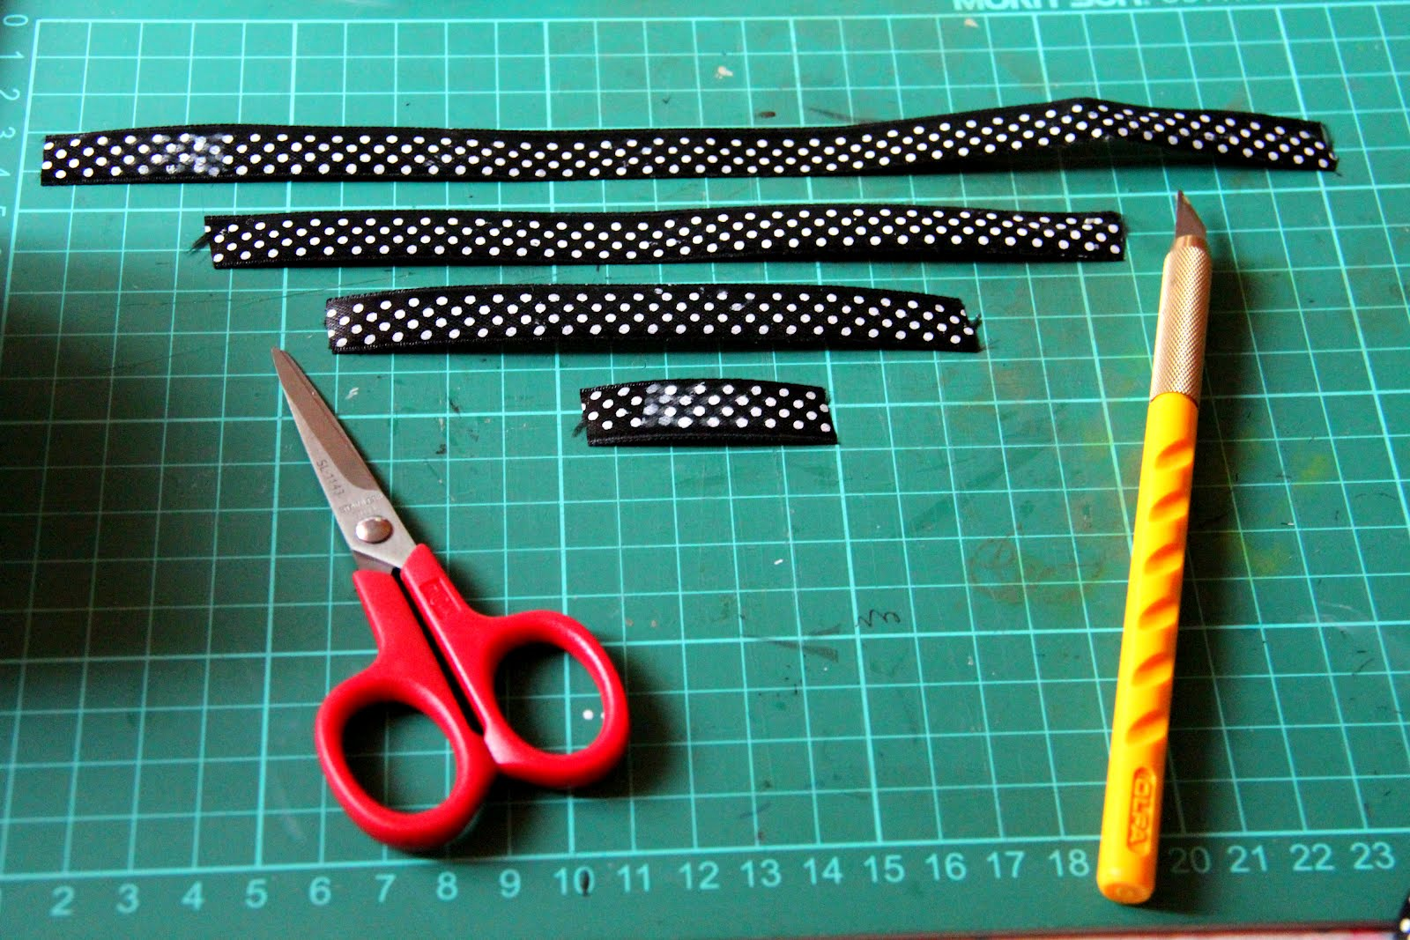
Notes:
Here’s another practical example. What if you have three-fourths of a yard of ribbon leftover from a project. You want to make a bows that require 1/4 of a yard of ribbon each. How many bows can you make?

Slide 11
The Problem
You have three-fourths of a yard of ribbon leftover from a project. You want to make bows that require 1/4 of a yard of ribbon each. How many bows can you make?

Slide 12





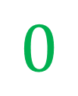

$$\frac{3}{4} ÷ \frac{1}{4}$$
$$=3$$
$$0$$
$$\frac{3}{4}$$
$$1$$
$$\frac{1}{4}$$
$$\frac{1}{2}$$
Notes:
We can represent this scenario as ¾ divided by ½. We have ¾ of a yard of fabric. Using this number line to represent our ribbon, let’s see how many sets of 1/4 are in ¾. First, we will identify ¾ in red. We can easily identify our sets of one-fourths. The first set of ¼ is represented in yellow. Can we get another ¼ of a yard? Yes. And another? Yes. In total, there are 3 sets of one-fourth yds. of ribbon in ¾ of a yard of ribbon.

Slide 13

The Problem
You have $\frac{3}{4}$ of a birthday cake. You want to share it with your friends. Each friend will get a slice that is $\frac{1}{8}$ of the (whole) cake. How many friends will get a slice of cake?
*You are not a part of the group!

Slide 14






$$\frac{3}{4}÷ \frac{1}{8}$$
$$\frac{1}{4}$$
$$\frac{1}{4}$$
$$\frac{1}{4}$$
$$\frac{1}{4}$$
Notes:
Here’s a common problem. Your family celebrated your birthday and each family member got a piece of birthday cake. Cake was served after a big dinner, so everyone was pretty full and only wanted a small piece. The next day, you decide to take the leftover cake to an after-school meeting you have to attend. You want the members who are present to get a nice slice of cake. A slice that is one eighth of this entire cake would be a generous size per person. How many friends will you be able to serve with such a large slice?
First, let’s section our cake into fourths. We only have 3 of the fourths because one-fourth of the cake was eaten the previous night.

Slide 15







$\frac{3}{4}÷ \frac{1}{8}$
= 6
$$\frac{1}{8}$$
$$\frac{1}{8}$$
$$\frac{1}{8}$$
$$\frac{1}{8}$$
$$\frac{1}{8}$$
$$\frac{1}{8}$$
Notes:
Now, how can we get eighths from fourths? If I half one fourth, I get one eighth. Watch as the fourths are sectioned into eighths. Even though one-fourth of the cake has already been eaten, my re-sectioning into eighths must include what was the entire cake. How many of the one-eighth sections are in our ¾ of a cake? I count 6, one-eighths. So we can serve 6 people 1/8 of a cake each.

