Slide 1

Calculating Gratuities

Slide 2
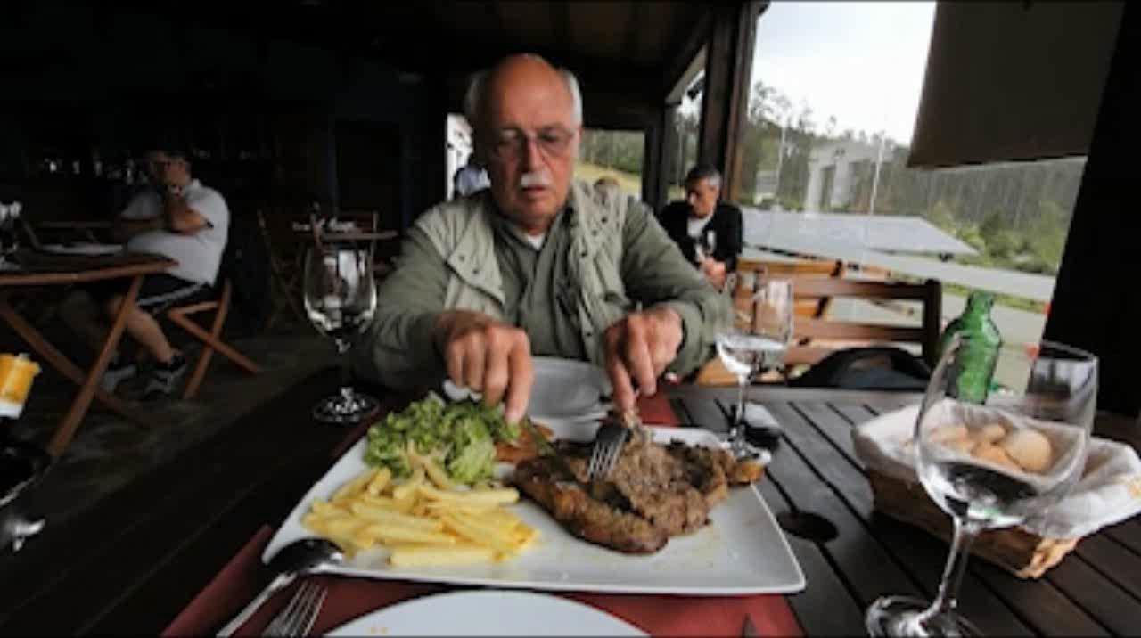
Notes:
Americans like to eat out at restaurants. Some restaurants are self serve…no one waits on your table. These are like fast-food restaurants. But, some restaurants, like this one, employ servers who bring your food and drinks to the table.

Slide 3
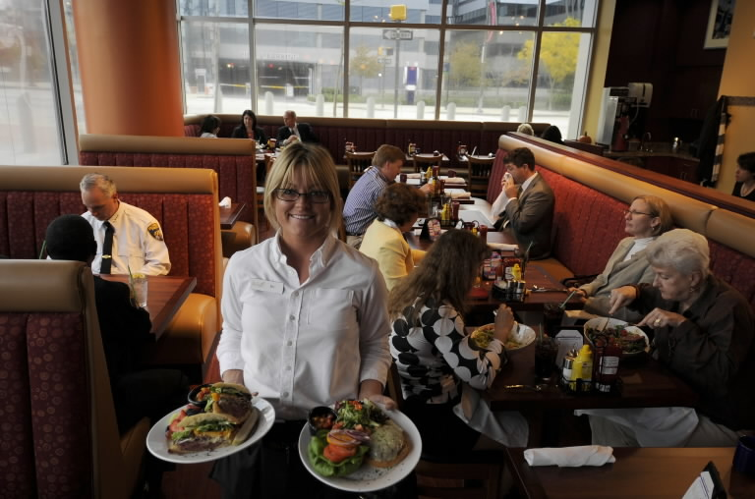
Notes:
What do these servers expect from you in return for their service? A gratuity!

Slide 4
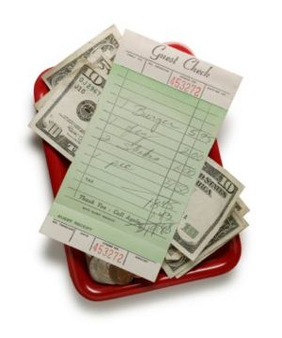
Gratuity “Tip”
Notes:
A gratuity is also known as a tip. A gratuity, or tip, is something a diner gives, usually voluntarily, to a server for the service he received while dining.

Slide 5
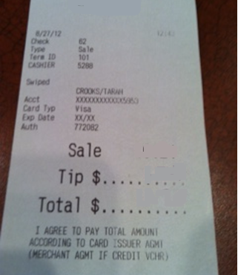
Notes:
Look at this bill. The section in red (click) is for the diner to write in an extra amount of money for the server.. his tip or gratuity. How much should the diner give the server?

Slide 6
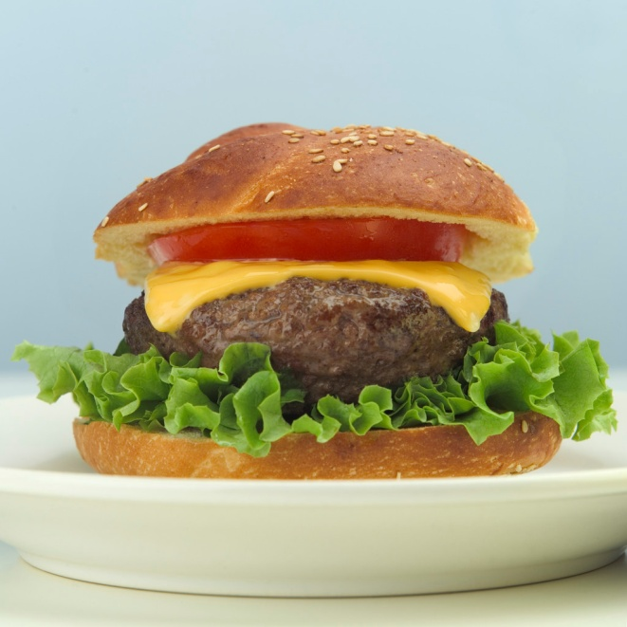

10%
15%
20%
Meal Cost
Notes:
While the amount of the gratuity is up to the diner, a good rule of thumb (click) is to tip 10, 15, or 20 percent based on the cost of the meal. This means that going to a restaurant involves doing math!

Slide 7
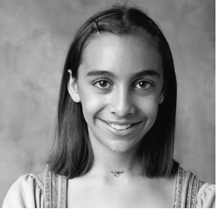
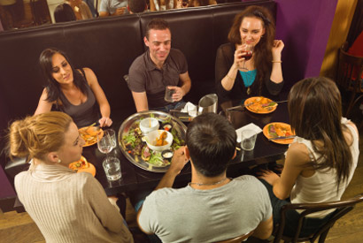
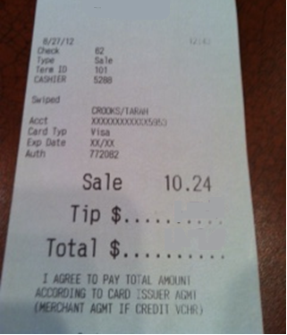
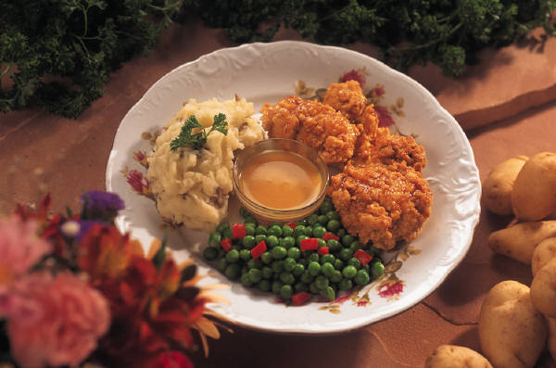
Notes:
Consider this scenario. Jasmine (click) goes to this restaurant (click). She order this (click). Her bill says this (click). Let’s determine her tip or gratuity.

Slide 8
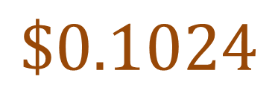

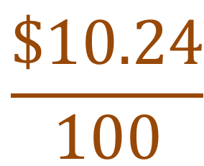

$$\frac{\$10.24}{100}$$
$$=$$
$$\$0.1024$$
$$≈\$0.10$$
1%
$10.24
Notes:
Let this 10 x 10 (click) grid represent Jasmine’s entire bill of $10.24 (click). That is, 100% of her bill. There are 100 squares in our 10 x 10 grid. So, each square represent 1% of the bill (click). If we divide Jasmine’s bill by 100 (click), we get (click, click) a value equal to a little more than 10 cents. Since there is no coin in the American monetary system smaller than a penny, we will round this amount to 10 cents (click). That means each square in our grid represents 10 cents (click).

Slide 9



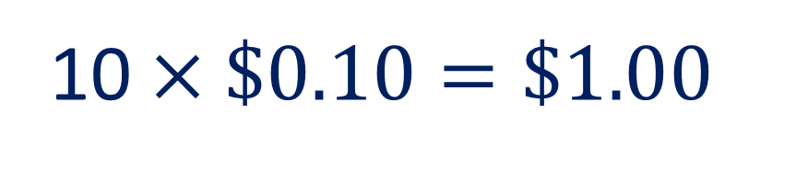

$$\$0.10$$
$$\$0.10$$
10 $×\$0.10=\$1.00$
$$\$0.10$$
$$\$0.10$$
$$\$0.10$$
$$\$0.10$$
$$\$0.10$$
$$\$0.10$$
$$\$0.10$$
$$\$0.10$$
$10.24
Notes:
How can we use this new information and our 10 x 10 grid to help determine Jasmine’s gratuity? Let’s consider first the amount she would pay if she paid a tip equal to 10% of her bill. Let’s identify a section of the grid to represent 10 percent (click). Since each square represents 10 cents (click 10 times), we can multiply 10 cents (click) by 10 to determine Jasmine’s tip.

Slide 10
$1.00
$11.24
Notes:
Now, we add the gratuity (click) of $1.00 to the cost of her meal to get a total (click) of $11.24.

Slide 11
$0.50
$1. 00
+ . 50__
$1. 50
$1.00
$10.24
Notes:
What if, however, Jasmine thought her server did a really good job and decides that she wants to pay a tip equal to 15% of the cost of her bill. A 15% tip is equal to 10% (click) of the bill plus an additional 5% (click) of the bill. Recall that 10% of the bill was equal to $1.00. Since 5% is half of 10%, why don’t we half 10% of the bill, or $1.00, to determine 5% of the bill. Half of $1.00 is 50 cents. The total amount of our gratuity (click) is $1.50.

Slide 12
$1.50
$11.74
Notes:
Now, we can add the gratuity (click) of $1.50 to the cost of her meal to get a total (click) of $11.74.

Slide 13
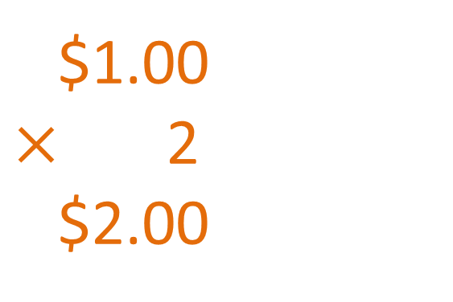
$1.00
$×$ 2
$2.00
$1.00
$1.00
Notes:
If Jasmine thought her server gave excellent, above-the-call-of-duty service, she might decide to pay a gratuity equal to 20% of her bill. Since we already know the value of 10% (click) of her bill, or $1.00, what can we do to determine a tip of 20%? We can just double (click) the 10%, right? That is just $1.00 (click) multiplied by 2!

Slide 14
$2.00
$12.24
Notes:
Let’s add our tip of $2.00 (click) to our bill for a total of $12.24 (click).

Slide 15
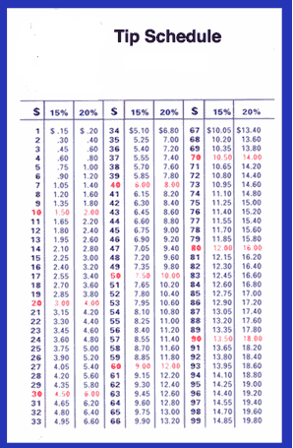
Notes:
Some people have tipping guides in their wallets. They are the size of a credit card and help a diner determine his gratuity cost based on the cost of the meal. The next time someone at your table calculates his tip using a tipping guide like this one, you will know the math behind the numbers!

