Slide 1

Finding Percent using a
Bar Model

Slide 2
Whole
Part
Percent

Slide 3
75% of
24
24
6
12
18
24
25%
50%
75%
100%
100%

Slide 4
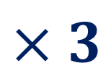
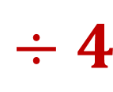

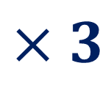
100%
24
Symbolically
75%
of
24
$$÷4$$
$$÷4$$
25%
6
$$×3$$
$$×3$$
75%
18

Slide 5
30% of 21
21
10%
20%
30%
40%
50%
60%
70%
80%
90%
100%
100%

Slide 6
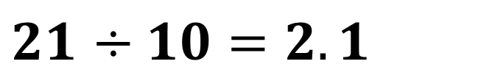
30% of 21
$21$ $÷10=2.1$
2.1
4.2
6.3
21
10%
20%
30%
40%
50%
60%
70%
80%
90%
100%

Slide 7

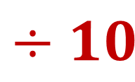
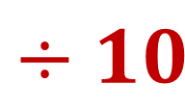

Symbolically
30% of 21
100%
21
$$÷10$$
$$÷10$$
10%
2.1
$$×3$$
$$×3$$
30%
6.3

Slide 8
21 is 30% of what number?
?
10%
20%
30%
40%
50%
60%
70%
80%
90%
100%
100%
Notes:
Based on knowing 30 as my percentage, I know 10 is a factor of both 30 and 100. I can partition my bar equally into section of 10% each.

Slide 9

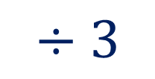
21 is 30% of what number?
$$÷3$$
7
21
10%
20%
30%
40%
50%
60%
70%
80%
90%
100%
10%
30%
$$÷3$$

Slide 10
21 is 30% of what number?
10 x 7 = 70
7
14
21
28
35
42
49
56
63
70
10%
20%
30%
40%
50%
60%
70%
80%
90%
100%

Slide 11
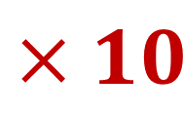
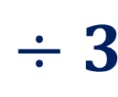

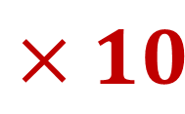
Symbolically
21 is 30% of what number?
30%
21
$$÷3$$
$$÷3$$
10%
7
$$×10$$
$$×10$$
100%
70
Notes:
30% of 21
21 is 100%
2.1 is 10%
6.3 is 30%

Slide 12
21 is what percent of 30?
30
3
6
9
12
15
18
21
24
27
30
10%
20%
30%
40%
50%
60%
70%
80%
90%
100%
100%

Slide 13
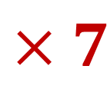
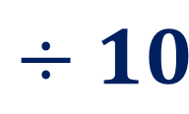
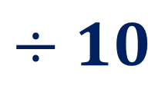

Symbolically
21 is what percent of 30?
100%
30
$$÷10$$
$$÷10$$
3
10%
$$×7$$
$$×7$$
21
70%

