Slide 1

Differences & Rate of Change
Free Falling

Slide 2
Collect some data – groups of 3
Roles in each group
Meter stick holder
Ball dropper
Time recorder
Completing data table
Compute 3 measurements for each time
Use the median value
Height (m) | Falling Time (sec) | Avg. Speed (m/sec)
0.20
0.40
0.60
0.80
1.00
Look at groups’ findings

Slide 3
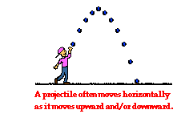
Formulas often used in physics
Assuming object dropped (initial velocity zero):

Slide 4
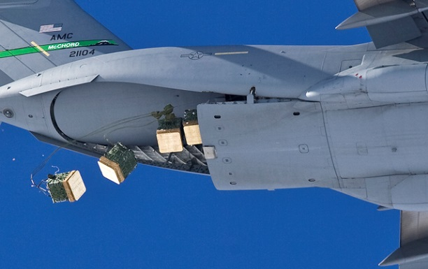
Impact of Delivery
A bundle of supplies is to be air dropped. The bundle’s height from the ground t seconds after it was dropped is given by the equation
h(t) = 500 – 16.1 t²
with height h(t) measured in feet.
The bundle can withstand a speed of no more than 165 feet per second. Will it survive the impact of this drop?

Slide 5

Impact of Delivery – Questions
From what height was the bundle dropped?
How long will it take the load to reach the ground?
Estimate the average speed of the bundle from the moment it was dropped until it reaches the ground.
What does this tell us about the integrity of the load at the moment of impact?

Slide 6
Impact of Delivery – More questions
How far does the bundle fall in its last 2 seconds of descent?
Estimate the bundle’s average speed during that 2-second interval.
Estimate the bundle’s average speed during its last 1 second of descent.
How can we obtain a more accurate estimate of the speed at impact?

Slide 7
Mathematically explain the physics formulas

