Slide 1
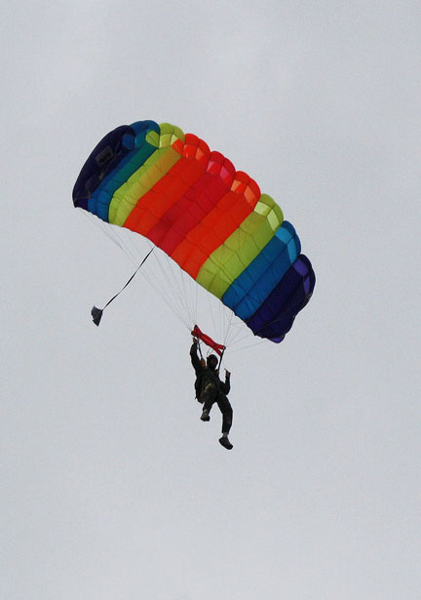
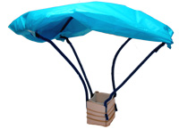
Free Fallin’ II
Considering air resistance

Slide 2
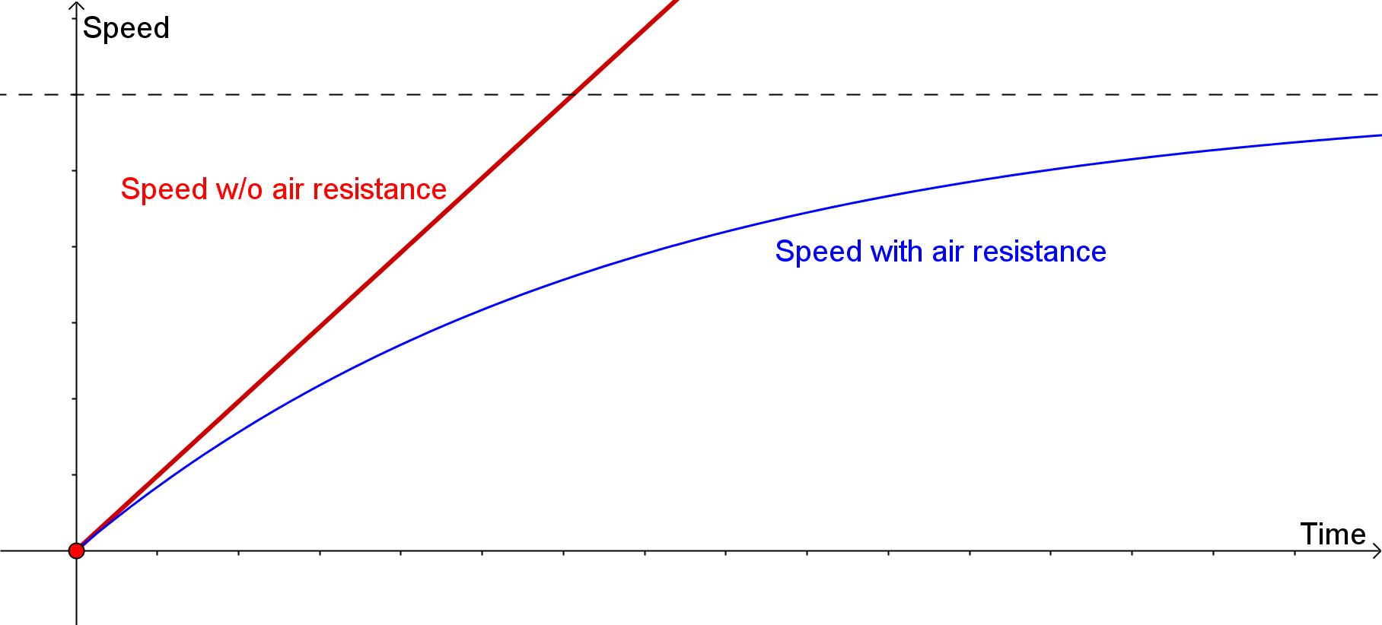
Speed with and without air resistance
Goal: Estimate the terminal velocity

Slide 3

Compute Results Expected Without Air Resistance
Use y = d – ½ gt² to compute descent times.
Use v = gt to compute speeds of impact.

Slide 4

Experimental Results
Times have been averaged.
Estimate speeds of impact . . . .
Assuming constant acceleration,

Slide 5
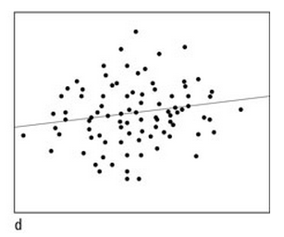
Compare results with scatter plots

Slide 6
Estimate terminal speed
Quadratic regression with experimental time-speed pairs.

Slide 7
Results
Vertex (5.51, 105.6)

