Slide 1
The Simplicity of Complex Numbers
Teacher Quality Workshop
9/21/2016

Slide 2

What are complex numbers and why does anyone care?
Beauty and “neatness”
Elegant theory
Real, real world applications

Slide 3


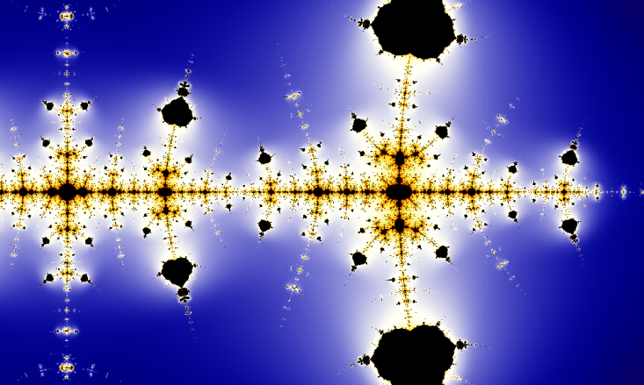

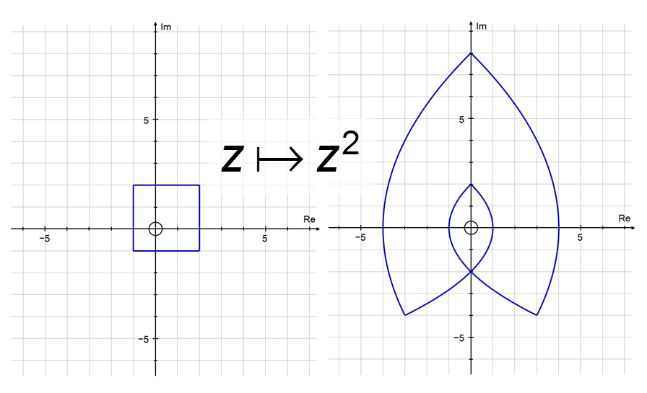
Beauty and Neatness

Slide 4

Elegant theory
Fundamental Theorem of Algebra
Every (non-constant) polynomial of degree n has exactly n roots (counting multiplicities).

Slide 5
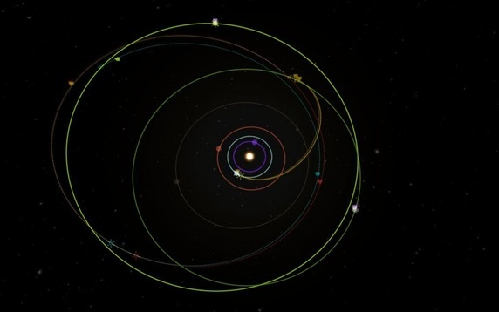
Real, real world applications
Orbital dynamics, Kepler’s laws
Computer graphics
Navigation
2nd order differential equations:
  Electric circuits
  Oscillating mechanical systems
  a y’’ + b y’ + c y = 0 ➔ a r² + b r + c =0

Slide 6
Euler’s Neat Formula

Slide 7
Euler’s Neat Formula

Slide 8
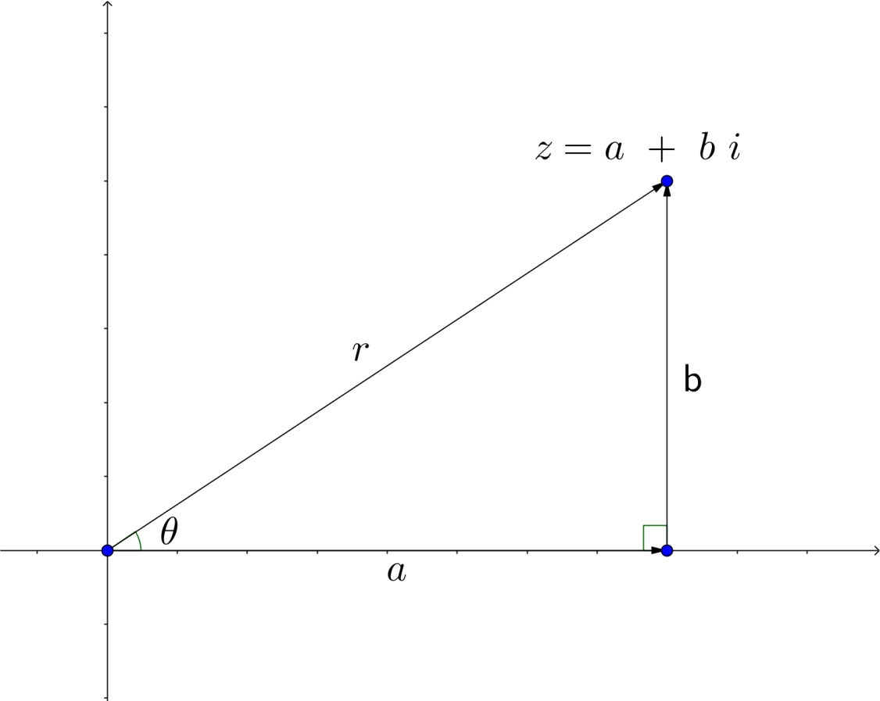
The Polar Form of a Complex Number

Slide 9
Useful Resources
https://www.math.toronto.edu/mathnet/questionCorner/complexinlife.html
https://betterexplained.com/articles/a-visual-intuitive-guide-to-imaginary-numbers/

