Slide 1
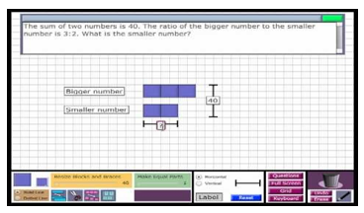
Using The Bar Model to Solve Problems
Mathematics Playground

Slide 2


Slide 3
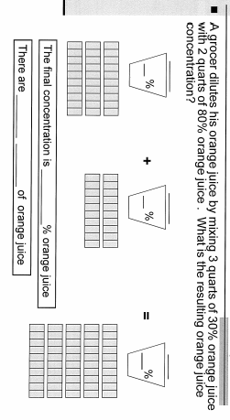

Slide 4
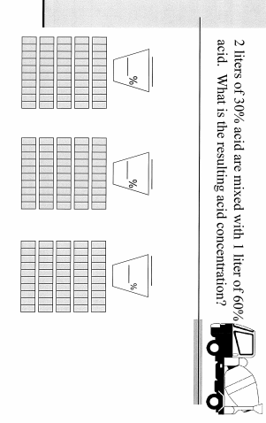

Slide 5
