Slide 1
I notice, I wonder . . .

Slide 2
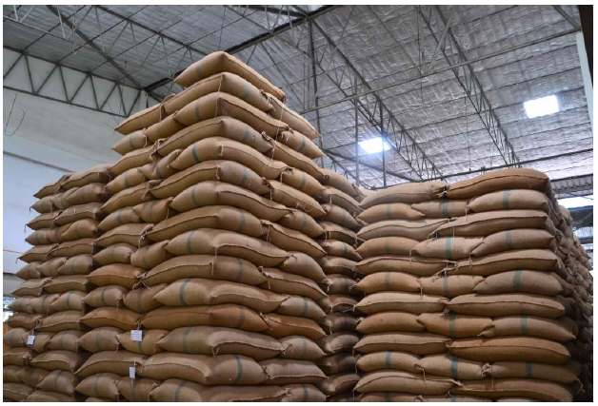

I notice, I wonder

Slide 3

I notice, I wonder

Slide 4

I notice, I wonder

Slide 5

I notice, I wonder

Slide 6

I notice, I wonder

Slide 7
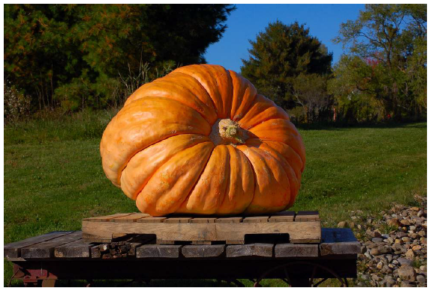
I notice, I wonder

Slide 8

I notice, I wonder

Slide 9

I notice, I wonder

Slide 10

I notice, I wonder

Slide 11
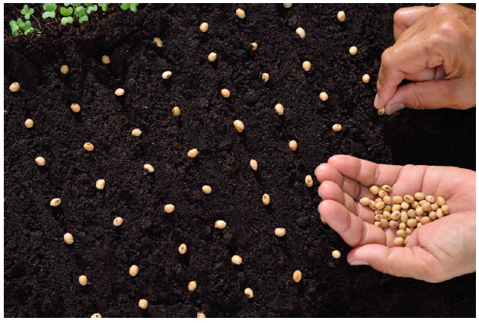
I notice, I wonder

Slide 12

I notice, I wonder

Slide 13

I notice, I wonder

Slide 14
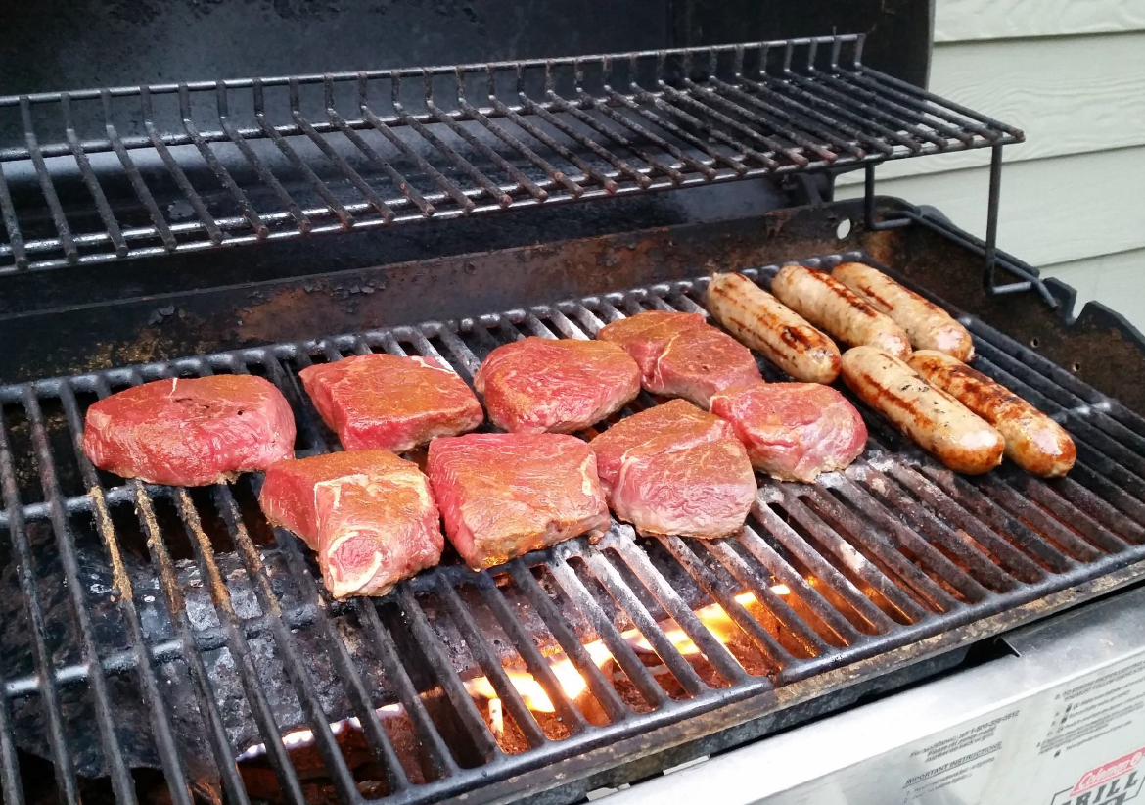
I notice, I wonder

Slide 15

I notice, I wonder

Slide 16
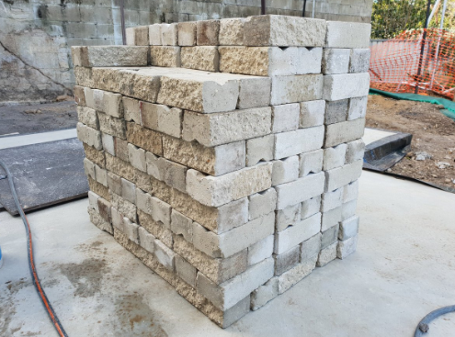
I notice, I wonder

Slide 17
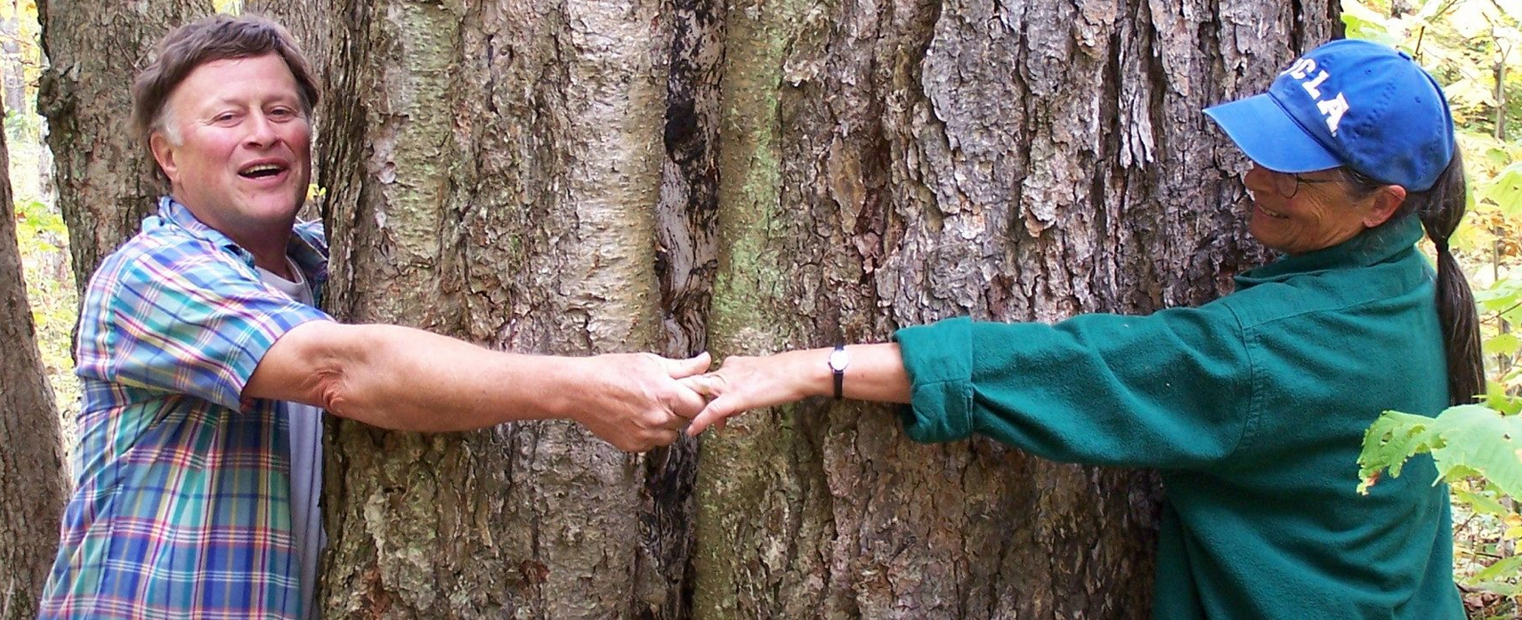
I notice, I wonder
Annie Fetter’s post:
That’s my parents. They’re making a rough estimate of the chest-high circumference of a big yellow birch near their cabin in northern Vermont. They noticed it was way bigger than the trees around it and wondered how old it was. The state forester told them that the average width of a growth ring of a yellow birch is about 1/8″. They determined the circumference was about 160″, and they did some math from there to figure out the tree’s age. (The details are left to the reader – you didn’t really think I was going to tell you, did you?) The area where the tree is was clear-cut by a paper company around the turn of the last century, so this tree really stands out as one of the few trees that was left standing.

Slide 18

I notice, I wonder
https://www.youtube.com/watch?v=7SYZWDYmLf8&list=PLFE32C319A204FE3A&index=1

Slide 19
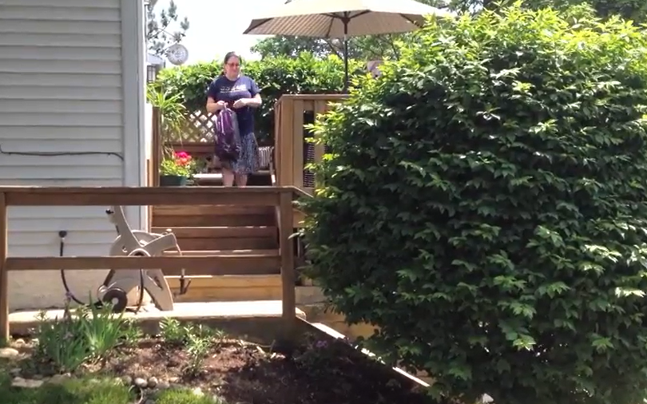
I notice, I wonder
https://www.youtube.com/watch?v=B6wqal116aM&list=PLFE32C319A204FE3A&index=3

