Slide 1
Imaginary Numbers
Operations… explained?

Slide 2
Goals for today:
How did we get to imaginary numbers historically? (slide 4)
Why is there a need for imaginary numbers mathematically?(slide 5)
We have gotten along fine without them until now?
Where do I put them? (slide 6)
Why are they complex?
What does adding and subtracting complex numbers look like? (slide 7)
What does multiplying complex numbers look like? (slide 8)

Slide 3
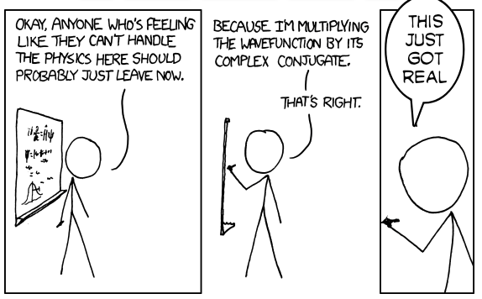
What math words do you recognize?
Math Humor -
Not Imaginary.
Notes:
A good slide to show at the start of class to ask students what words they recognize. Also to see if they get the joke.

Slide 4
A little history - RUUUUMMMMMBBBBLLLLEE
You will have five minutes to research your historical figure.
Be ready to explain how your figure relates to any one or few of these words.
Negative or positive numbers (1 point)
Complex numbers (1 point)
Imaginary numbers (1 point)
Complex number plane (1 point)
Number line (1 point)
Be ready to explain how they relate to one of the other historical figures.
2 points for each connection
Notes:
The teacher is umpire and arbitrator and decider of points.

Slide 5
Number line Cha - Cha
Objective: Place yourself on the number line given your number and the position of zero ( my hero!)
Take a number
Find your place on the line.
Be ready to answer some rather obvious or oblivious questions…
(Remember you are the math hero here!)
Notes:
Have students place themselves on a number line… move the students by having them add 2, subtract 2 multily by 1 or 2 and multiply by -1 or -2.
When they multiply by the square root of -1 they should have difficulty using the number line… dissonance.. Opportunity to ask questions

Slide 6
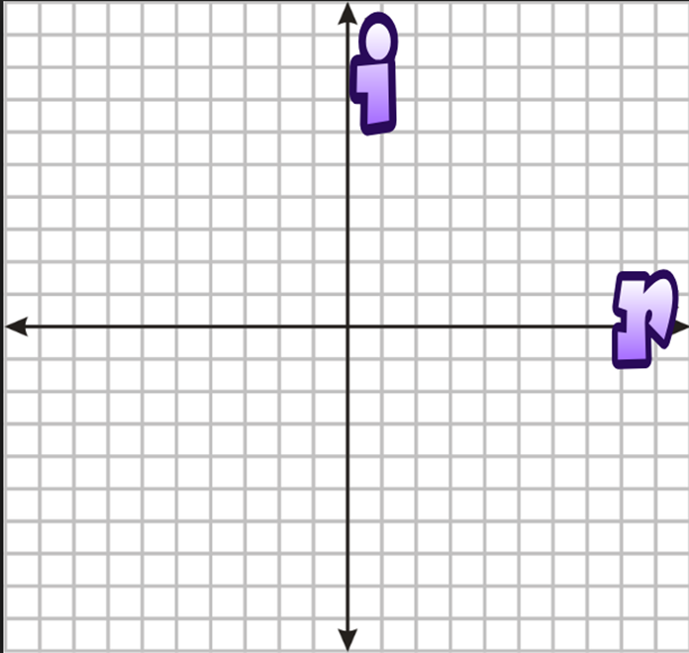




A Real- Imaginary Number Plane
Real numbers have inverses. -1 ------ 1
Imaginary numbers rotate.
i
-1
1
-i
Notes:
Each time you multiply by i you rotate 90 degrees counter clockwise. When you multiply by -1 you rotate 180 degrees.

Slide 7
What does adding complex numbers look like?
real part + imaginary part
( a + bi)
(2 +3i) + (-6 + 4i)
Notes:
Video games work on the principal of vectors because characters and props can be any dimension as long as you have imaginary numbers. 2D, 3D, 4D, etc...

Slide 8
What does multiplying look like?
real part + imaginary part
( a + bi)
(-2 + i) (4 + 5i)

Slide 9
So what did we learn??
Math does NOT come in a box… it develops…
Imaginary numbers exist to because they are actual solutions.
Imaginary numbers do not exist on the real number line.
When we operate on real numbers, actual physical things happen.

