Slide 1

Measurement/Repeated Subtraction Model of Division

Slide 2
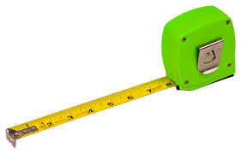
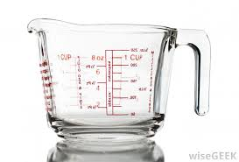
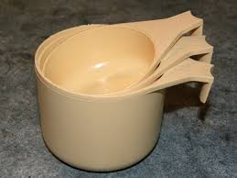
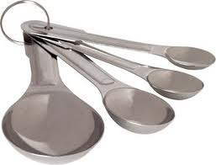
Prior Knowledge

Slide 3

Mark has 24 apples.
He puts them into bags containing 6 apples each.
How many bags can Mark fill?
Known: Size of group
6
Unknown: Number of groups of size 6
Mark can make

Slide 4

4
Number of groups
6
24
Total Apples
Size of group

Slide 5
Think: 7 is being measured out 2 at a time.
Ask: How many groups of 2 can be made from or measured out from 7?

Slide 6

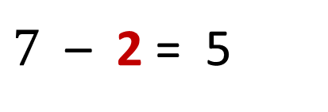
Repeated Subtraction
$7$ – 2 = 5
1 group of 2
5 – 2 = 3
2 groups of 2
3 – 2 = 1
3 groups of 2
1 remains out of a group size of 2
$$7÷2=3\frac{1}{2}$$

Slide 7


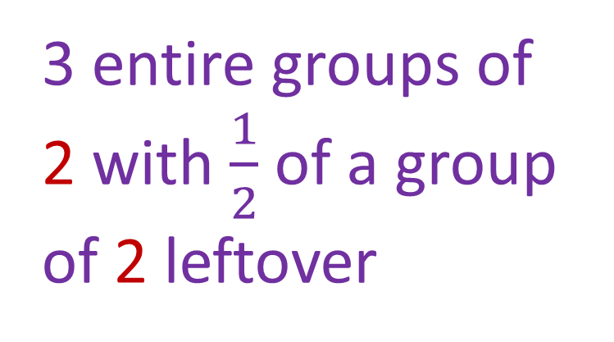
3 entire groups of 2 with $\frac{1}{2}$ of a group of 2 leftover

