Slide 1

Modeling
with
Percent
Notes:
Voice this

Slide 2
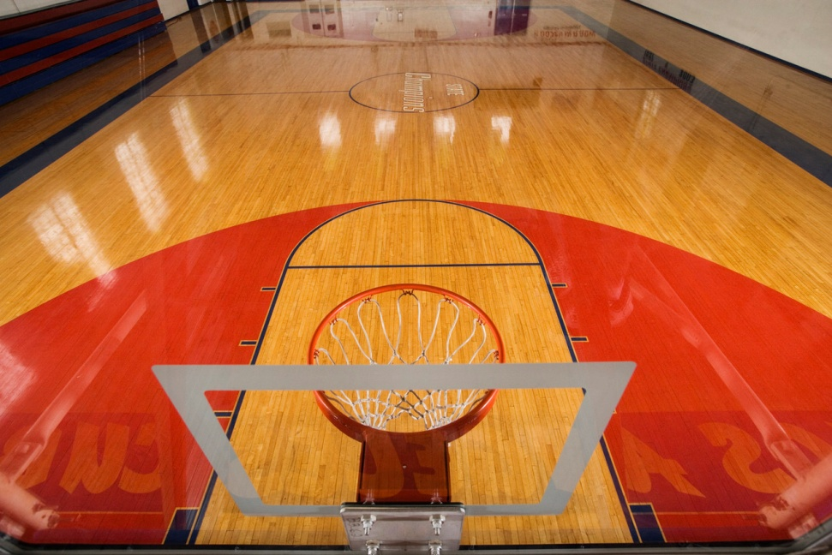

Notes:
Percent problems have so many real-world connections. In this vodcast we will look at how to model problems involving percent. Let’s get started.

Slide 3
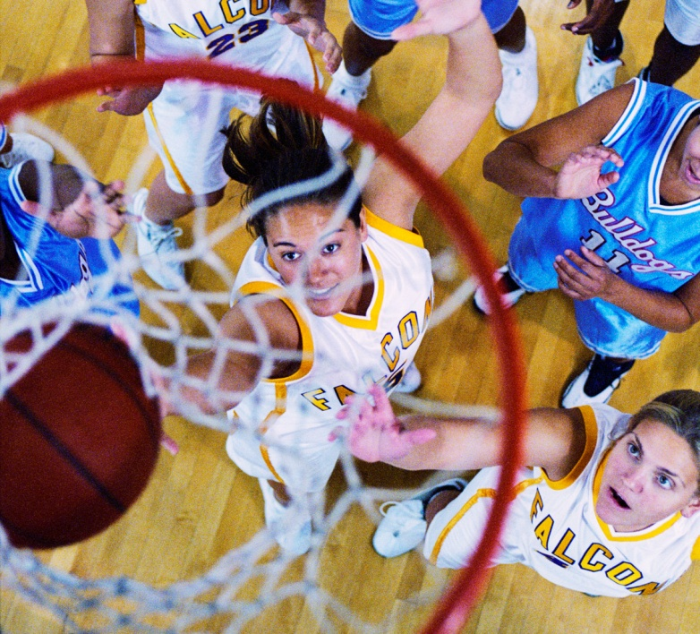
Notes:
Most everyone who plays a sport or follows a sports team likes to discuss team statistics . When the season is over, we want to know how well our team performed.

Slide 4
Your middle school basketball team won 80 percent of its . How many games did the team win?
25
games
Whole -
25
?
Part -
Percentage -
80
Notes:
First, let’s identify the part, the whole, and the percentage. Identifying these parts will help us determine what information we will need to model our problem with a picture.
The whole is the 25 games the team played.
The part is the information we are missing. We do not yet know how many of the 25 games the team has WON.
The percentage is 80.

Slide 5
100%
25 games
Notes:
To represent this problem, we will use a picture. Let this box (click) represent the whole, or (click, click) 25 games. 25 games represents all of the games, or (click, click) 100% of the games played.

Slide 6

80 and 100
Greatest Common Factor?
100%
20%
20%
20%
20%
20%
Notes:
How can we divide this whole, or 100%, in order to show 80 percent, the percent of games the team won? Think about 80%. What is the largest common factor between 80 and 100 (clicK)? 20, right! I can divide my rectangle into sections of 20 percent.

Slide 7
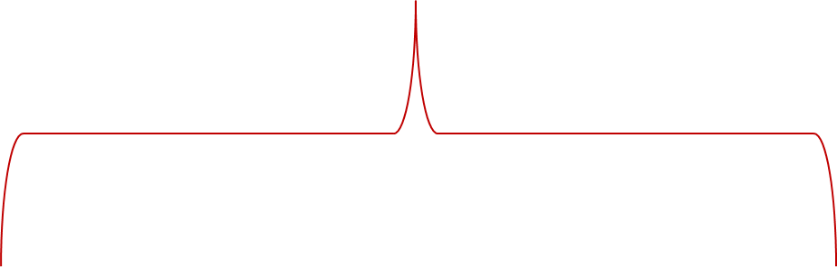
20%
20%
20%
20%
20%
100%
Notes:
How many section of 20 are in 100? There are five sections of 20 because 5 multiplied times 20 is 100.

Slide 8
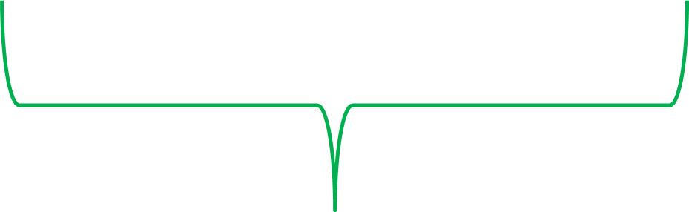
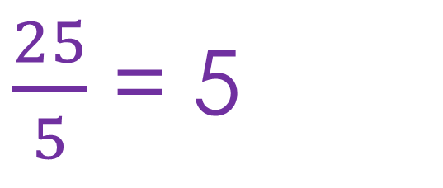
5
5
5
5
5
25 games
$\frac{25}{5}$ = 5
Notes:
Recall that the value of our whole is 25 (click). If we divide the whole, 25, into five sections, the value of each section is 5.

Slide 9
Your middle school basketball team won 80 percent of its 25 games. How many games did the team win?
5 games
5 games
5 games
5 games
5 games
20%
20%
20%
20%
20%
80%
Notes:
Our original problem stated that the team won 80% of its 25 games. Now we are ready to use our model to answer the question, “How many games did the team win?” Identify 80% of the 100% (click). That is, 4 out of the 5 boxes (click). That percentage corresponds to a numerical value of 20.
The team won 20 of its 25 games.

Slide 10
Jamal has read 60 of the 180 pages in his novel. What percent of the book has he read so far?
Whole –
180
Part -
60
Percentage -
?
Notes:
Let’s try another problem. Jamel has read 60 of the 180 pages in his novel. What percent of the books has he read so far? Let’s first identify the part, whole, and percentage.
The whole is the total # of pages, 180
The part is the pages Jamel as read, 60
The percentage is the information we are missing.

Slide 11
100%
180 pages
Notes:
Our box represents the whole, or 180 pages (click). We also know the box represent 100% (click). How can we divide this whole to show 60 pages?

Slide 12
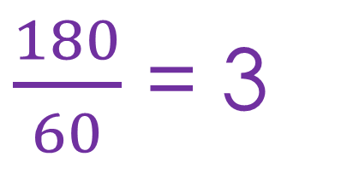
180 and 60
60
60
60
180 pages
$\frac{180}{60}$ = 3
Notes:
The largest common factor between 180 and 60. It is 60. We will divide our rectangle into three sections of 60 (click) because 180 divided by 60 is 3.

Slide 13

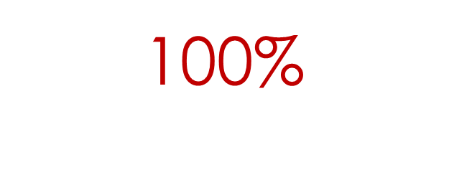



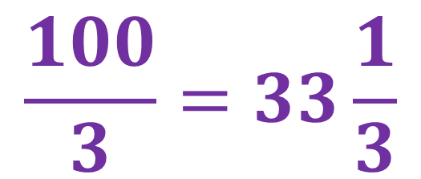
$$\frac{100}{3}=33\frac{1}{3}$$
$$33\frac{1}{3}\%$$
$$33\frac{1}{3}\%$$
$$33\frac{1}{3}\%$$
Notes:
Now, we are ready to divide our 100% into three sections. 100 divided by 3 is 33 and 1/3.

Slide 14




$$33\frac{1}{3}\%$$
$$33\frac{1}{3}\%$$
$$33\frac{1}{3}\%$$
Notes:
Now we are ready to use our model to answer the question, “What percent of the book has he read so far? 60 pages (click) corresponds to 33 and 1/3 percent of the whole book.

Slide 15


Whole –
Part -
Percentage -
Notes:
Using a model to represent percent problems helps us visualize all of the pieces (click, click) of a problem. In the case of percent problems, the part, whole, and percentage. Putting the pieces together (click) helps us solve the problem….always a goal in mathematics!

