Slide 1
Reasoning Proportionally in the Real World

Slide 2
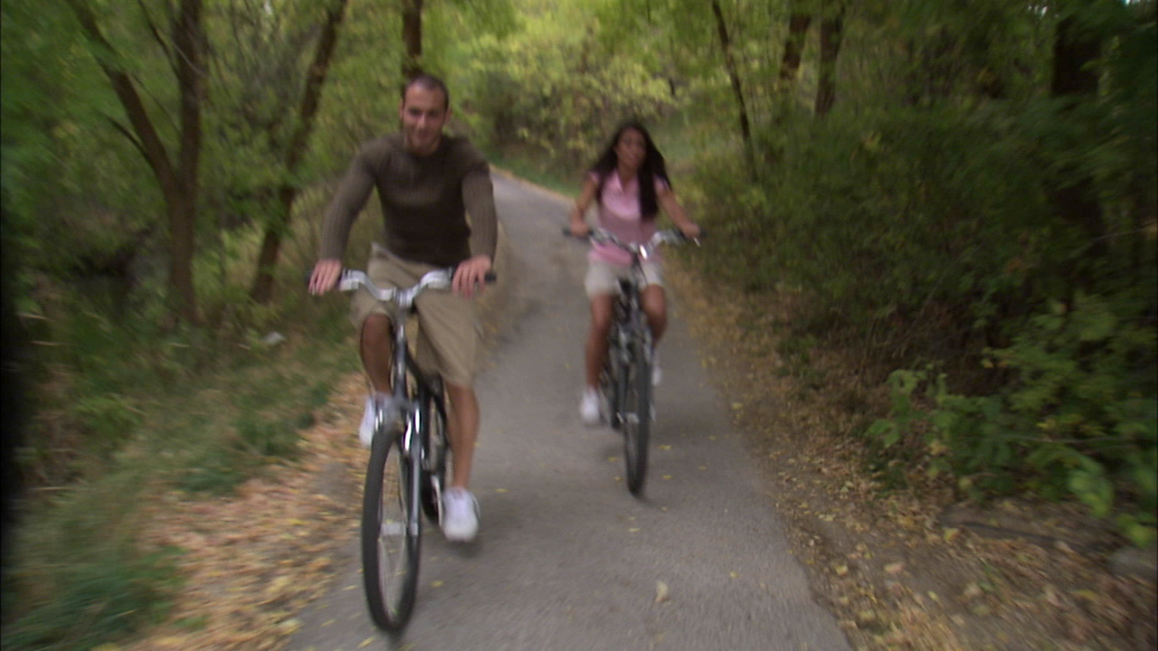

Notes:
Riding bikes footage
These people are enjoying a hobby that most of us have known how to do since childhood…riding a bike.

Slide 3
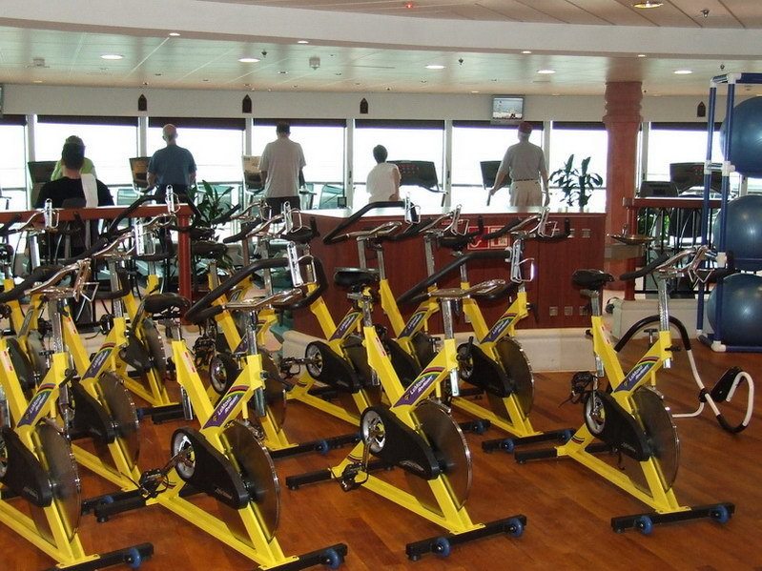
Notes:
Riding bikes in the great outdoors is not only pleasurable, but it is also great exercise. But, if the weather is bad, we may have to settle for a stationary bike at the gym.

Slide 4
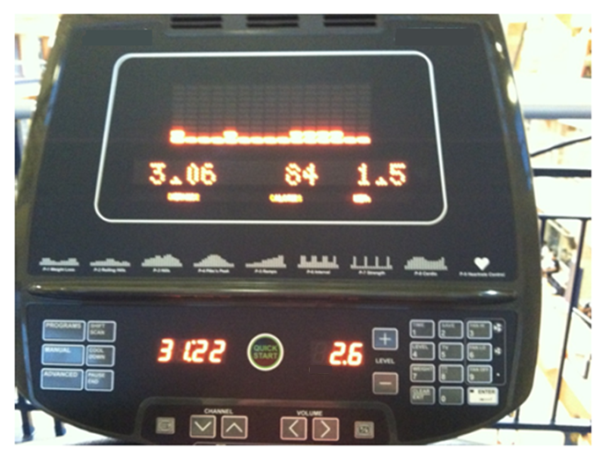
Notes:
Exercising on a machine is a great time to think about math. Yes, that’s right, math! Look at this electronic display. The amount of time (click) the biker has biked is 31 minutes, 22 seconds. The rider has biked (click) 2 and sixth tenths miles.

Slide 5
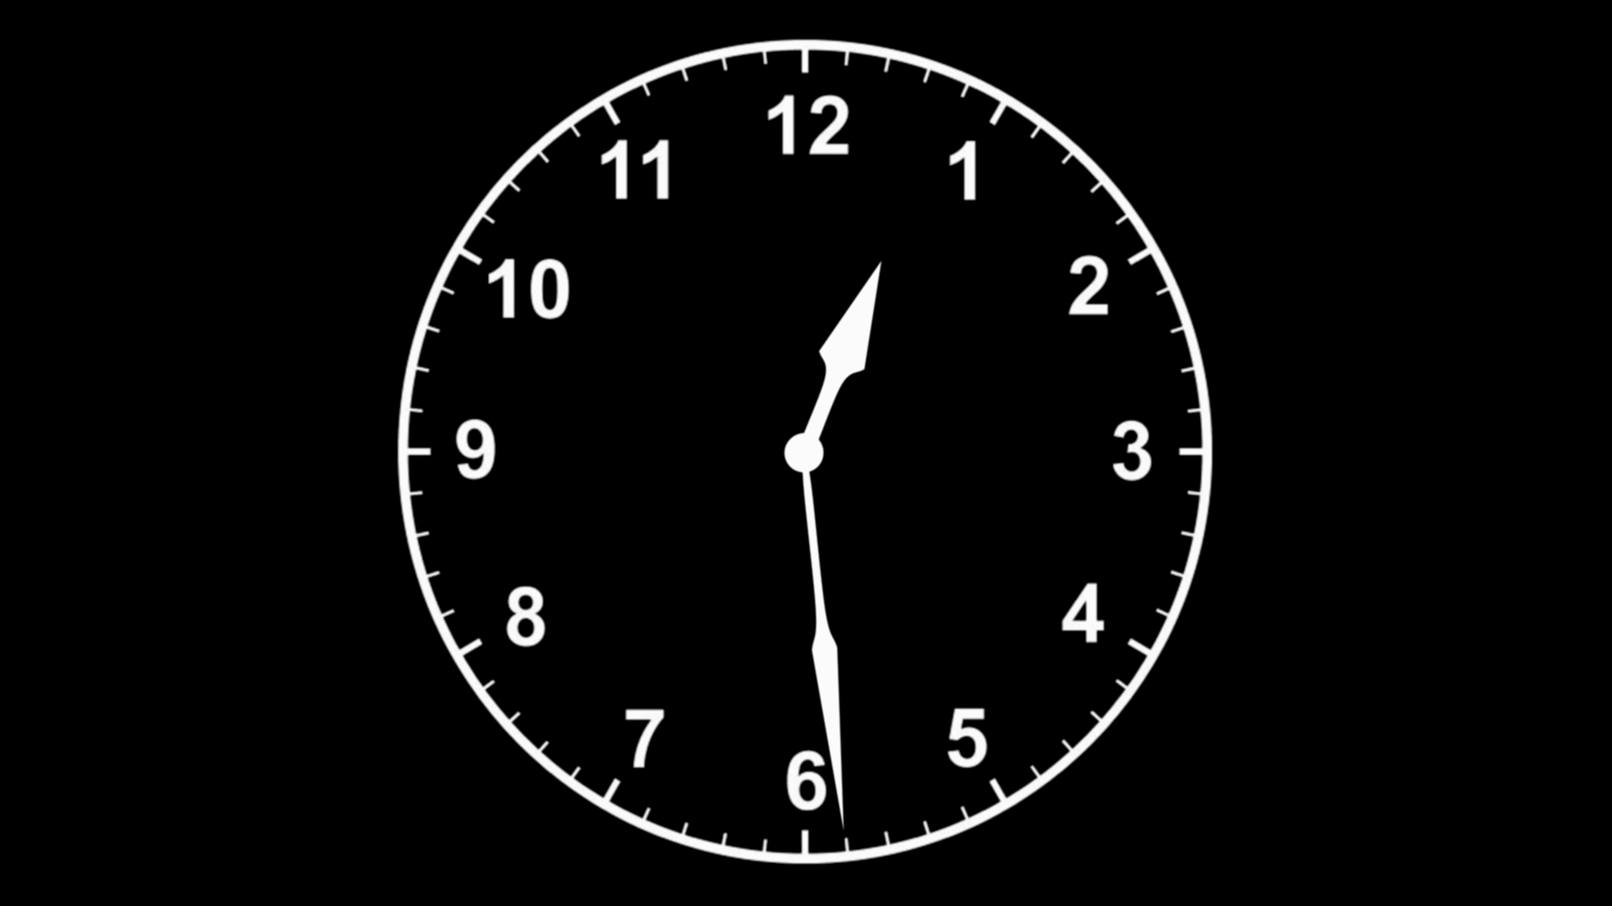
45:00
Notes:
Fast forward to when the clock would say 45 minutes. What if the rider wants to determine the amount of miles she will bike if she stays on the machine for that length of time? Let’s assume she continues peddling at her current speed.

Slide 6

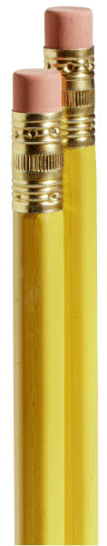
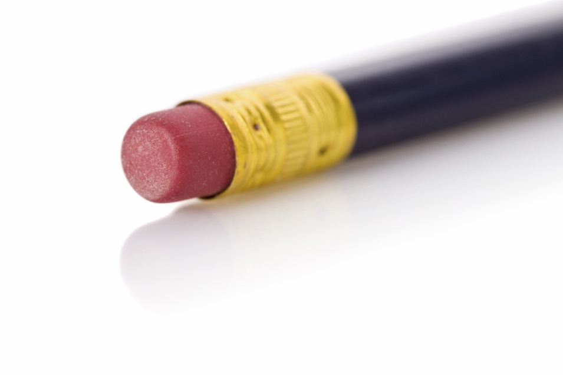
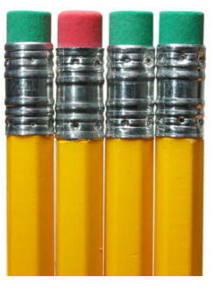
Notes:
How, without a pencil and paper (click 4 times), could she possibly figure out the answer? Even without paper and pencil, it is a good idea to think of a picture in your mind to help solve the problem.

Slide 7
12
30 minutes
9
3
6
Notes:
Since we are talking about time, let’s imagine something like a clock (click) in our mind’s eye. Recall that our biker has ridden 31 minutes, 22 seconds. This number is not what we would call a “nice number.” When doing mental math, it is “nice” to use a “nice” number. We can use an estimate to represent a “nice” number. A good estimate for 31 minutes, 22 seconds is (click) 30 minutes.

Slide 8
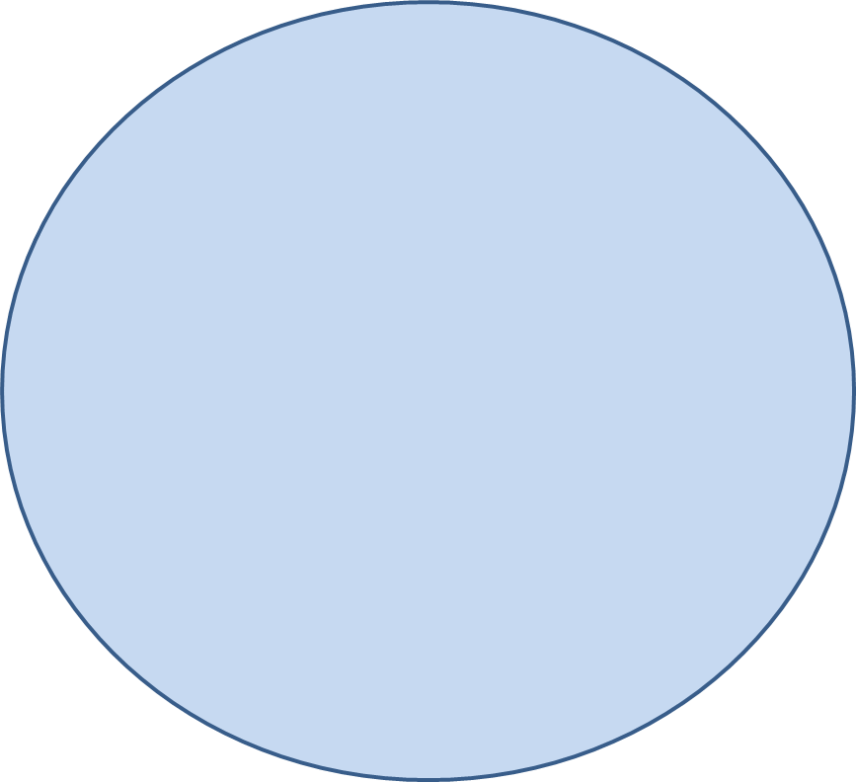
12
9
3
6
Notes:
Since our biker has ridden at least 30 minutes, let’s section our clock representation (click 3 times) to represent 30 minutes, or one-half of an hour. Since we want to know what her distance will be in 45 minutes, let’s section our “clock” again to show 45 minutes. 30 minutes divided the clock face in half. Representing 45 minutes will divide our clock face into fourths. If we divide one-half of the clock in half, we must divide in half the other side of the clock, as well.

Slide 9
12
15 minutes
15 minutes
9
3
15 minutes
15 minutes
6
30 minutes
Notes:
Our biker has ridden 2 and 6/10 miles (click) in approximately 30 minutes. However, now our clock has been sectioned into groups of 15 minutes (click four times). Can we still determine how much distance she biked in 15 minutes?

Slide 10
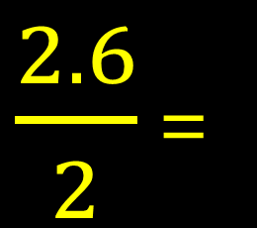
12
2.6 miles
+ 1.3 miles
3.9 miles
1.3 miles
9
3
1.3 miles
1.3 miles
6
$\frac{2.6}{2}$ =
.3
1
Notes:
Certainly! Let’s divide 2 and 6/10 miles in half (click)! That will give us our answer. We don’t need to do paper and pencil math here. Mental math will do! What is half of 2? One, right (click). What is half of six-tenths? 3 tenths (click)! So in 15 minutes, our biker rode 1.3 miles (click). Adding another 1.3 miles to represent the next 15 minutes (click) to represent 30 minutes, and finally another 1.3 miles for a total of 45 minutes (click). We have (click) a total of 3.9 miles. 3.9 miles is our approximated value.

Slide 11
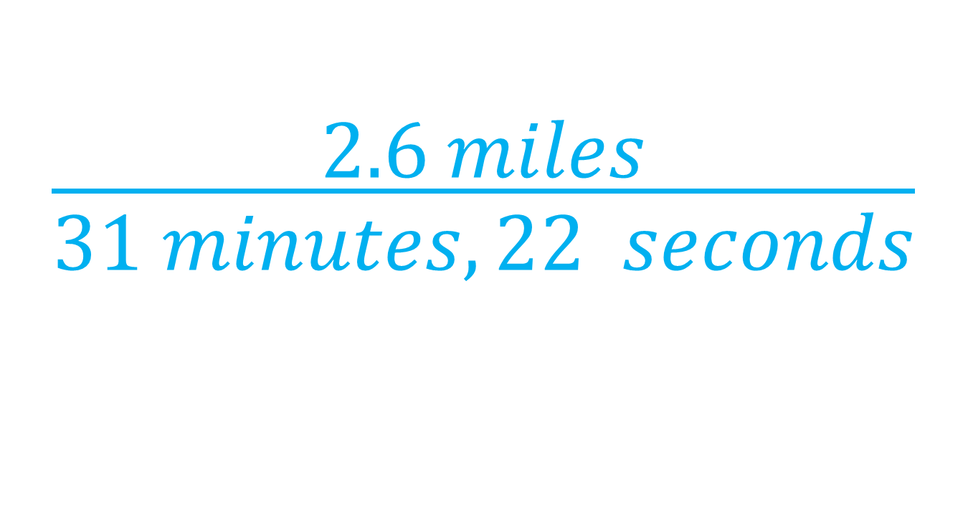
$$\frac{\begin{aligned} \\ 2.6 miles\end{aligned}}{31 minutes, 22 seconds}$$
Notes:
Recall that the actual bike riding time was 31 minutes, 22 seconds. Mathematically, we can write a ratio to compare the 2 and 6 tenths miles we rode to the amount of time it took. Remember, a ratio is a comparison of two quantities by division.

Slide 12
What if I can’t draw a picture?
Notes:
What should you do if you can’t draw a picture? Since we cannot always draw a picture to solve a math problem, we need the convenience of an algorithm, or rule, that will work every time in solving problems.

Slide 13
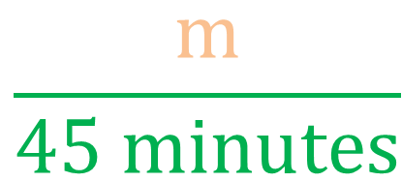


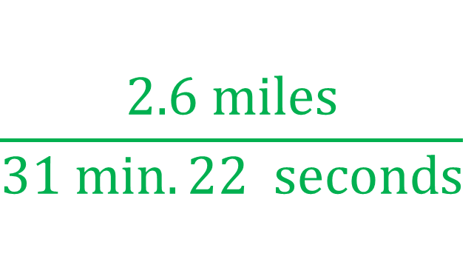
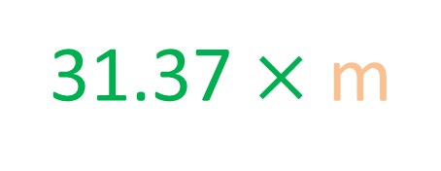
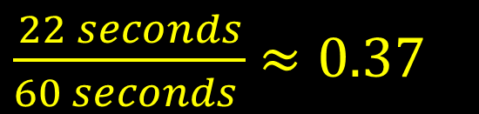
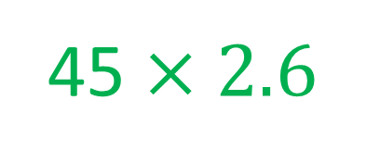
$$\frac{2.6 miles}{31 min.22 seconds}$$
Proportion
$$=$$
$$\frac{m}{45 minutes}$$
$\frac{22 seconds}{60 seconds }$ $≈0.37$
45 $×2.6$
=
31.37 $×$m
117
=
31.37m
3.73 $≈ m$
Notes:
We will set up a proportion (click), or two ratios set equal to each other. The first ratio we already know (click). It is equal to (click) our second ratio. In our second ratio (click), we find our missing value is the number of miles our biker will bike if she rides for 45 minutes. Our missing value is shown as the orange “m”. Notice how we made sure miles is in the numerator of our new ratio and minutes in the bottom to match our original ratio.
We need to quickly convert (click) 22 seconds into a decimal value by dividing by 22 seconds by 60 seconds. Now we know that 31 min. 22 seconds is equivalent to 31 and 37 hundredths minutes. Now, we will cross multiply to solve for the missing value, m (click, click, click).
The product of 45 times 2.6 is 117 (click). This product is equal to (click) the product of 31.37 times m is 31.37m (click).
Divide both sides by 31.37, the value of “m” (click) is approximately 3.73 miles. Our approximated answer was 3.9 miles. Those values are very close!

Slide 14

Proportion
Estimate
Does my answer make sense?
Notes:
You can always set up a proportion (click) made up of two equal ratios to solve these kinds of problems…where we have three known values and 1 unknown value. But don’t forget the power of an estimate (click). Our estimate allowed us to be fairly convinced that our actual amount of approximately 3.93 miles was a valid, sensible answer (click).

