Slide 1

Multiplying Decimal Numbers using estimation

Slide 2
What Does it Mean to Multiply?
_____________ groups of _______________
Number of groups
Multiplier
Amount in each group
Multiplicand

Slide 3

15.1 x 3.7 =
15.1
x 3.7
105.7
+ 453.0
558.7
About 15 groups of 4
15 x 4 = 60
55.87

Slide 4

24 $×$ 63 = 1,512
  2.4 x 6.3
  2.4 x 0.63
  0.24 x 6.3
  0.24 x 0.63
Using only the product of this whole-number multiplication problem, how can we place the decimals through estimation?

Slide 5
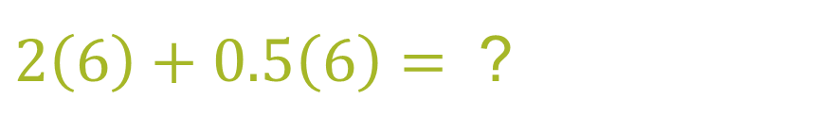
  2.4 x 6.3
Given: 24 x 63 = 1,512
One Interpretation:
    Approximately 2.5 groups of 6
$2\left(6\right)+0.5\left(6\right)=$ ?
    $12 + 3 =15$
    So, given 1,512
    15.12

Slide 6
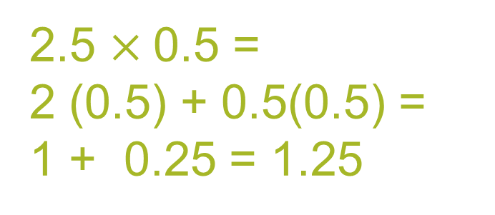

  2.4 x 0.63
Given: 24 x 63 = 1,512
Interpretations:
About 2 groups of 0.5
About 2.5 groups of 0.5
2 $×$ 0.5 = 1
2.5 $×$0.5 =
2 (0.5) + 0.5(0.5) =
1 + 0.25 = 1.25
    So, given 1,512
    1.512

Slide 7
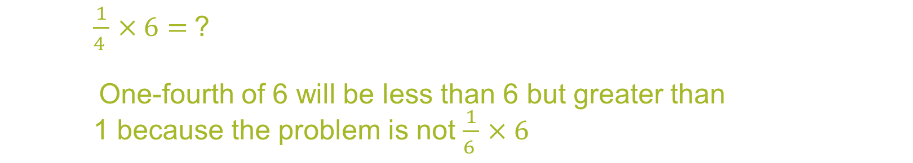
0.24 x 6.3
Given: 24 x 63 = 1512
One Interpretation:
Approximately 0.25 of a group of 6
$\frac{1}{4 }$ $×6=$?
One-fourth of 6 will be less than 6 but greater than
1 because the problem is not $\frac{1}{6 }$ $×6$
    So, given 1,512
1.512

Slide 8
0.24 x 0.63 =
Given: 24 x 63 = 1,512
One Interpretation:
About 0.5 group of 0.5 or, more generally, 0.5 group of a number less than 1
0.5 x 0.5 = 0.25
    So, given 1,512
0.1512

Slide 9
Word of Advice
Estimation works for all decimal multiplication problems.
However…
Some problems are harder to estimate.
0.0083 x 0.004

Slide 10

0.0083 x 0.004
Scientific Notation
0.0083 = 8.3 x 10⁻³
8.3 $×$ 10⁻³ $×$ 4 $×$ 10⁻³
0.004 = 4 x 10⁻³
8.3 x 4 = 33.2
10⁻³ x 10⁻³ = 10⁻⁶
33.2 x 10⁻⁶ = 0.0000332
3.32 x 10⁻⁵ = 0.0000332

Slide 11
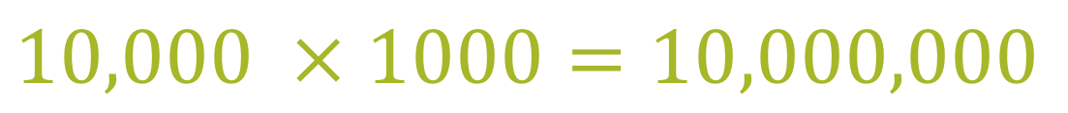
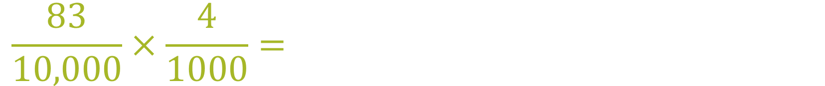
0.0083 x 0.004 = 0.0000332
Fraction multiplication
$$\frac{83}{10,000}×\frac{4}{1000}=$$
$$10,000 ×1000=10,000,000$$

