Slide 1
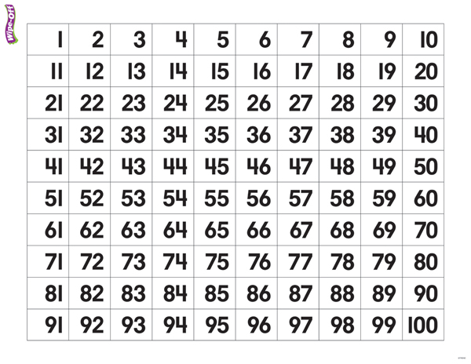

PICK 6 Game Board
-30
-10
-3
+1
-2
-2

Slide 2
PICK 6 recording sheet
Player #1 will record his/her starting number, then add or subtract the “Direction Card(s)” he/she used for each move, like the example below:
Round
1
2
3
4
57 – 30 – 10 – 2 – 2 = 13
______________________________________________
______________________________________________
______________________________________________
______________________________________________

Slide 3
PICK 6 Game Board
-20
-30
+2
-10
+1
+10
-2
-2
-3
+3

Slide 4
PICK 6 recording sheet
Player #1 will record his/her starting number, then add or subtract the “Direction Card(s)” he/she used for each move, like the example below:
Round
1
2
3
4
57 – 30 – 10 – 2 – 2 = 13
______________________________________________
13 + 10 + 3 = 26
______________________________________________
______________________________________________
______________________________________________

Slide 5
PICK 6 Game Board
+1
-30
-20
+2
+10
+3
-3
+3

