Slide 1
Stairs: Slope in the Real World

Slide 2
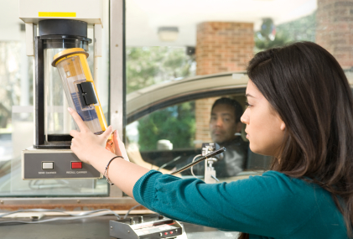
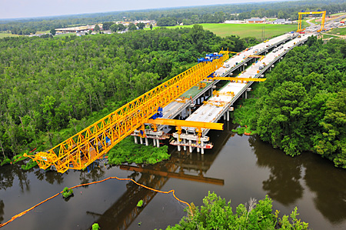

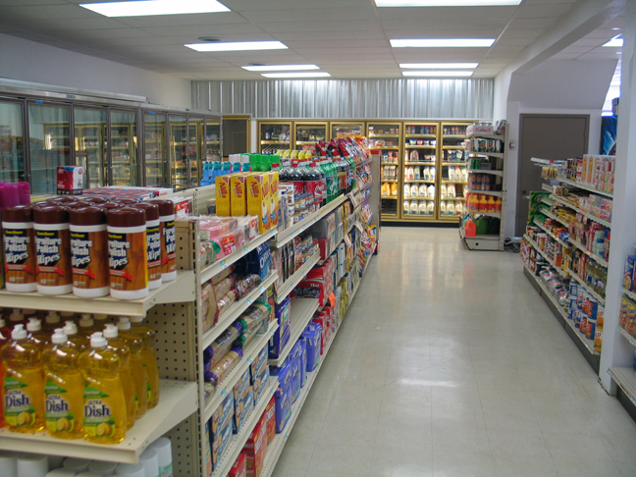

Notes:
It is so easy to think that math happens only in your textbook. Yet, math surrounds you in your daily life (click 4 times). Some places where you find it seem obvious, but some are less obvious.

Slide 3
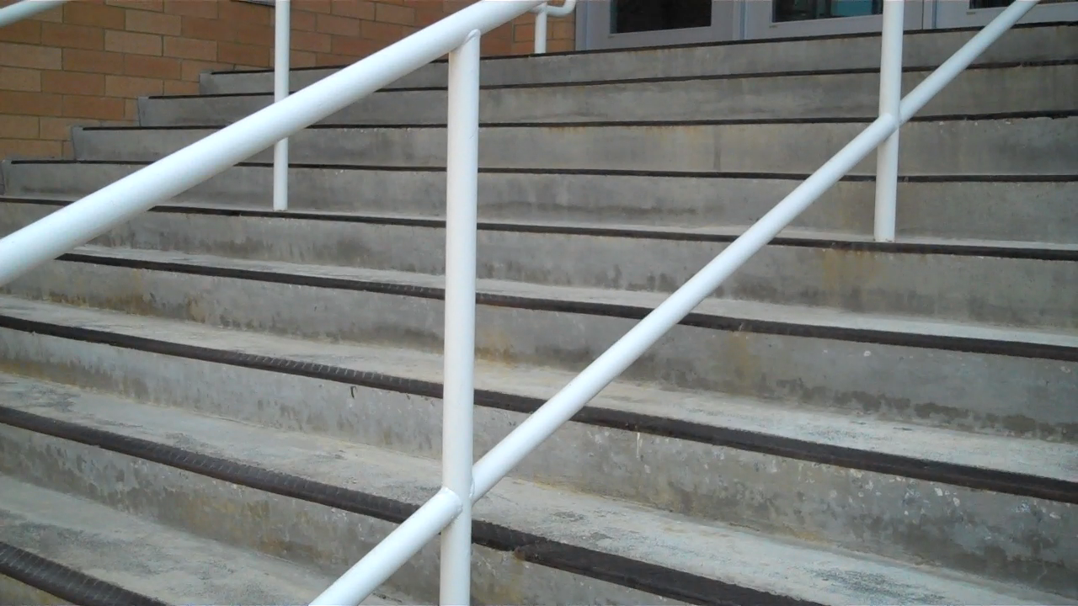
Notes:
(prefer a video clip from website but don’t know how to do it…)
If you’ve ever climbed a set of stairs, you can thank the carpenter who knew the behind-the-scenes mathematics.

Slide 4
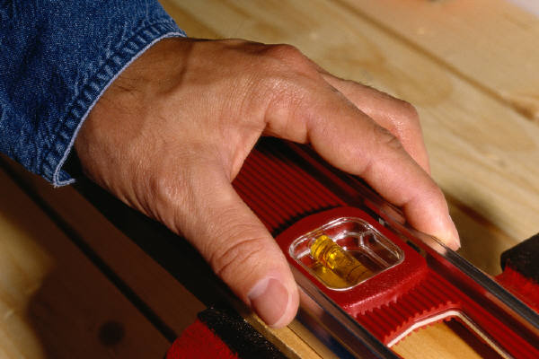
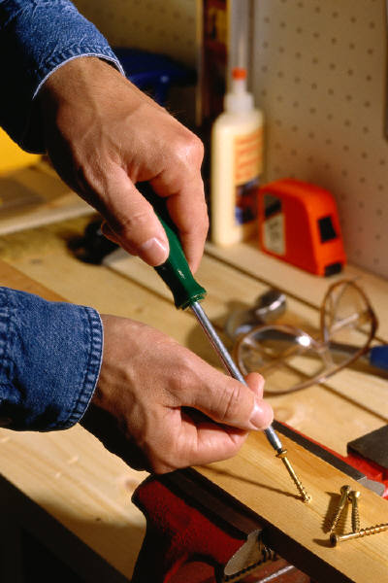
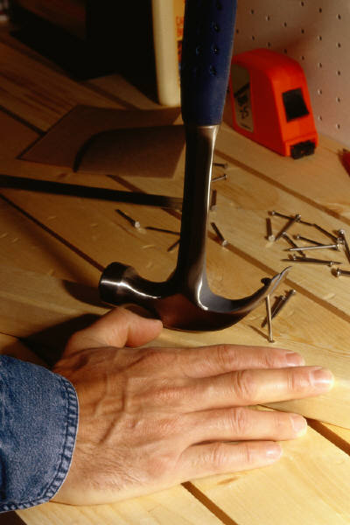
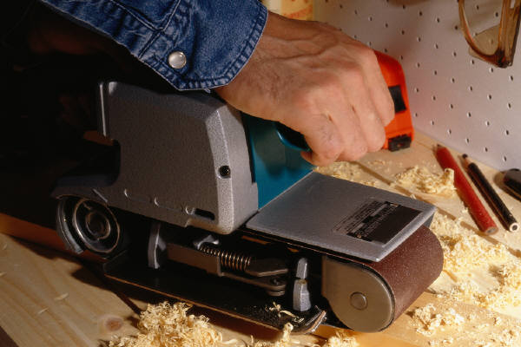
Notes:
When you learned about slope in your math class, you may not have realized how slope is in the world of building construction.

Slide 5
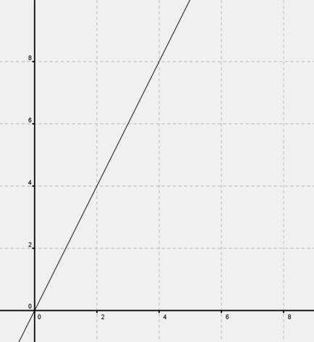
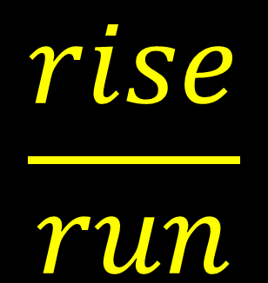
run
$$\frac{rise}{run}$$
rise
Notes:
Recall that the slope of a line is defined as a measure of its steepness. It is calculated by dividing the vertical change (click) by the horizontal change (click), or the ratio of rise to run (click).

Slide 6
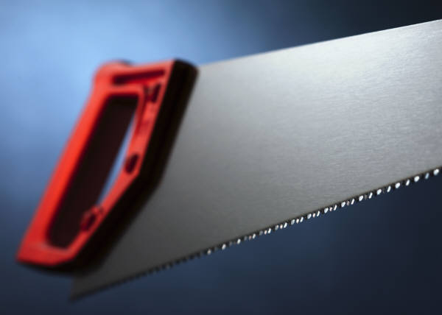
TREAD
RISER
Notes:
Carpenters must determine the rise and run of a staircase in order to build it. In their business, however, these vocabulary terms become “riser” and “tread.”

Slide 7
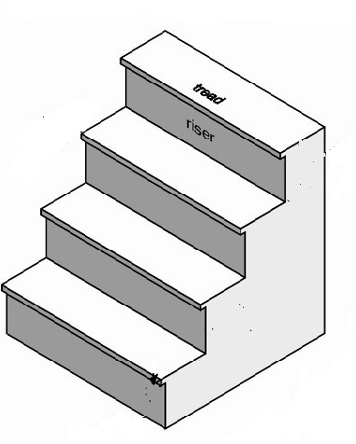
Notes:
The “riser” is the vertical distance or height (click) from one step to another. The carpentry term “riser” is similar to the mathematical word “rise”. If the riser is too high or too low, climbing stairs would be difficult.
The “tread” (click) is the actual step width. It’s where your foot (click, click, click) goes!

Slide 8
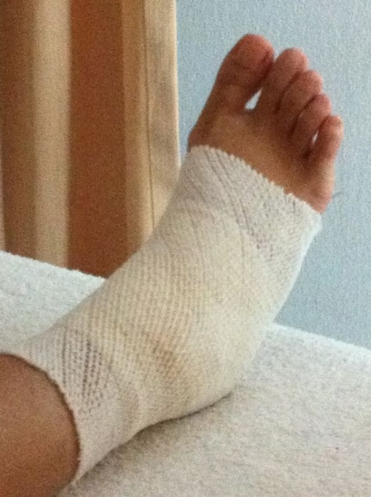
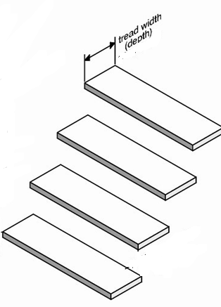
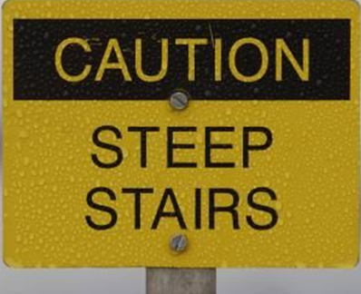
Notes:
The width of the tread is very important. If the tread is too long, climbing stairs becomes tricky (click). If it’s too short…well (click), you might fall.

Slide 9
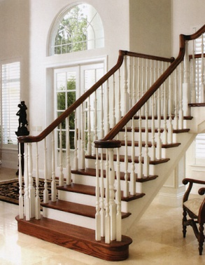
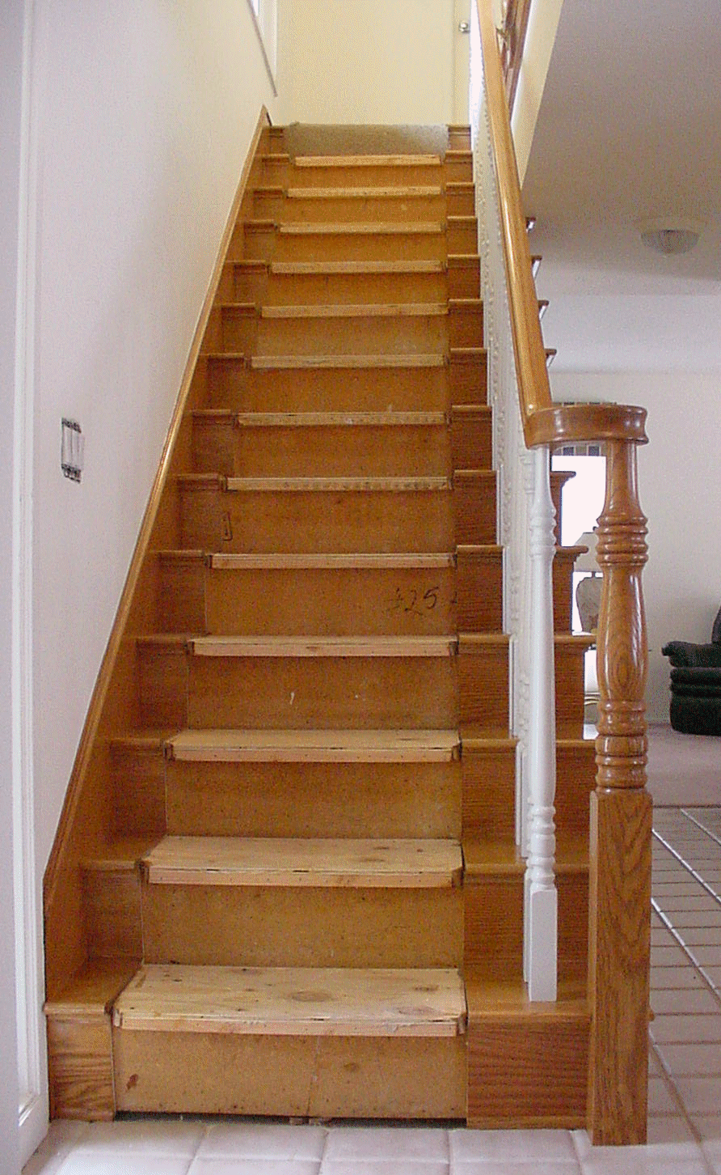
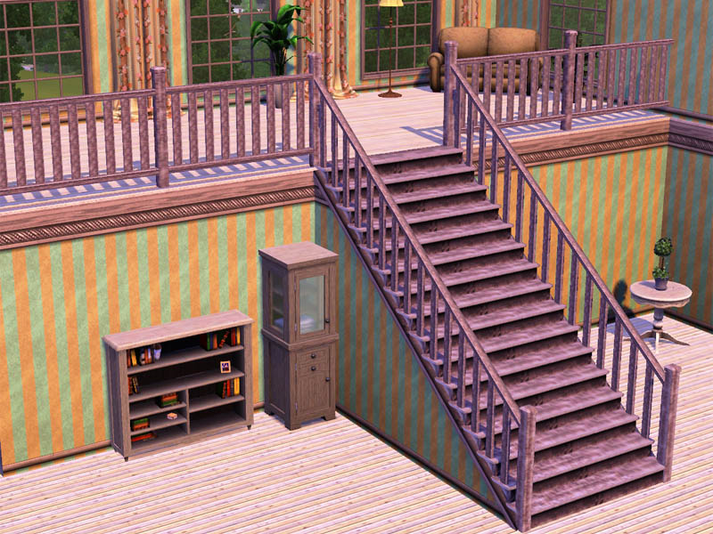
Notes:
Another important factor in stair design is determining the steepness. In fact, steepness is a major safety issue. Think of the accidents that can happen on stairs! Steepness is such serious business that there are guidelines that inform builders how staircases should be constructed.

Slide 10
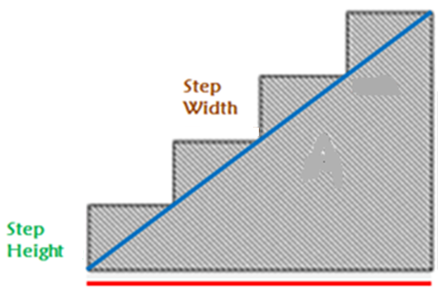
TOTAL RISE
STEEPNESS
TOTAL RUN
Notes:
Since each step has a rise and a run, or riser and tread, the staircase, itself, must have a slope. Of course, in the construction business carpenters talk about a the “steepness” of a staircase (click).
We can find the steepness of our staircase, mathematically, by determining its slope.
First, we must determine the vertical distance or “rise” of each step. The rise is the height of each step (click, click, click, click). The total rise, then, is the sum of the individual rises of each step (click).
Now, we must determine the horizontal distance or “run” of each step (click, click, click, click). The total run, then, is the sum of the individual widths of each step (click).

Slide 11
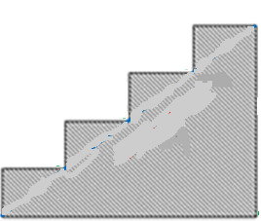
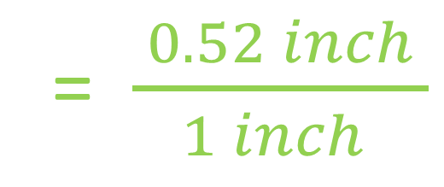
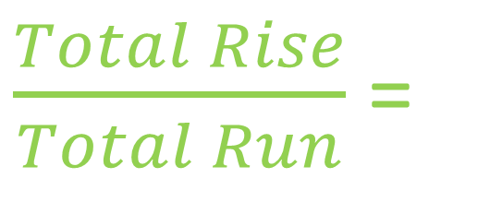
$\frac{Total Rise}{Total Run}$ =
24 inches
= $\frac{ 0.52 inch }{1 inch }$
46 inches
6 inches
11.5 inches
Notes:
If each step’s rise (click) is 6 in., the total rise is 24 inches (click). If each step’s run (click) is 11.5 in., the total run is 46 inches. Simplifying this ratio tells us that for every one inch of run, there is 0.52 inches of rise (click).

Slide 12
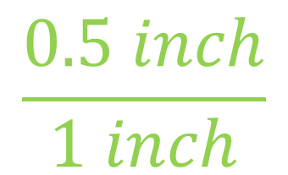
$$\frac{0.5 inch}{1 inch}$$
Notes:
If we approximate the steepness of our staircase to 0.5 to one, we can more clearly see that for every 1 inch (click) of riser, there is approximately one-half (click) inch of tread.

Slide 13

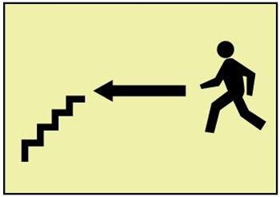
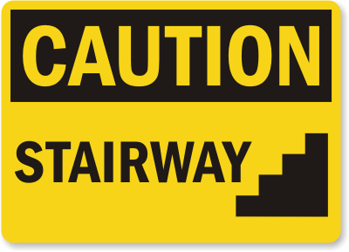
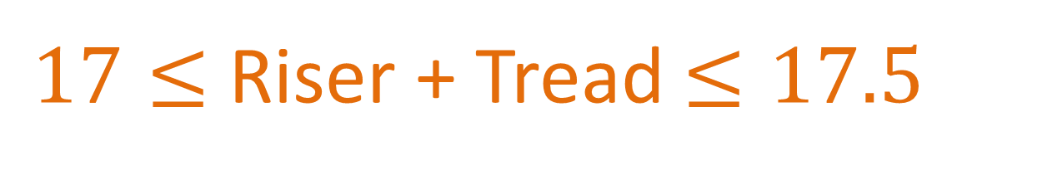
$17≤$ Riser + Tread $≤17.5$
6 inches + 11.5 inches = 17.5 inches
Notes:
A good rule of thumb (click) for stair dimensions is that the height of the riser plus the width of the tread should be greater than or equal to 17 and less than or equal to 17.5 inches (click). We can write an inequality to express this guideline.
The sum of our riser and tread is 17. 5. Our staircase would be a safe one.
We would only need to post this sign (click)…..not this one (click).

Slide 14
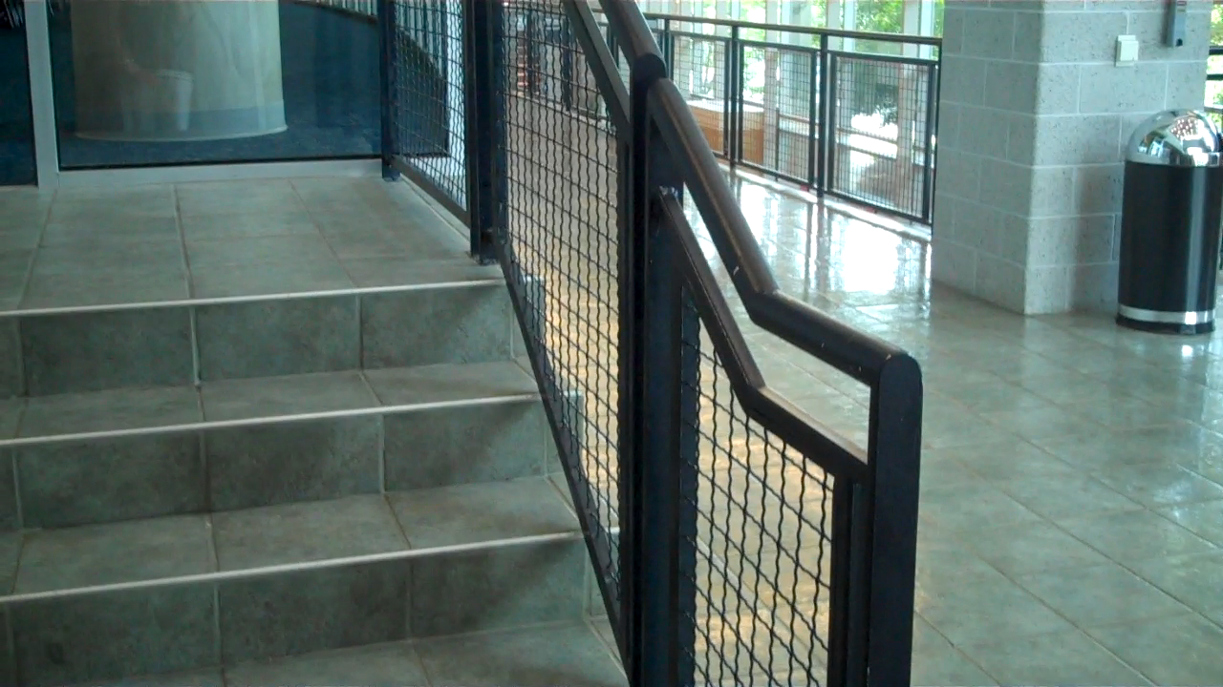
Notes:
The more you know about math, the more you view the world as a whole new place!
INSERT video footage from website

