Slide 1


Solving One-Step Equations with Fractional Coefficients

Slide 2
Goal: To find the value of the variable using a single operation
Subtraction
Addition
Multiplication
Division

Slide 3

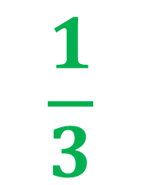
What is a Fractional Coefficient?
Multiplied by the variable in an algebraic expression
h

Slide 5
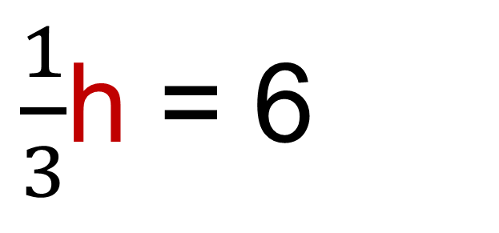
What does this equation mean ?
Variable;
unknown number;
“mystery number”
One-third of the value of some number h is 6.
One-third multiplied by some number h is 6.

Slide 6

Determine the value of the variable h.

Slide 7
We must find the value of…
One whole h

Slide 8

Pictorial Representation

Slide 9
yellow hexagon
blue rhombus

Slide 10
Notes:
FIX FIX FIX FIX

Slide 11


6
6
6
18
3 groups the value of 6 each
3 x 6 = 18

Slide 12

Symbolic Representation

Slide 13
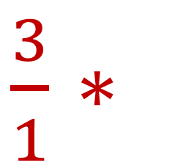
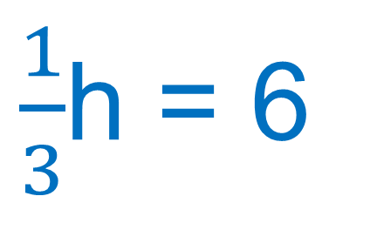
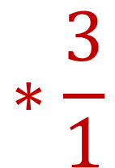
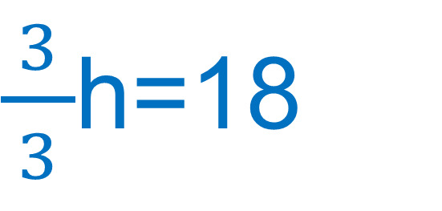
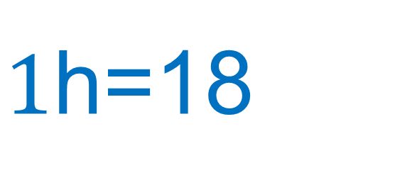
3 x 6

Slide 15
Pictorial Representation

Slide 16

3
3
6
6

Slide 17
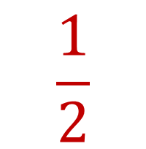


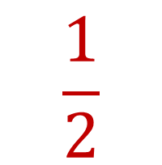

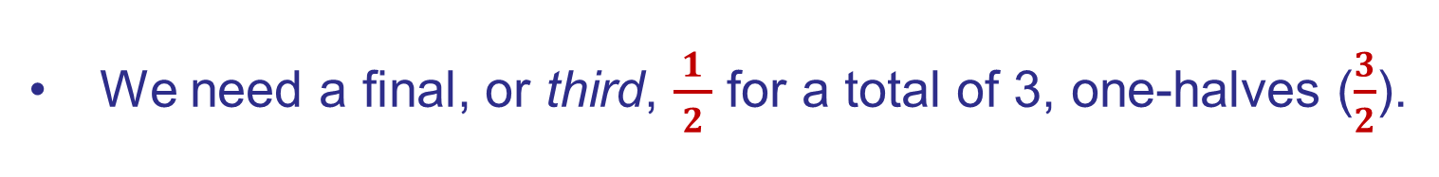

3
3
Notes:
One ½; two ½s; three 1/2s

Slide 18



3
3
3 groups the size of $\frac{1}{2}$ of $\frac{2}{3 }$ each
3 groups with a value of 3 each
3 x 3 = 9

Slide 19
Symbolic Representation

Slide 20
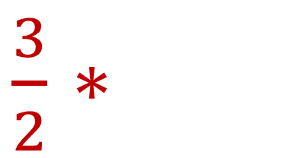
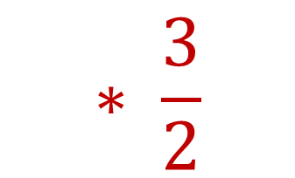
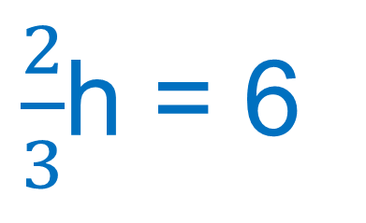
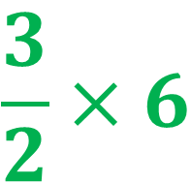
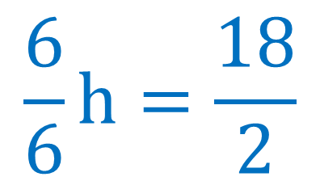
1h = 9

