Slide 1
It will hold how much!?
A lab applying volume measure to composite solids.

Slide 2
Explain volume formulas and use them to solve problems
MGSE9-12.G.GMD.3 Use volume formulas for cylinders, pyramids, cones, and spheres to solve problems.
Apply geometric concepts in modeling situations
MGSE9-12.G.MG.1 Use geometric shapes, their measures, and their properties to describe objects
(e.g., modeling a tree trunk or a human torso as a cylinder).
MGSE9-12.G.MG.2 Apply concepts of density based on area and volume in modeling situations
(e.g., persons per square mile, BTUs per cubic foot).
MGSE9-12.G.MG.3 Apply geometric methods to solve design problems (e.g., designing an object or structure to satisfy physical constraints or minimize cost; working with typographic grid systems based on ratios).
Notes:
Jodi - Let me know which of these you want to address. Delete the ones you don’t want. Highlight the ones you want to emphasize

Slide 3
Which will hold more? (a mistake could be messy)
Consider a standard sheet of copy paper (8 ½ by 11 inches).
Which cylinder would hold more? … Or would they hold the same?
The sheet taped so that the 8 ½ inch edges meet?
Or the sheet taped so the 11 inch edges meet?
Reason your answer.
No Calculator.
Would a sphere with a height of 11 inches hold more than each of the cylinders?
Notes:
If possible, we want to keep this a thought experiment so they ask questions of themselves and of the teacher.
*by reasoning the 8.5 inch cylinder would hold more. The base has a greater radius. The radius is squared and effects the volume more than the change in height.
* The same reasoning carries to the sphere… the radius is cubed in the formula so the volume grows .

Slide 4
4 Challenges….
You and your team will have 4 challenges to complete.
You may use your calculator, formula sheet and materials found at the station.
REMEMBER: The team answer must grow from reasoning.
Answers must be supported by the process.
Your team will record work on the Problem Solving Frame worksheet. While you will work with a team, each student will have a sheet to record work.
Record thoughts, calculations, diagrams and drawings as you proceed.
You will be asked to represent your answer in multiple ways.(formula, exact and approximate forms)
Notes:
The process document sheet developed by Robert Kaplinsky will be used to document and present work.

Slide 5
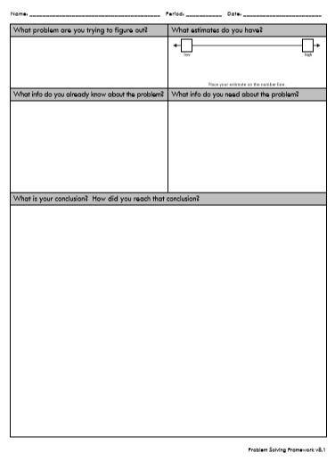
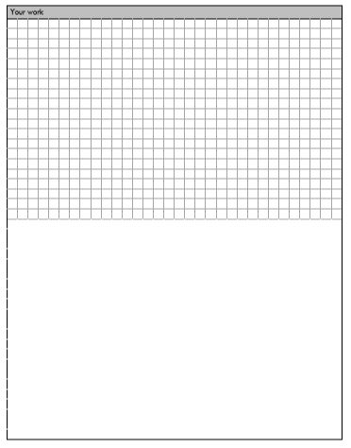
Problem Solving Framework
How do I show my work?

Slide 6
What's the Volume?
What is the volume of the Champagne Glass?
Use the formula sheet, calculator and ruler to determine the volume of the Champagne glass in cubic centimeters. Answers should be reported as a math expression (formula), exact (in terms of pi), and approximate (in decimal to the nearest 10th cubic centimeter) forms.
Determine the volume of the champagne glass in cubic centimeters using mathematical tools. DOCUMENT YOUR PROCESS!
Report your answer as an expression, in exact and in approximate forms.
Get the amount of rice you calculated and “test” your answer by pouring that amount into the champagne glass.
Assess your process. (How did you do?)

Slide 7
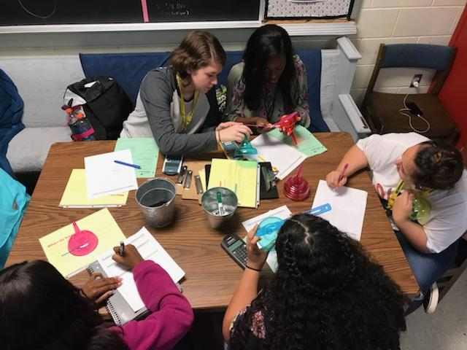
What's the Volume?
Students engaged in
finding the volume of
an irregular shaped
glass.

Slide 8
Rank the Volume
Rank in order from Most Volume to Least Volume.
Sphere or Cup or Cylinder
Determine the volume of each object in cubic centimeters using mathematical tools. DOCUMENT YOUR PROCESS!
Answers should be reported as a math expression (formula), exact (in terms of pi), and approximate (in decimal to the nearest 10th cubic centimeter) forms.
Get the amount of rice you calculated for the largests and “test” your answer by pouring that amount into each object.
Assess your process. (How did you do?)

Slide 9
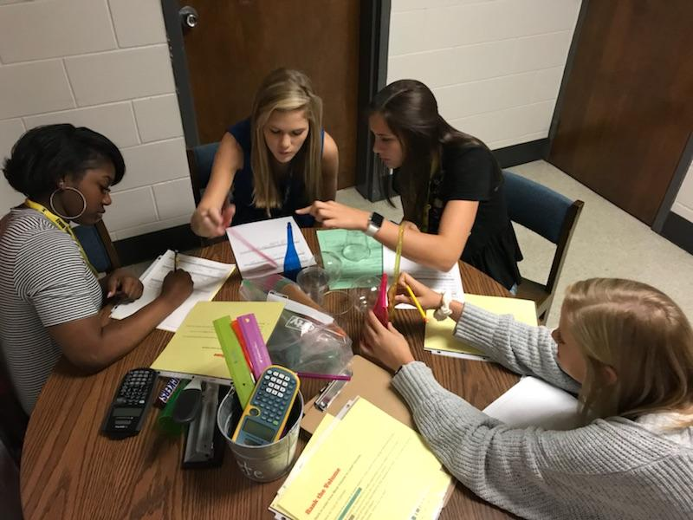
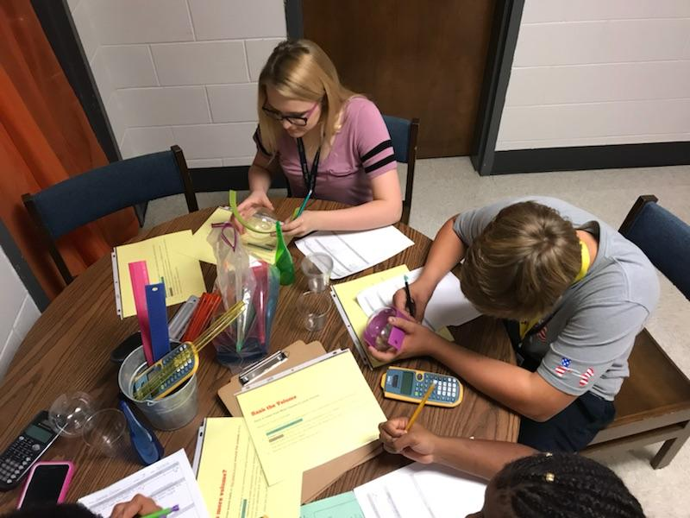
Rank the Volume
Students work to
rank the shapes in
order.

Slide 10
Which has more volume?
The volume of the three tennis balls or the space in can around the outside of the tennis balls?
Determine the volume of objects in cubic centimeters using mathematical tools. DOCUMENT YOUR PROCESS!
Answers should be reported as a math expression (formula), exact (in terms of pi), and approximate (in decimal to the nearest 10th cubic centimeter) forms.
Get the amount of rice you calculated and “test” your answer by pouring that amount into tennis ball can.
Assess your process. (How did you do?)

Slide 11
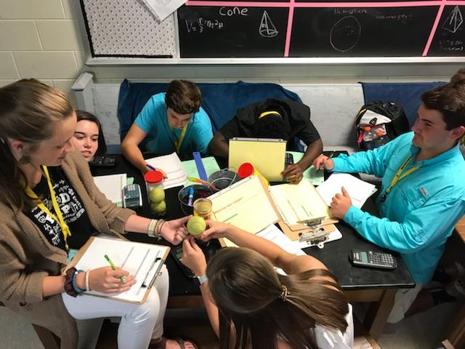
Which has more volume?
Students work to determine the
volume of the tennis ball
and the cylinder that contain the
tennis balls.

Slide 12
BCS - Box to Cylinder to Sphere
Determine the Volume of the Cereal Box.
What would the dimensions of a cylindrical container be if the cylinder where the same height and volume as the cereal box?
What would be the radius of the sphere that would hold the same volume of cereal as that of the cereal box?
For each Shape
  Determine the volume of the cereal box, cylinder and sphere in cubic centimeters using mathematical tools. DOCUMENT YOUR PROCESS!
  Answers should be reported as a math expression (formula), exact (in terms of pi), and approximate (in decimal to the nearest 10th cubic centimeter) forms.
  Assess your process. (How did you do?)

Slide 13
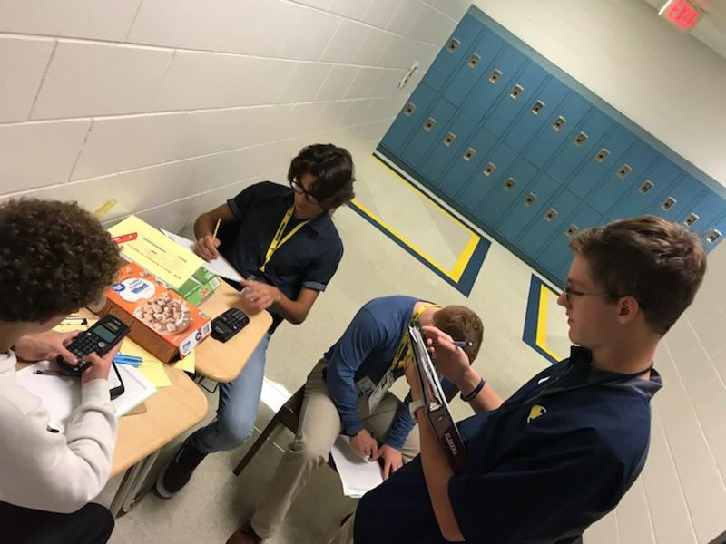
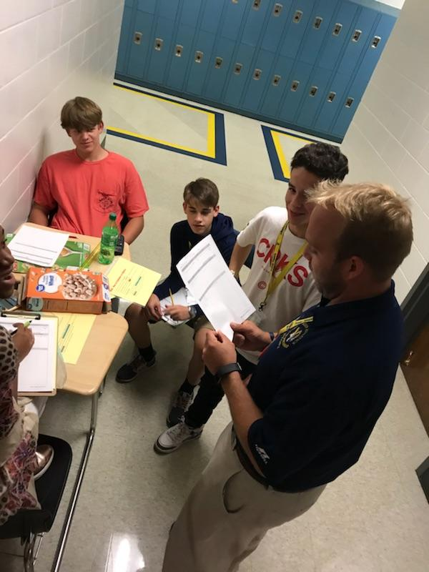
BCS - Box to Cylinder to Sphere
Students measure a box
to determine the volume.
How tall will the be cylinder
of the same volume?
The sphere?

