Slide 1

What it Means to Multiply

Slide 2
Vocabulary
The Multiplicand is the number of objects in each group.
a.k.a. the given number
noun
The Multiplier is the number of groups.
a.k.a. the action taken on the multiplicand
a verb

Slide 3
Whole Numbers
3 x 4
Given Number, or Multiplicand
Action to take, or Multiplier
Notes:
Don’t start with the action; start with what is given

Slide 4

groups of 2 equals 7
Multiplier is
Multiplicand is 2
Product is 7
Notes:
Let’s apply our understanding of multiplication to non-whole number multipliers that are greater than 1

Slide 5

2 groups of
Multiplier is 2
Multiplicand is
Product is 7
Notes:
Using the commutative property is a game changer in terms of how our problem looks, not the product

Slide 6

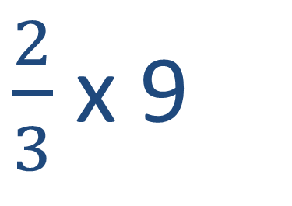
$\frac{2}{3}$ x 9
Two-thirds of a group of 9
Multiplier is $\frac{2}{3}$
Multiplicand is 9
Product is 6
Notes:
Let’s apply our understanding of multiplication to non-whole number multipliers that are less than 1

Slide 7
Generalizing the Effect of the Multiplier on the Product
What can be determined about
based on the values of a and b?
If and , then…
multiplier
multiplicand

Slide 8
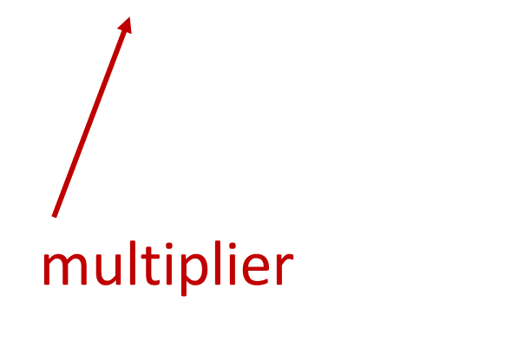
Generalizing the Effect of the Multiplier on the Product
What can be determined about
based on the values of a and b?
If , then…
multiplicand

Slide 9
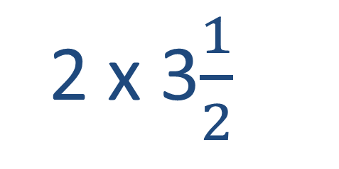
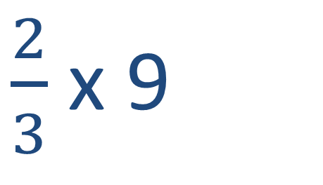
Examples
2 x 3$\frac{1}{2}$
If and , then…
$\frac{2}{3}$ x 9
If , then…

Slide 10
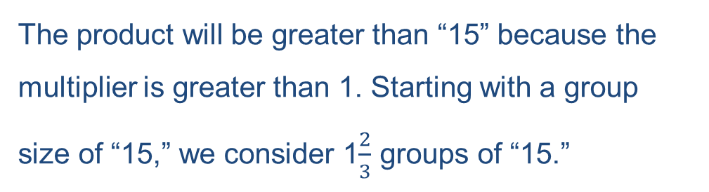
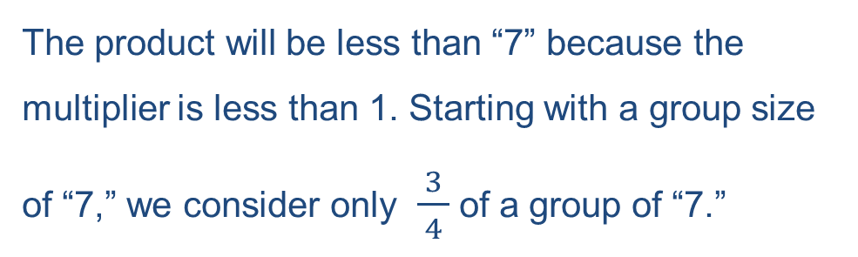
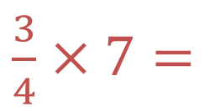
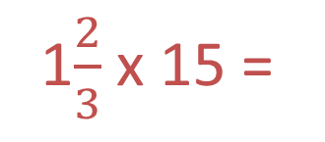
Test Yourself
The product will be less than “7” because the multiplier is less than 1. Starting with a group size of “7,” we consider only $\frac{3}{ 4 }$ of a group of “7.”
$\frac{3}{4}$ $×7=$
The product will be greater than “15” because the multiplier is greater than 1. Starting with a group size of “15,” we consider 1$\frac{2}{3}$ groups of “15.”
1$\frac{2}{3}$ x 15 =

