Slide 1

What’s My Share?
Nancy Mims
CRMC Secondary Resource Teacher
Columbus State University

Slide 2
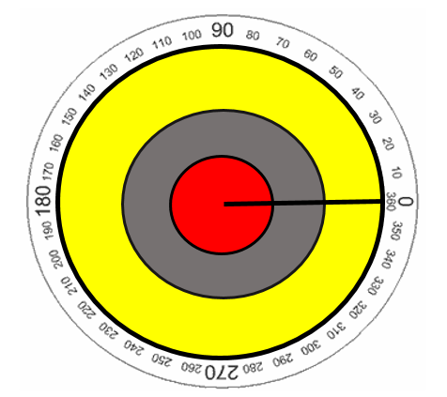
The Circle
1 Radian
Radius

Slide 3
How Many Radians to Cover Half the Circle?
2 Radians
3 Radians
1 Radian
+ a bit more
Radius

Slide 4
A Smaller Circle
Both are almost 60°
1 Radian
Radius
But are not equal lengths!

Slide 5
Why?
Circumference
Radius

Slide 6


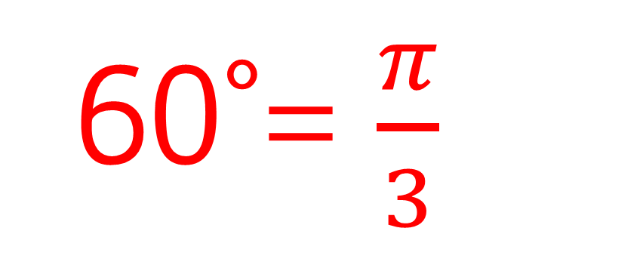
C = 2$π$r
If the radius is 1, then the circumference is 2$π$.
60°= $\frac{π}{3}$

Slide 7
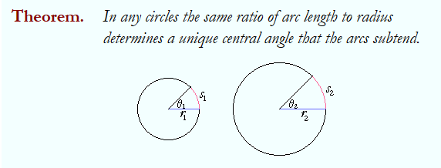

Slide 8
Measuring Arc Lengths
Measure the radius of each circle
Finish constructing “circle wedge maker”
Use “wickie stick” and ruler to measure the arc length for each circle at Θ = 120°
Find the arc length for 3 more angles
Record your angles and arc lengths

Slide 9
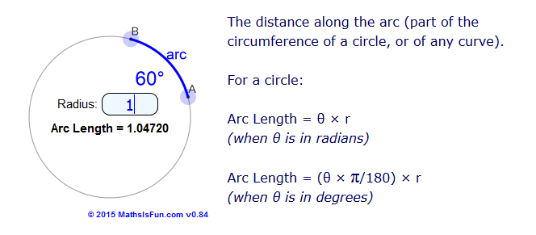
Arc Length Calculations
Math is Fun

Slide 10
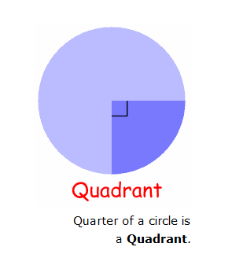
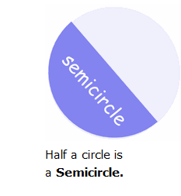
Common Sectors

Slide 11
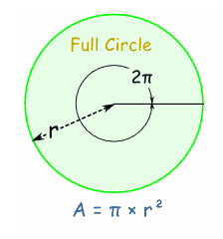
Area of Circle

Slide 12
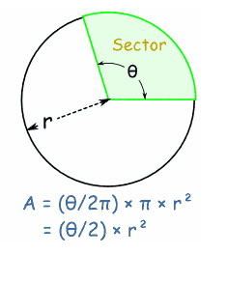
Area of Sector

Slide 13
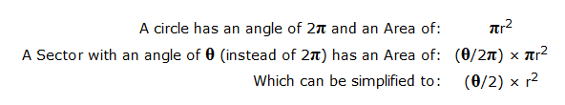
Area of Sector

Slide 14
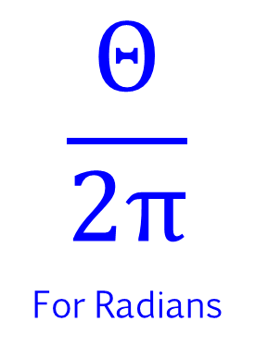
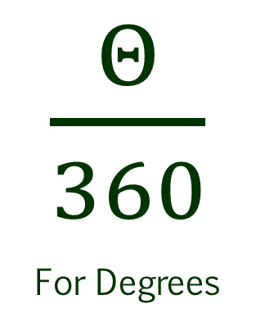
So…..
A Sector is a Fraction of a Circle
The Area of a Circle is πr²
$\frac{Θ}{360}$
For Degrees
$$\frac{Θ}{2π}$$
For Radians
The Fraction is

Slide 15
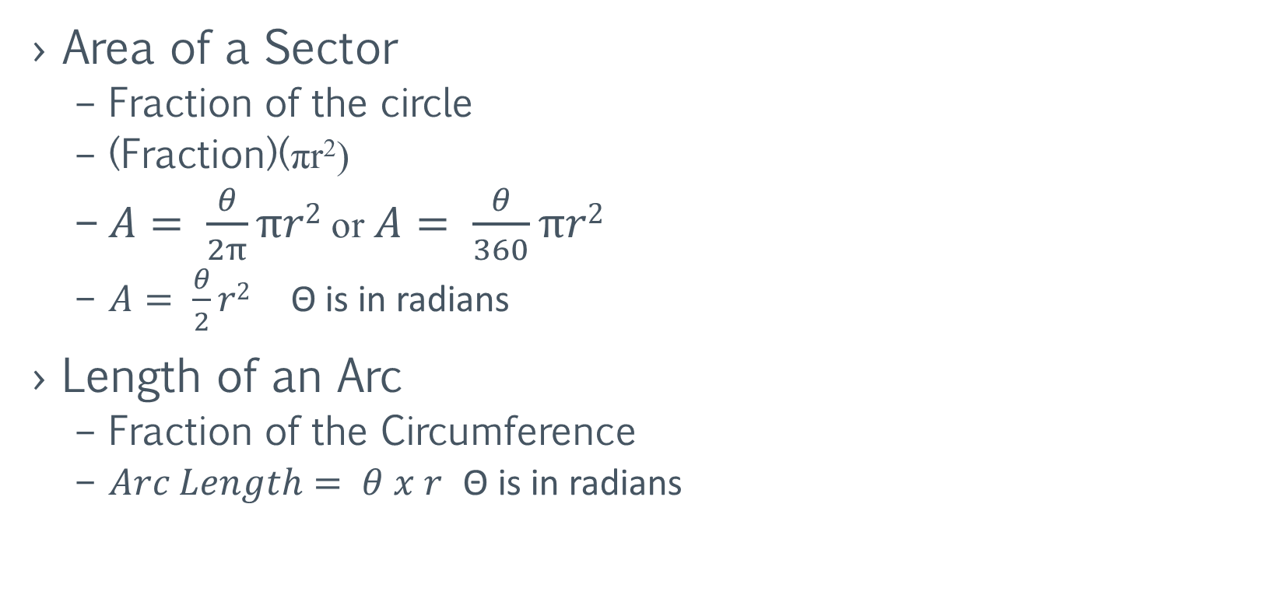
Formulas
Area of a Sector
Fraction of the circle
(Fraction)(πr²)
$A= \frac{θ}{2π}πr2$ or $A= \frac{θ}{360}πr2$
$A= \frac{θ}{2}r2$ Θ is in radians
Length of an Arc
Fraction of the Circumference
$Arc Length= θ x r$ Θ is in radians

Slide 16

What’s My Share?
Half of an
8 inch pizza
One slice of a 16 inch pizza cut into 8 equal pieces

