Slide 1
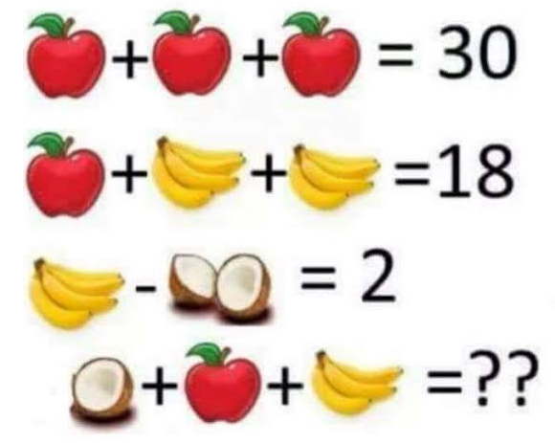
welcome

Slide 2
Functions and modeling winter follow-up
February 18, 2016
Columbus Regional Mathematics Collaborative
Nancy Mims, Secondary Resource Teacher

Slide 3
agenda
8:30 – 8:45 Welcome
8:45 – 10:00 Polynomial Patterns
10:00 – 10:10 BREAK
10:10 – 11:20 Lesson and Idea Sharing
11:20 – 11:45 Pool Plunge Prep
11:45 – 12:45 LUNCH
12:45 – 2:00 Pool Plunge Data Gathering and Analysis
2:00 – 2:15 BREAK
2:15 – 2:30 Puzzler
2:30 – 3:45 Graphing Stories
3:45 – 4:00 Warp-up

Slide 4
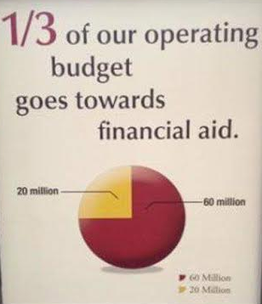
What is wrong with this picture?

Slide 5
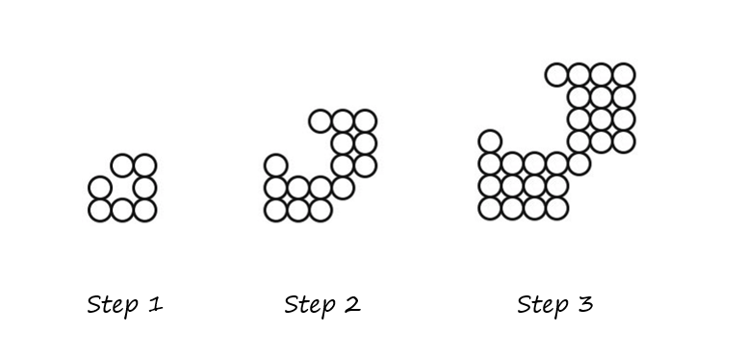
Circle fever

Slide 6
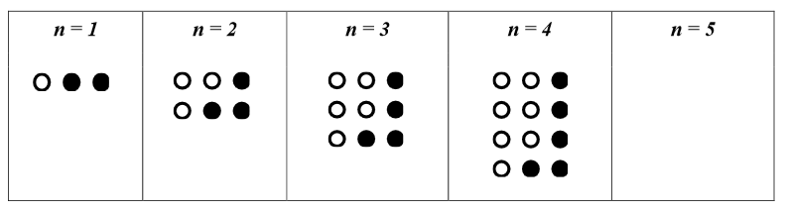
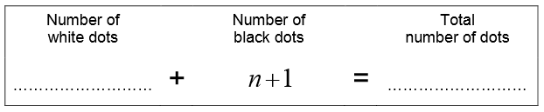
Polynomial patterns

Slide 7
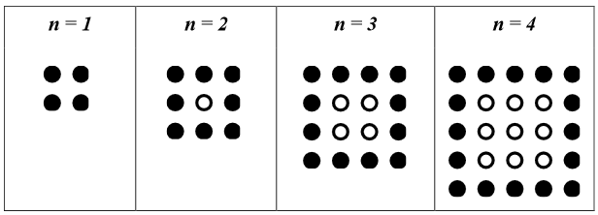
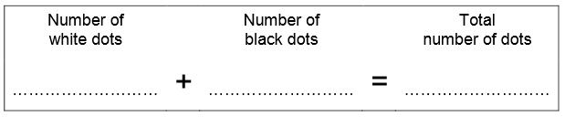
Polynomial patterns

Slide 8
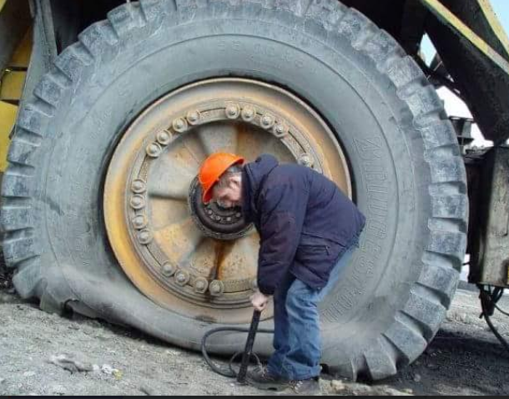
B r e a k

Slide 9

Lesson and idea sharing

Slide 10
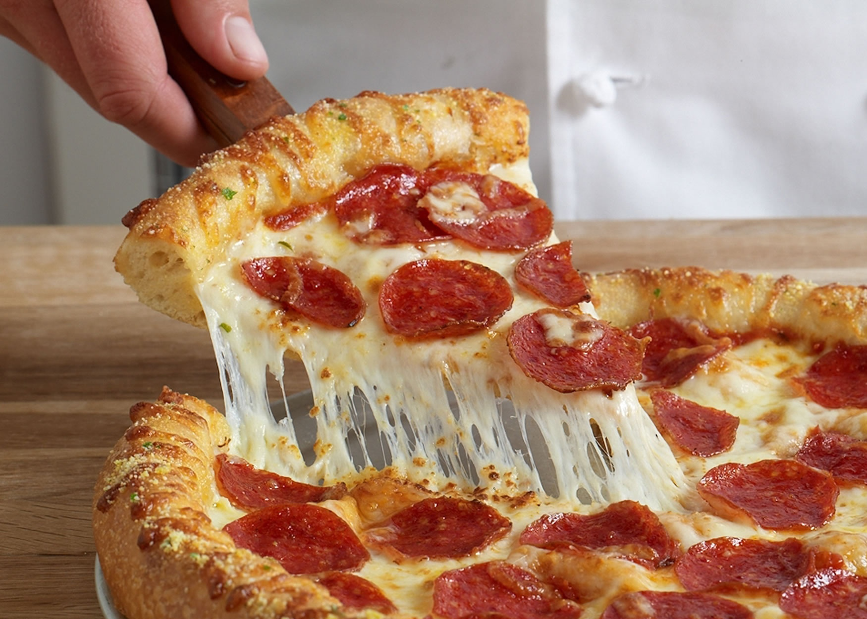
What’s My Share?
Half of an
8 inch pizza
One slice of a 16 inch pizza cut into 8 equal slices

Slide 11

12 Days of
Christmas

Slide 12
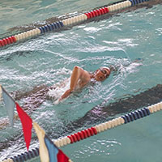
Pool plunge prep

Slide 13
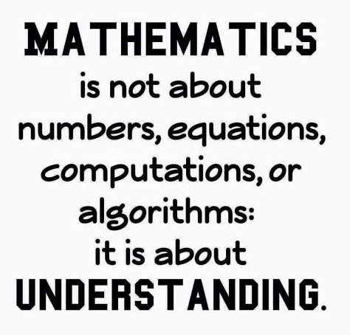
l
u
n
c
h

Slide 14
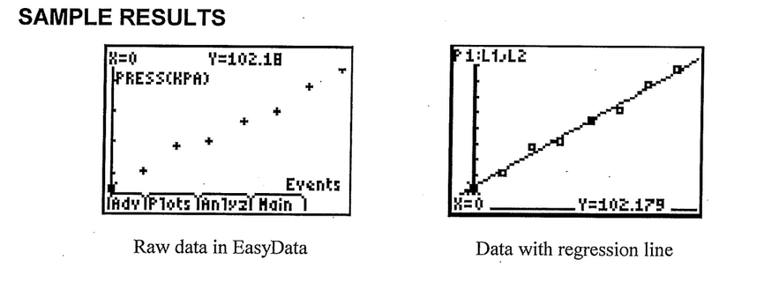
Pool plunge

Slide 15
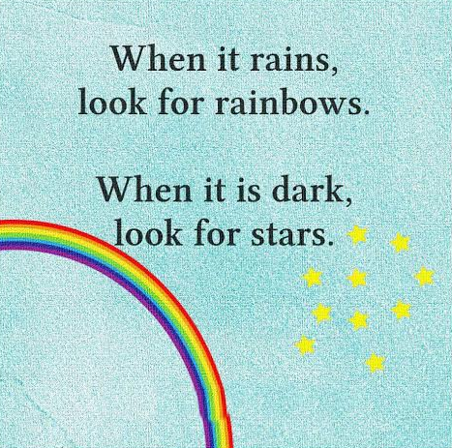
B
r
e
a
k

Slide 16

P u z z l e r

Slide 17
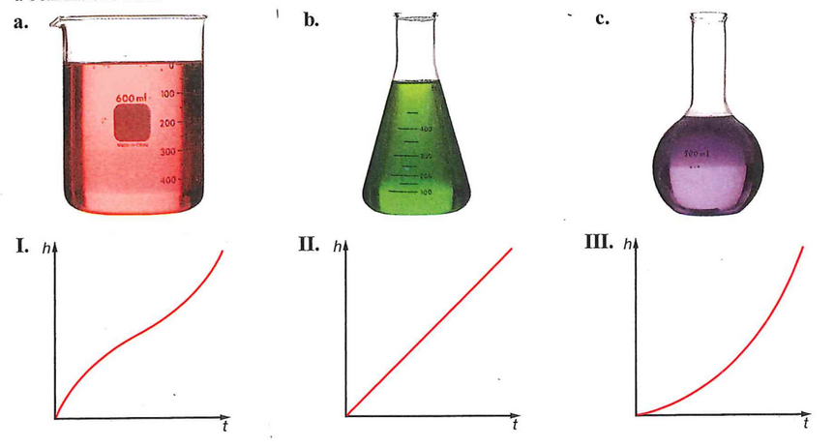
Match the container to the graph

Slide 18
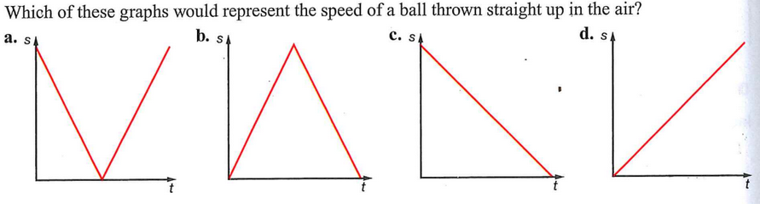
Try this one

Slide 19
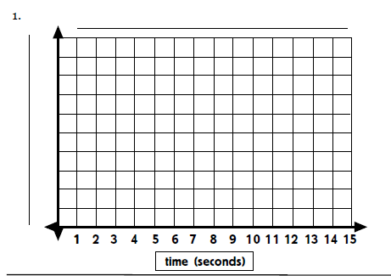
Graphing Stories
http://graphingstories.com

Slide 20
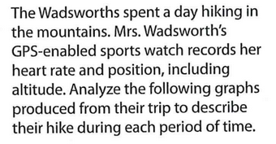
More graphing stories

Slide 21
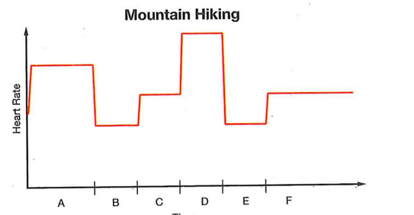
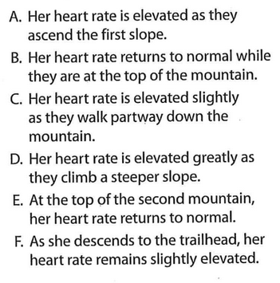
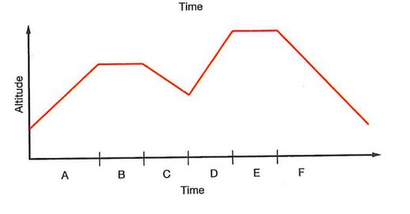

Slide 22
Please complete the evaluation form and Survey leave it on the front table thank you for attending the Follow-up

