Slide 1
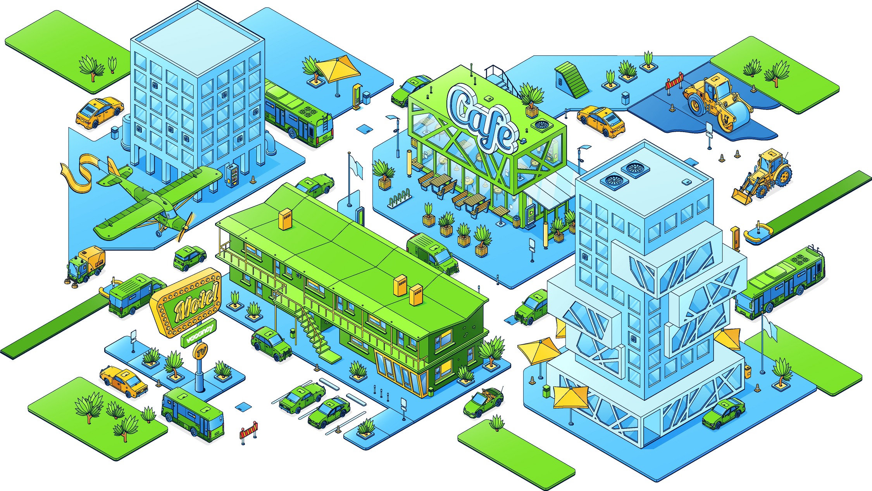

ENHANCING THE
CITY DESIGN
UNIT 8 - ALGEBRAIC CONNECTIONS TO GEOMETRIC CONCEPTS
Peter Anderson
April 2025
Link to Teacher resources: Unit Eight – Algebraic Connections to Geometric Concepts

Slide 2
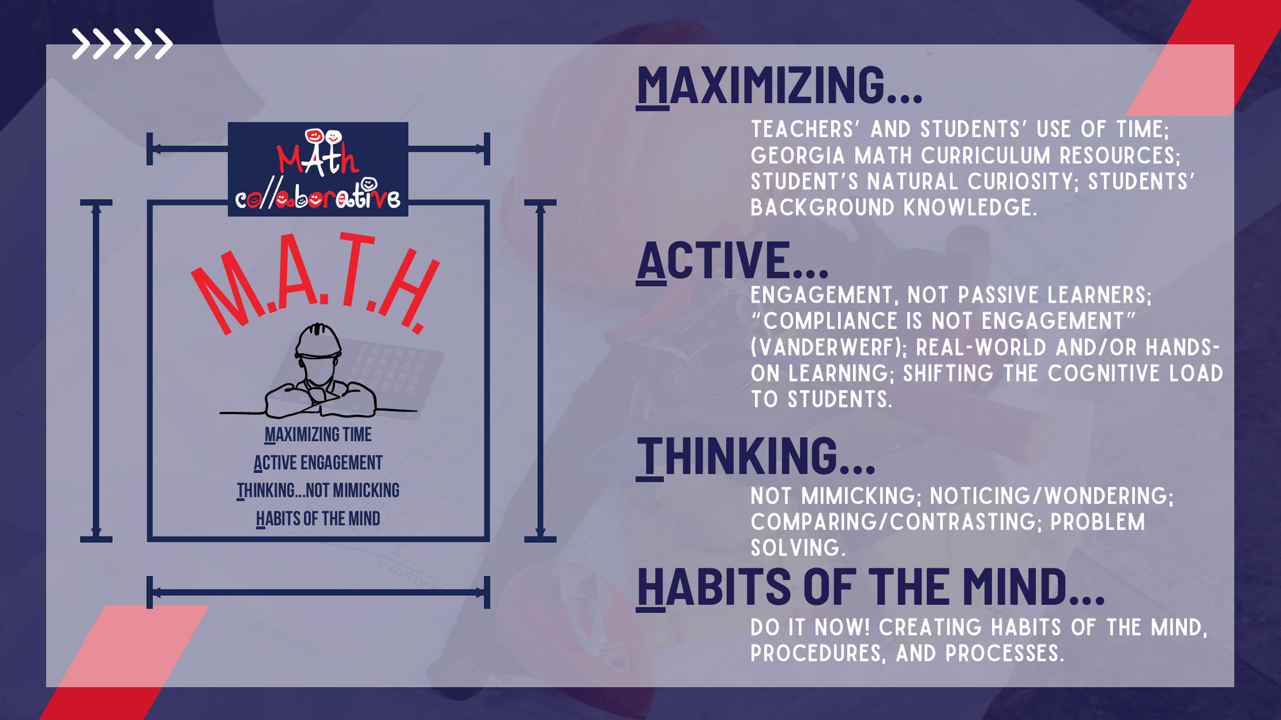
PROJECT OVERVIEW

Slide 3
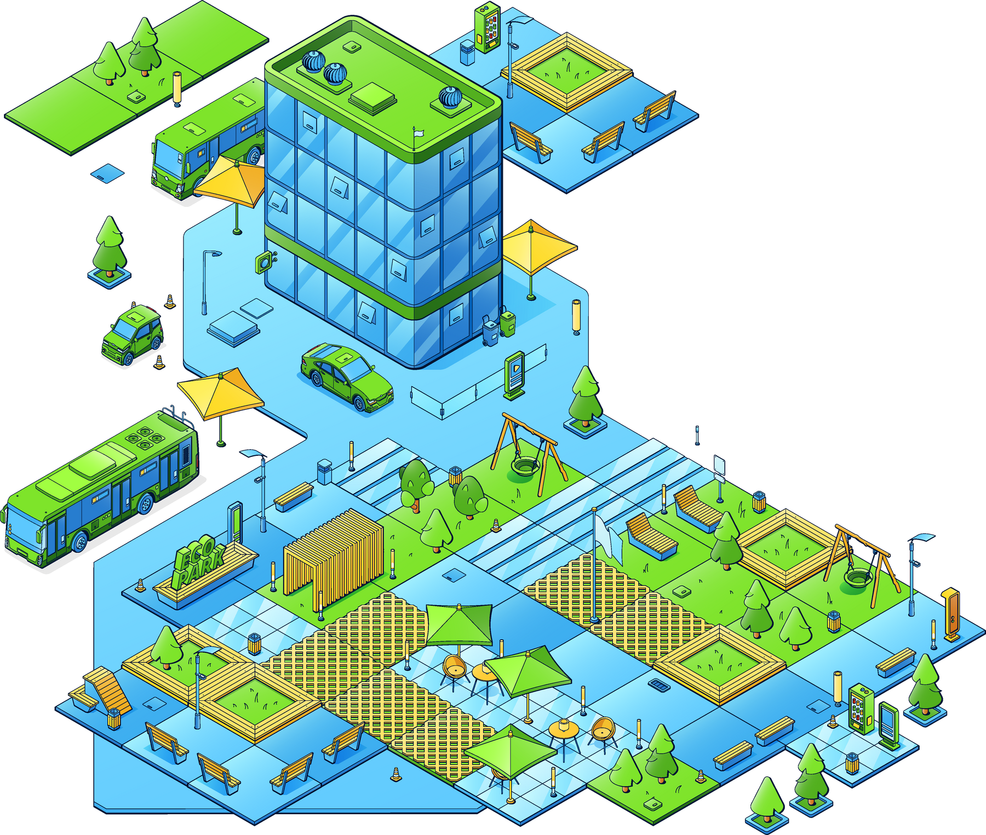
OUR GUIDE FOR TODAY:
PLAY WITH THE MATH!
Everyone will be respected -
and
Expected to be problem solvers.
You Are Smart!
Everyone is responsible to help their classmates learn
Notes:
It is important to establish a safe, responsible, and curious classroom.
These standards have worked for me as a teacher...but they also apply to me as a member of the class community.

Slide 4
LEARNING GOALS FOR TODAY
LEARN HOW TO:
Play a little and learn a lot!
Focus on Math Practices.
Understand Algebra and Geometry connections in deeper contexts.
Be able to apply mathematics in context.
Enhancing-the-City-Design-Algebra-CC-Unit-8
Enhancing the City Design Algebra CC Unit 8 Student Reproducibles
Notes:
Big R + little r = great teaching
Multiplying-Cells-Algebra-Unit-5-Learning-Plan
Note to Pete -
Play to Learn
Understand
Perform
Transform
It is important to establish a safe, responsible and curious classroom.
These standards have worked for me as a teacher.... but they also apply to me as a member of the class community.

Slide 5
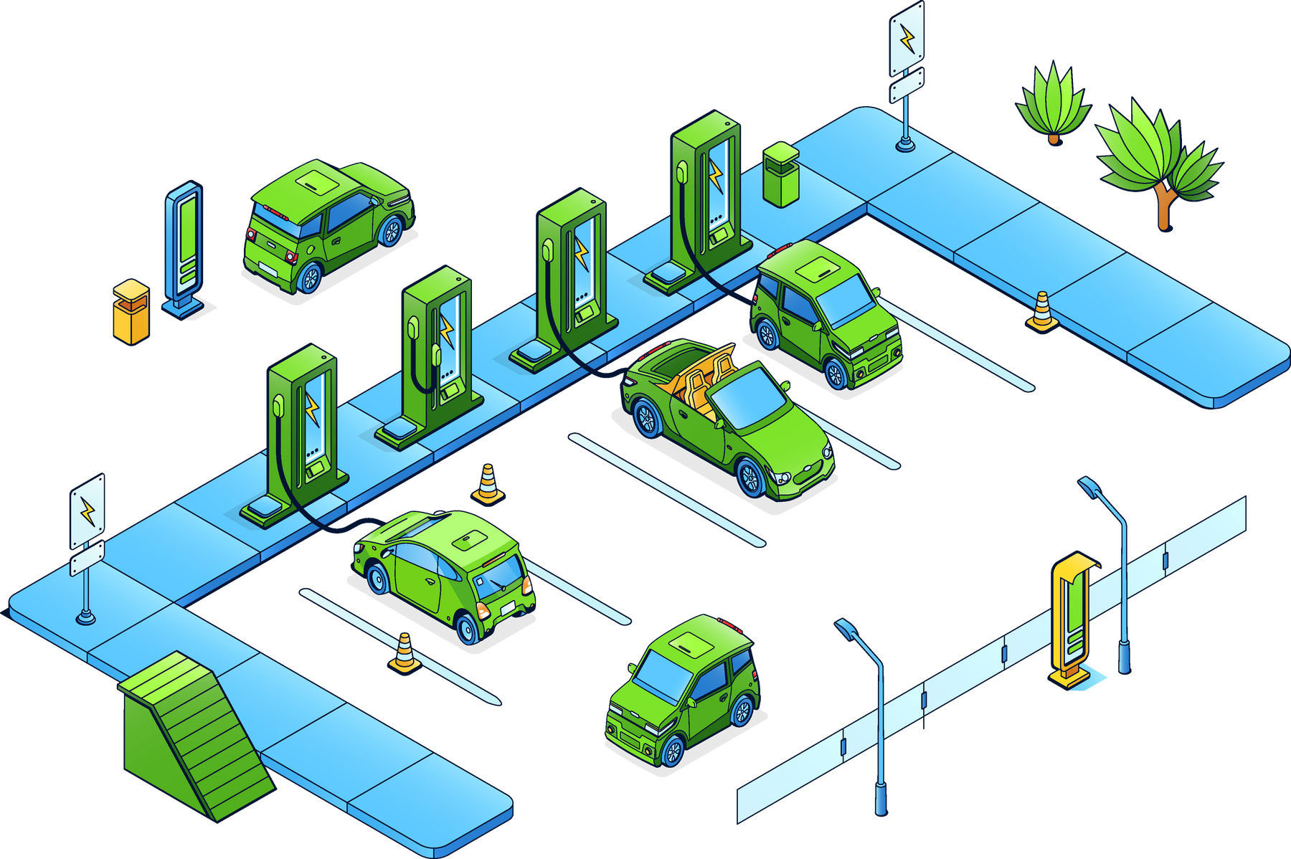
TEACHER PLAY
If you join the midpoints of the adjacent sides of any quadrilateral, then you always form an inscribed parallelogram.

Slide 6

[(6, 4), (10, 10), (4, -8), (2, -10)]
[(0, 6), (-2, -4), (-10, 4), (-4, 0)]
[(-10, 8), (-2, 6), (0, -4), (6, -2)]
[(2, 8), (-10, 8), (-6, -2), (-4, -2)]
[(-4, 8), (-2, 8), (-2, 10), (-4, 10)]
[(8, -5), (6, -5), (-9, 2), (3, 2)]
[(6, -6), (10, -6), (0, 2), (-2, 2)]
[(3, 2), (9, 3), (8, 7), (-6, 0)]
[(10, -6), (14, -6), (14, -4), (10, -4)]

Slide 7
Rhombus:
[(6, 4), (10, 10), (4, -8), (2, -10)]
Kite:
[(0, 6), (-2, -4), (-10, 4), (-4, 0)]
Irregular Quadrilateral:
[(-10, 8), (-2, 6), (0, -4), (6, -2)]
Parallelogram:
[(2, 8), (-10, 8), (-6, -2), (-4, -2)]
Square:
[(-4, 8), (-2, 8), (-2, 10), (-4, 10)]
Parallelogram:
[(8, -5), (6, -5), (-9, 2), (3, 2)]
Isosceles Trapezium:
[(6, -6), (10, -6), (0, 2), (-2, 2)]
Irregular Quadrilateral:
[(3, 2), (9, 3), (8, 7), (-6, 0)]
Rectangle:
[(10, -6), (14, -6), (14, -4), (10, -4)]

Slide 8
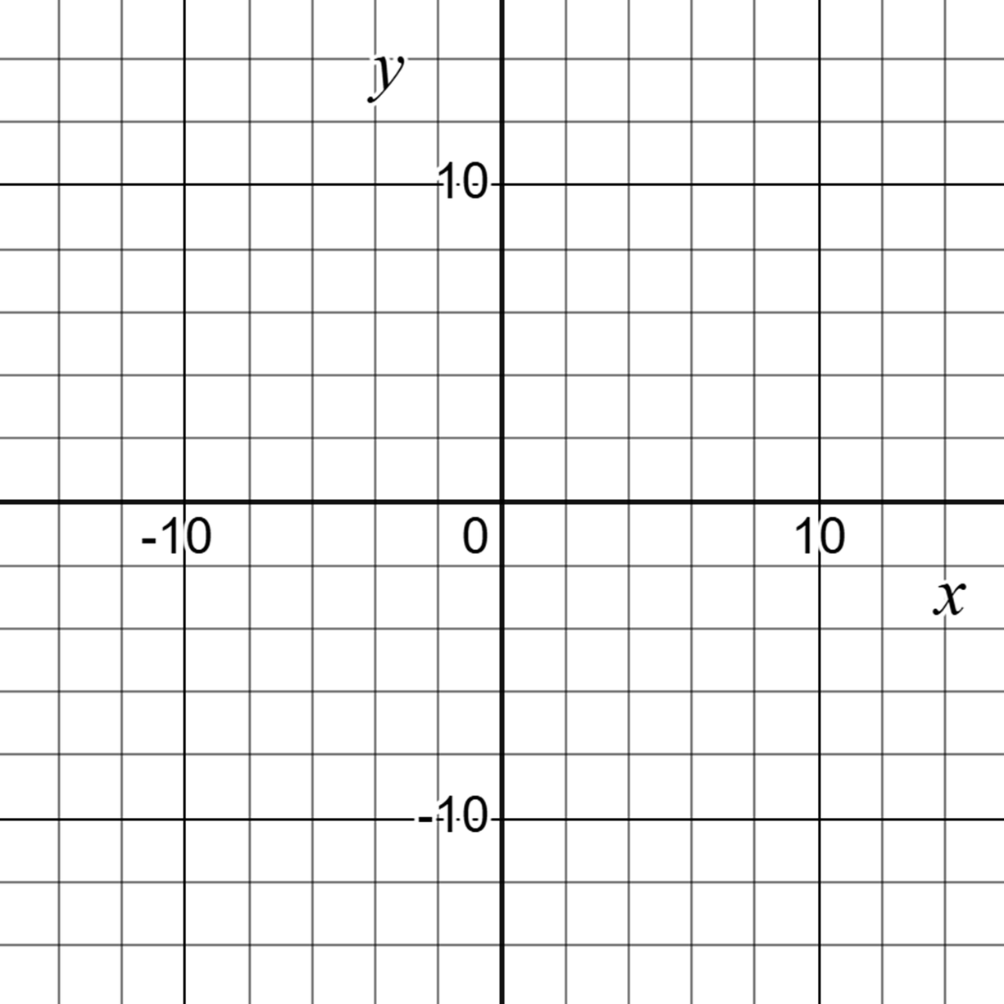

Slide 9
TEACHER EXPLORE:
ENHANCING THE CITY DESIGN
1.With an appointed colleague work through Diagnostic and Formative Assessment.
2. Make a list of the practices that your students would need to successfully solve these challenges.
3. Make a list of the skills your students would need in order to successfully solve these challenges.
What plan could you put in place to serve the success for both?

Slide 10
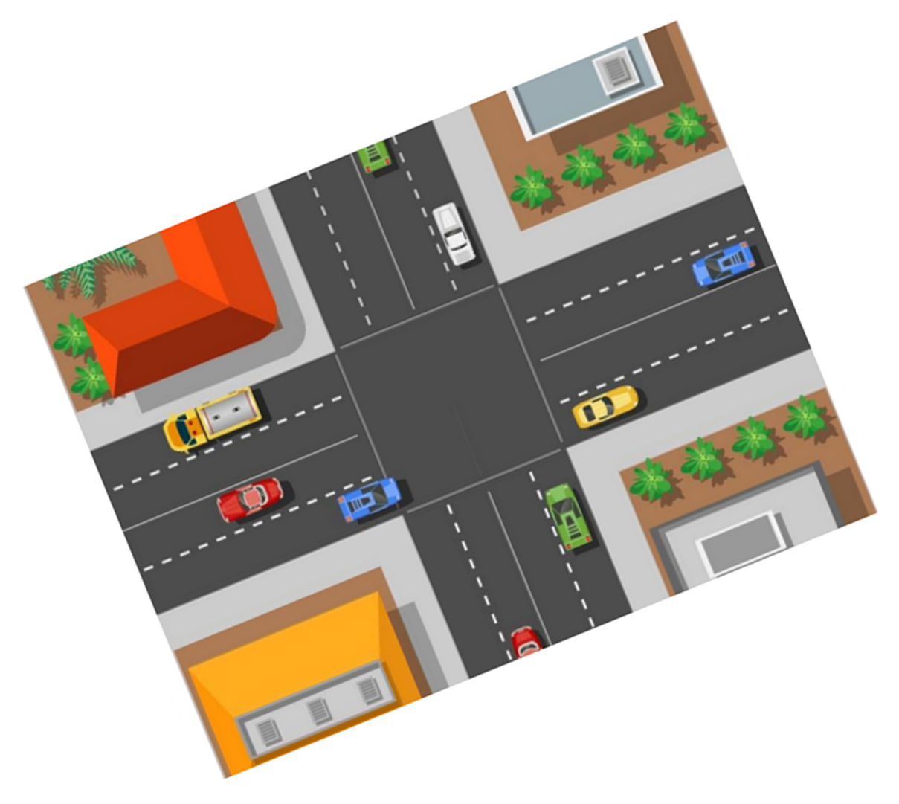
WHAT DO YOU NOTICE?
What do you notice? What do you wonder? – Multiplicity Lab

Slide 11
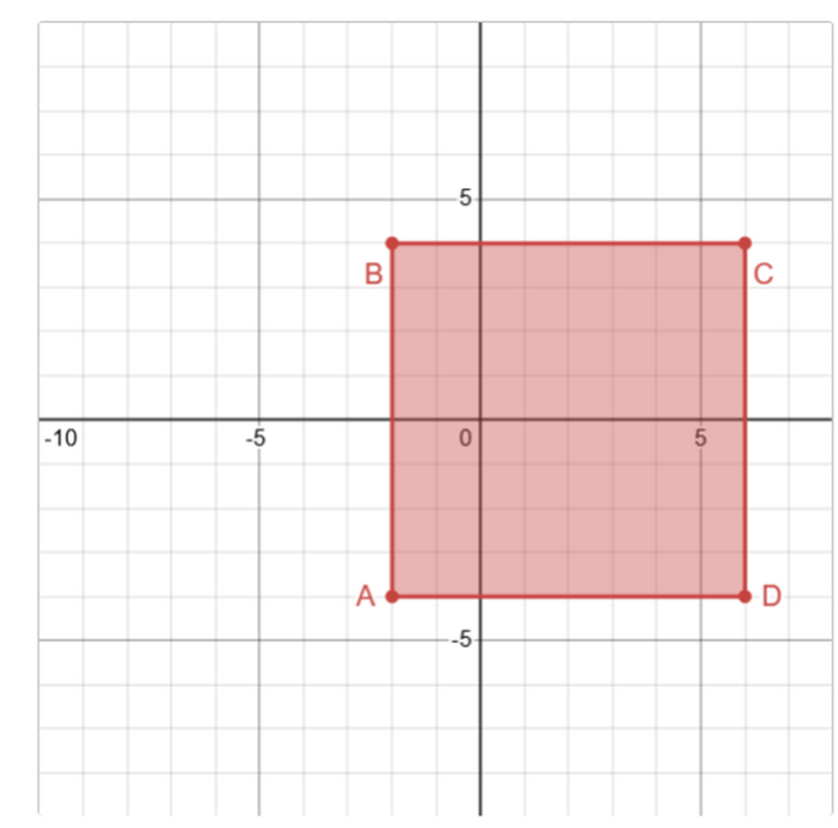
EXPLORE
What's the Midpoint?! Activity Builder by Desmos Classroom

Slide 12


Slide 13
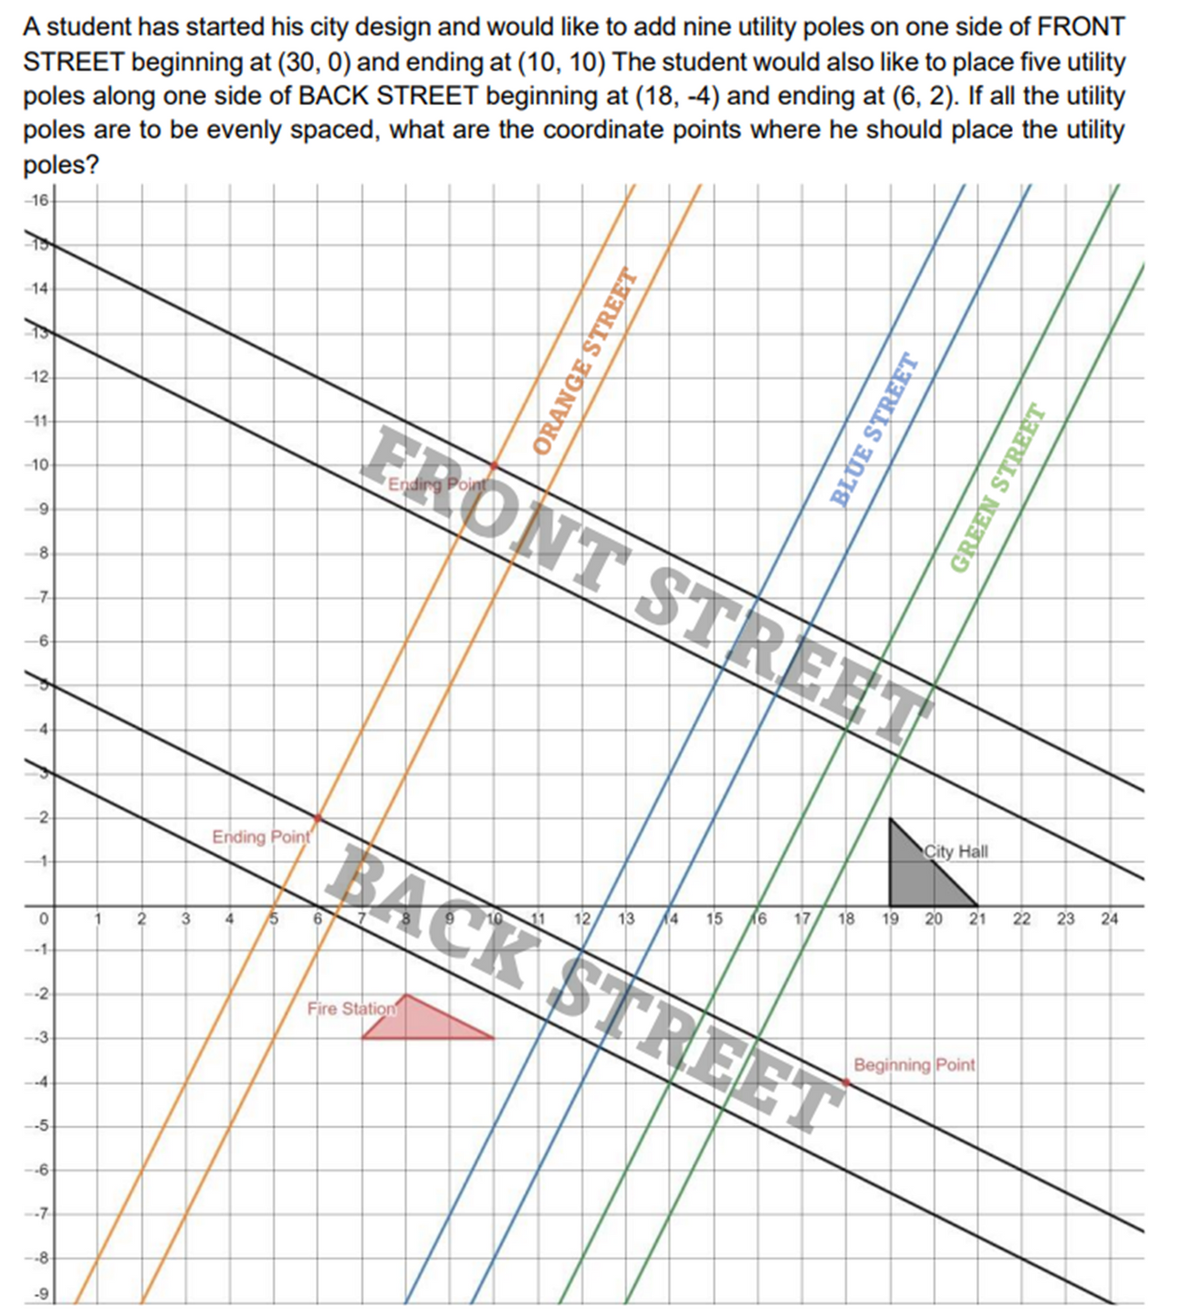
A student has started his city design and would like to add nine utility poles on one side of FRONT STREET beginning at (30,0) and ending at (10,10). The student would also like to place five utility poles along one side of BACK STREET beginning at (18,-4) and ending at (6,2). If all the utility poles are to be evenly spaced, what are the coordinates where he should place the utility poles?
EXPLORE
Student Reproducible Page 3

Slide 14
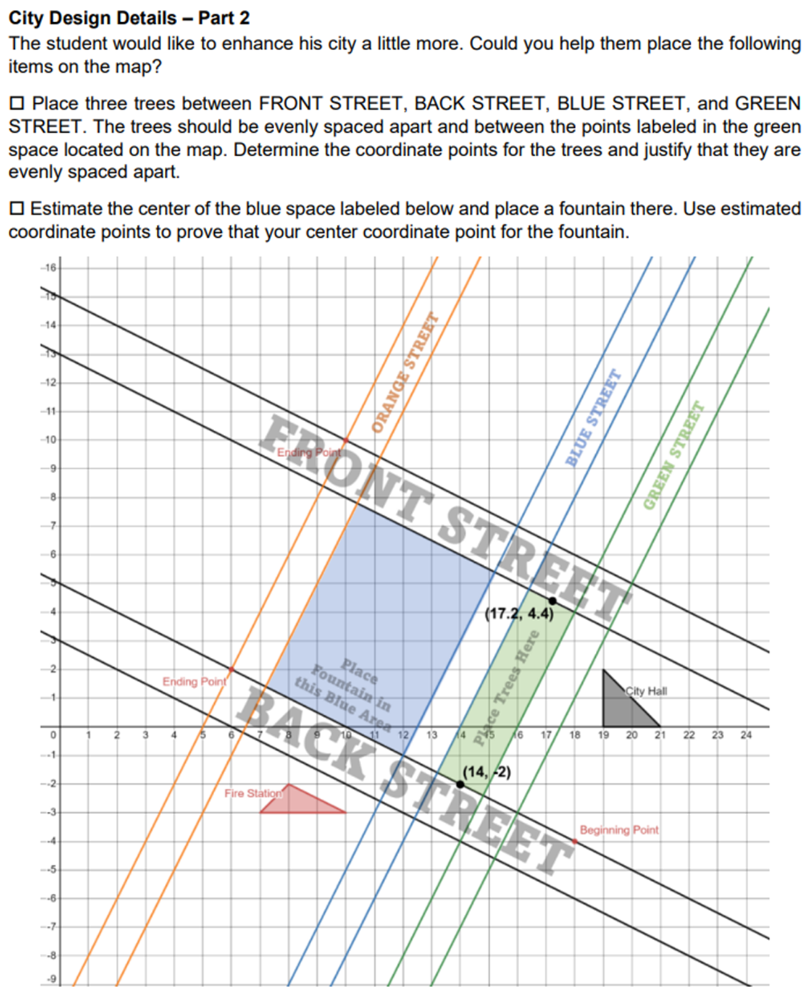
City Design Details - Part 2
The student would like to enhance his city a little more. Could you help them place the following items on the map?
  Place three trees between FRONT STREET, BACK STREET, BLUE STREET, and GREEN STREET. The trees should be evenly spaced apart and between the points labeled in the green space located on the map. Determine the coordinate points for the trees and justify that they are evenly spaced apart.
  Estimate the center of the blue space labeled below and place a fountain there. Use estimated coordinate points to prove your center coordinate point for the fountain.
Student Reproducible Page 3

Slide 15
Here are some real-life ways to use the concept of a midpoint without necessarily relying on the formula:​
  Meeting Point: If you and a friend live in different parts of town, you can choose a location that feels roughly halfway between your homes to meet up. This ensures neither of you has to travel too far.​
  Balancing Objects: When hanging a picture or setting up a display, you can visually estimate the center point to ensure it's balanced and looks symmetrical.​
  Sports: In games like soccer or basketball, players often intuitively find the midpoint of the field or court to position themselves strategically.​
  Sharing Space: If you're sharing a room or workspace with someone, you can divide the space evenly by finding a midpoint, ensuring both parties have equal areas.​
  Gardening: When planting rows of flowers or vegetables, you can estimate the midpoint to create a balanced and aesthetically pleasing garden layout.​
  Drawing and Art: Artists often eyeball the center of a canvas or paper to create symmetrical designs or to balance their compositions.​
  Construction Projects: When building something, you might measure and mark the midpoint of materials to ensure everything is evenly distributed and stable.​
  Navigation: When planning a trip, you can choose a midpoint destination that is roughly equidistant from your starting point and your final destination, making the journey more manageable.

Slide 16
REFLECT
How can the midpoint formula be used in real-world scenarios outside of city design?

Slide 17
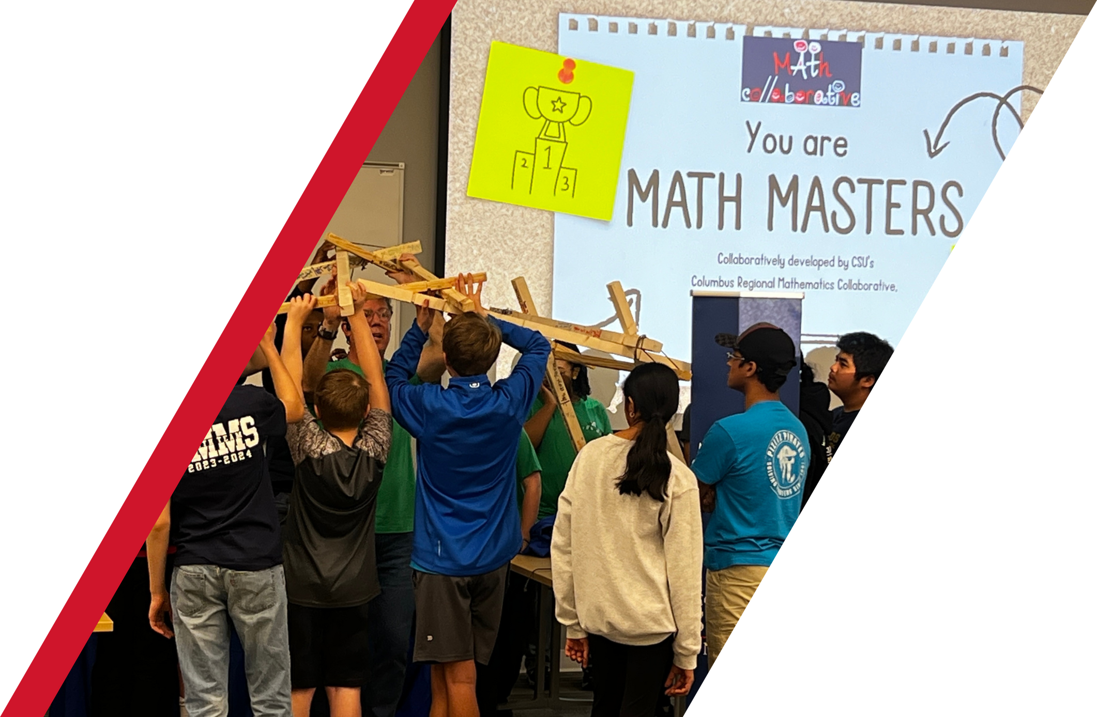

EMAIL ME: ANDERSON_PETER2@COLUMBUSSTATE.EDU OR SCAN THE QR BELOW TO OUR LINKTREE!

Slide 18

PROFESSIONAL LEARNING EVALUATION
Notes:
In groups of three students will be encouraged to tell all they know– this will follow a number talks format.

